Slide 1
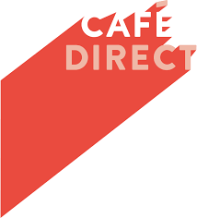
Notes:
Cafedirect is a UK based social enterprise selling tea, coffee and cocoa products.
Cafedirect is a pioneering company, determined to show that trade can make a positive difference in the way it does business.

Slide 2
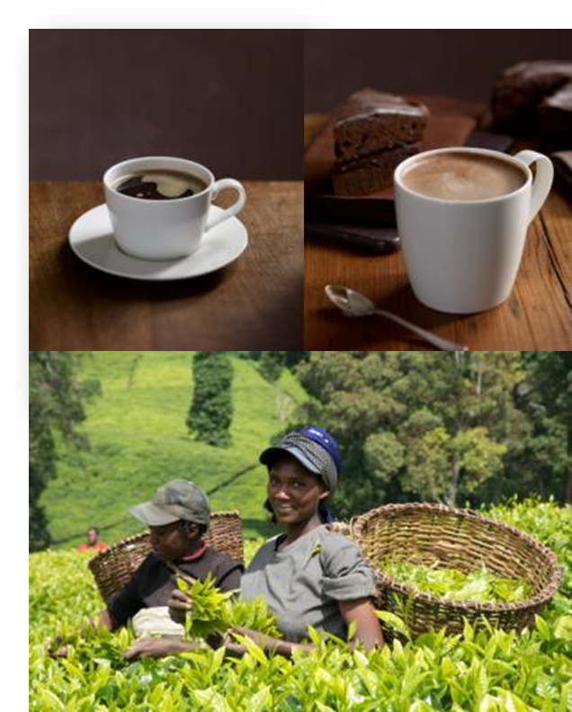
Cafédirect is a social enterprise
Cafédirect is a UK based business.
But it also a social enterprise.
Cafédirect:
Buys all its coffee, tea and cocoa directly from smallholder farmers,
Aims to improve the livelihoods of smallholder farmers,
Reinvests 50% of its profits into farmer organisations.
Notes:
Social enterprises ‘do business differently’. They may have been set up to tackle specific social or environmental problems. They make their money from selling goods and services in the open market, but usually do so in an ethical way, as well as reinvesting a part of their profits back into the business or their wider communities.
Cafédirect is a social enterprise. The company buys all of its coffee, tea and cocoa directly from smallholder farmers across 14 developing countries. 100% of Cafédirect’s products are Fairtrade, and 40% are Organic certified. Furthermore, 50% of the company’s profits go directly back to its producer partner organisations. The producer organisations hold two out of eight seats on the board, contributing to the decisions that govern the company, and most of them are shareholders, making them direct beneficiaries of the success of the brand.

Slide 3
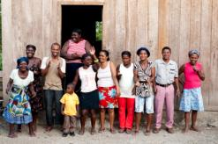


Cafédirect history
The collapse of the International Coffee Agreement, causing coffee prices to plummet
Cafédirect becomes a PLC – 75% of grower organisations are shareholders
Cafédirect officially starts
1990
1994
1989
1991
2004
Today
Three cooperatives in Peru, Costa Rica & Mexico each shipped a container of coffee to the UK on trust. The coffee was sold in church halls and through communities with profits returned to the growers. The idea of coffee direct from the growers was born
Fairtrade Mark launched in UK – Cafedirect is first coffee brand to feature it on pack
Cafédirect partners with 38 grower organisations across 13 countries directly improving the lives of more than 1.8m people
Notes:
Cafédirect was born during a crisis. In 1989, an international coffee agreement which had fixed global prices according to the cost of production, collapsed. Middlemen swooped in to buy up the coffee and the lives of millions of smallholder farmers around the world were in jeopardy as they were left with no choice but to sell their harvests at rock bottom prices.
In response, three coffee growing communities each shipped a single container of coffee, loaned on trust, to the UK. The beans were roasted and sold through church halls, charity shops and at local events, and in 1991 Cafédirect was created. And today it is still working directly with smallholder growers to change lives and build communities through inspirational, sustainable business.

Slide 4
Cafédirect today
Cafédirect is the UK’s largest 100% Fairtrade hot beverage brand.
2018 turnover £13.1m .
All Cafédirect coffee, tea and cocoa bought directly from smallholder farmers.
Cafédirect products are enjoyed all over the UK and around the world.
Cafédirect became the UK’s first B Corp certified company in 2018.
Notes:
Cafédirect is the UK’s largest 100% Fairtrade hot beverage brand. The company’s turnover for the year ended 31 December 2018 was £13.1m.
All Cafédirect coffee, tea and cocoa bought directly from smallholder farmers and are enjoyed all over the UK and around the world.
In 2014, they were the first company to launch Fairtrade Nespresso® compatible pods. In 2015, they launched a gourmet coffee subscription service called Handpicked.
In 2018, Cafédirect certified as a B-Corp. B-Corp is a global movement that enables businesses to demonstrate their commitment to using business ‘as a force for good’.

Slide 5

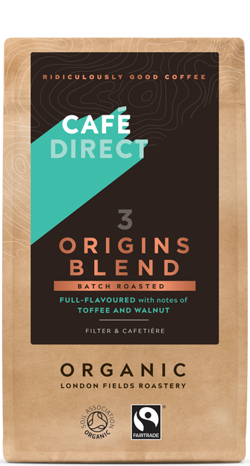
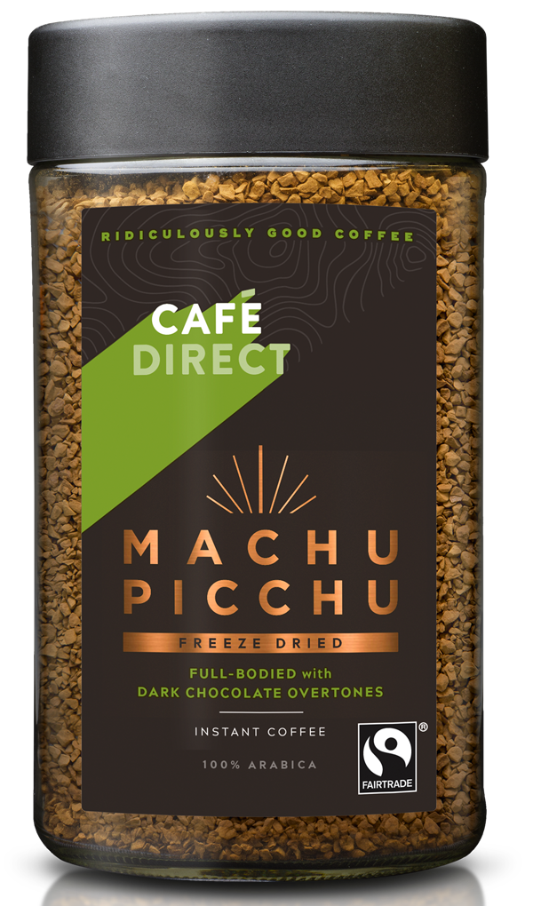
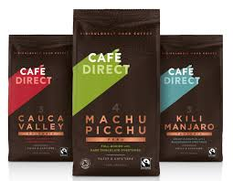
Coffee
Notes:
This image shows the range of coffees: roast and ground coffee, whole beans, instant coffee and coffee pods.
As you can see, all products carry the Fairtrade Mark as all the coffee is bought under the Fairtrade certification system. This means that there are a clear set of rules about what fair trade is, and that the process is subject to external verification so customers can trust that the claims made are true.

Slide 6
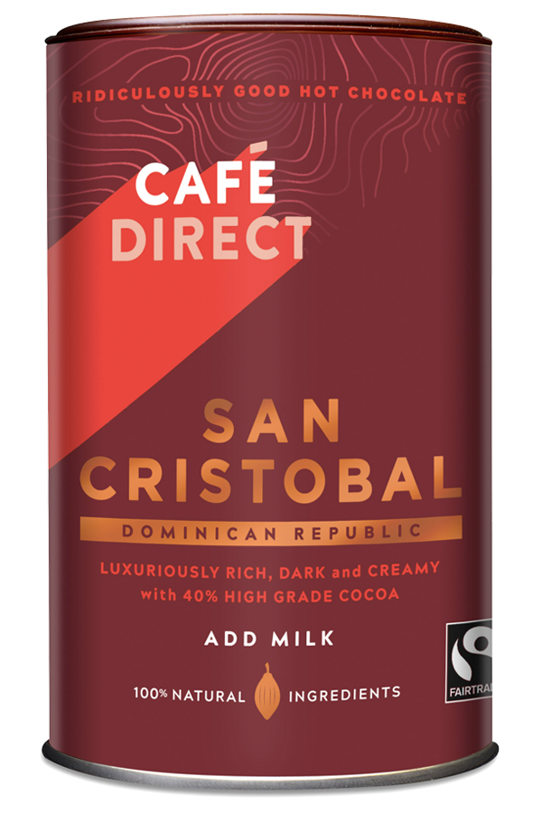
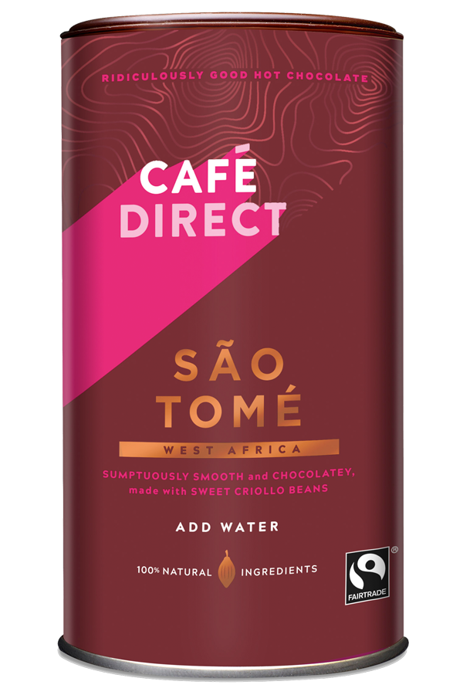


Cafédirect Hot Chocolate
100% Natural, Fairtrade & Small holder grown
San Cristobal Rich Add Milk Hot Chocolate
Just cocoa & sugar
Sao Tome Luxury Add Water Hot Chocolate
Cocoa, sugar & milk powder
Notes:
These are the hot chocolate products produced by Cafedirect. They also carry the Fairtrade Mark.

Slide 7
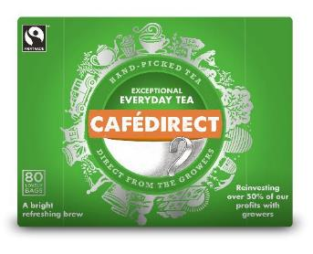
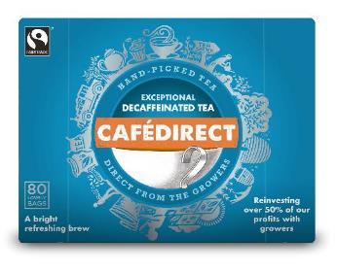
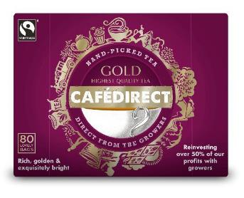
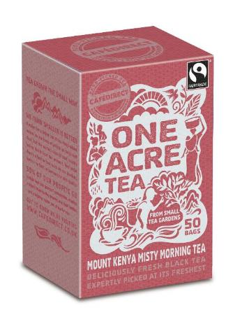
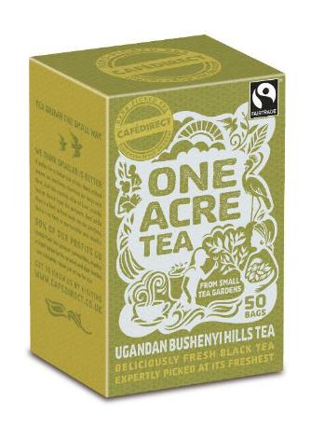
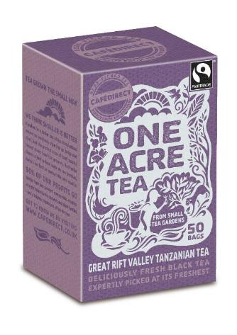
High quality teas and single origin teas
Notes:
Single origin, hand-picked small holder grown black teas

Slide 8
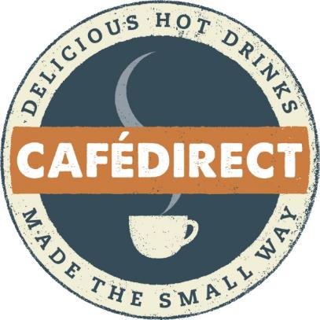
Mission & values

Slide 9
Cafédirect vision & mission
Vision
“A rebalanced world which celebrates business as a force for good and measures success in the shared wellbeing of the communities it touches.”
Mission
“Cafédirect champions the work & passion of smallholder growers, delivering great tasting hot drinks to improve livelihoods, whilst pioneering new better ways of doing business”.
The Gold Standard
Cafédirect created a framework called ‘The Gold Standard’ to ensure the business stays focussed on its vision and mission:
Grower focused in all they do
Integrated environmental action
An aspirational and accountable business

Slide 10
Branding philosophy

Slide 11
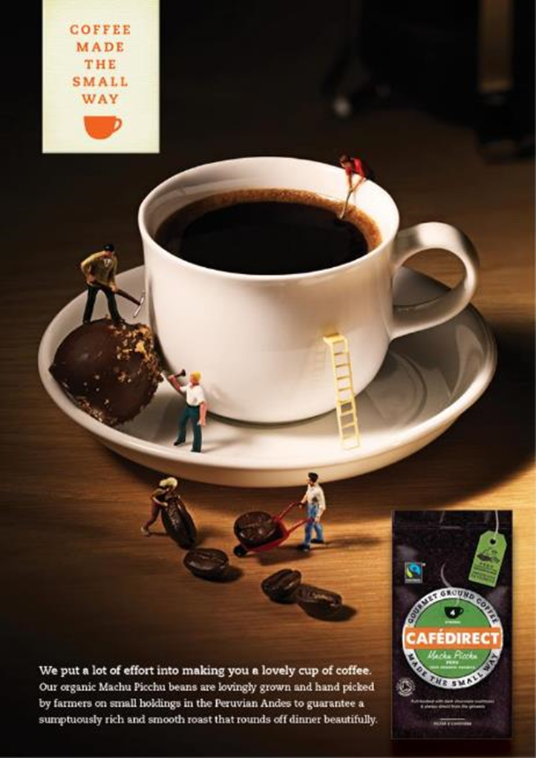
Branding
Cafedirect’s current branding features a logo with an upward block of colour, symbolising the beacon of social enterprise as a force for good.
The branding aims to make the connection with smallholder farmers through the ‘coffee made the small way’ tagline.
Packaging and advertising communicates the both the quality of the tea, coffee and cocoa and also emphasises the authenticity of the products in terms of provenance and traceability from crop to cup.

Slide 12
The business and impact

Slide 13
Managing the business
Sales
Cafedirect is exposed to the same pressures as other businesses.
Competition in the Fairtrade and ethical sector has grown, and supermarkets have moved into own-brand Fairtrade products.
As a consequence Cafédirect sales have declined between 2009-2014.
Business development
Continued innovation is important.
Introduced first Nespresso® compatible pods in 2014.

Slide 14

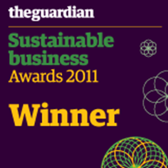

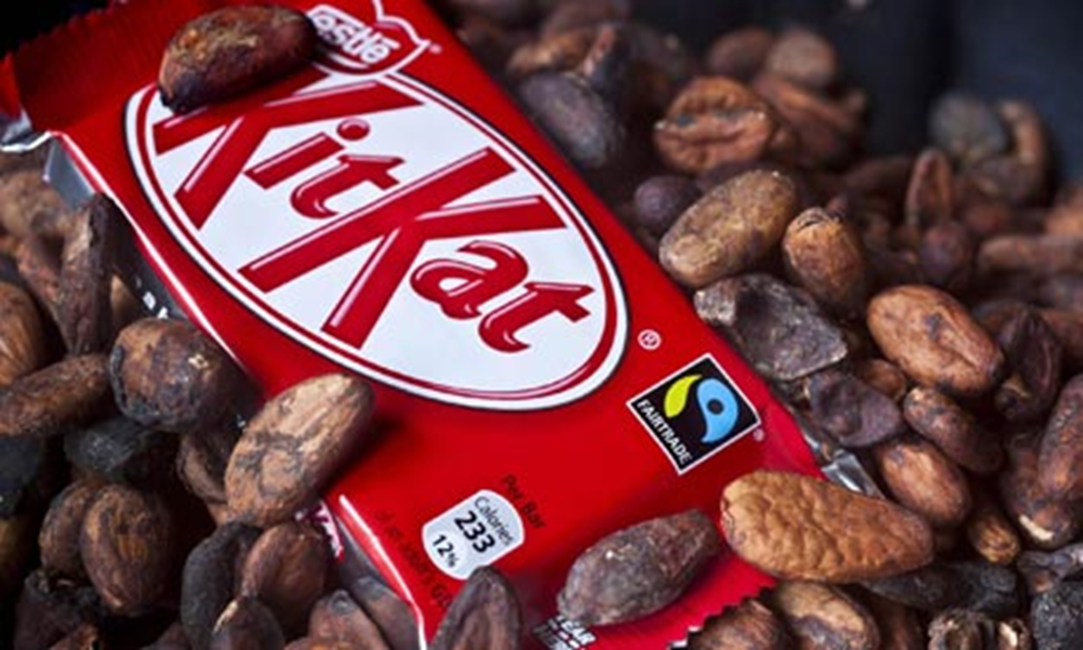
Impact in the UK
Winning Awards
Great Taste Awards – 23 Gold Stars in 5 years
The Guardian Sustainable Business – Social Impact
Beyond Business Awards, Financial Times
Good Housekeeping Magazine – Best Ethical Brand
Waitrose Way Award – Treating People Fairly
Where Cafédirect started, many others have followed…
Cafédirect inspired a new generation of competitors.
The UK market is now full of ethical and Fairtrade competitor products.

Slide 15
Impact on smallholder farmers
2015 in numbers
1,326 tonnes of coffee beans purchased
92 tonnes of tea purchased
44 tonnes of cocoa beans purchased
£433,000 paid in premiums for raw materials
£188,218 in donations to Cafedirect Producers Foundation
Since 2004 total payments to farmers in the developing world amount to more than £15.5 million.

Slide 16
