Slide 1
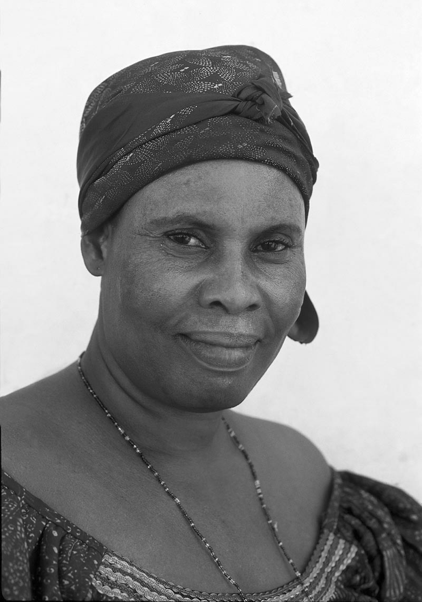
Notes:
Nana

Slide 2
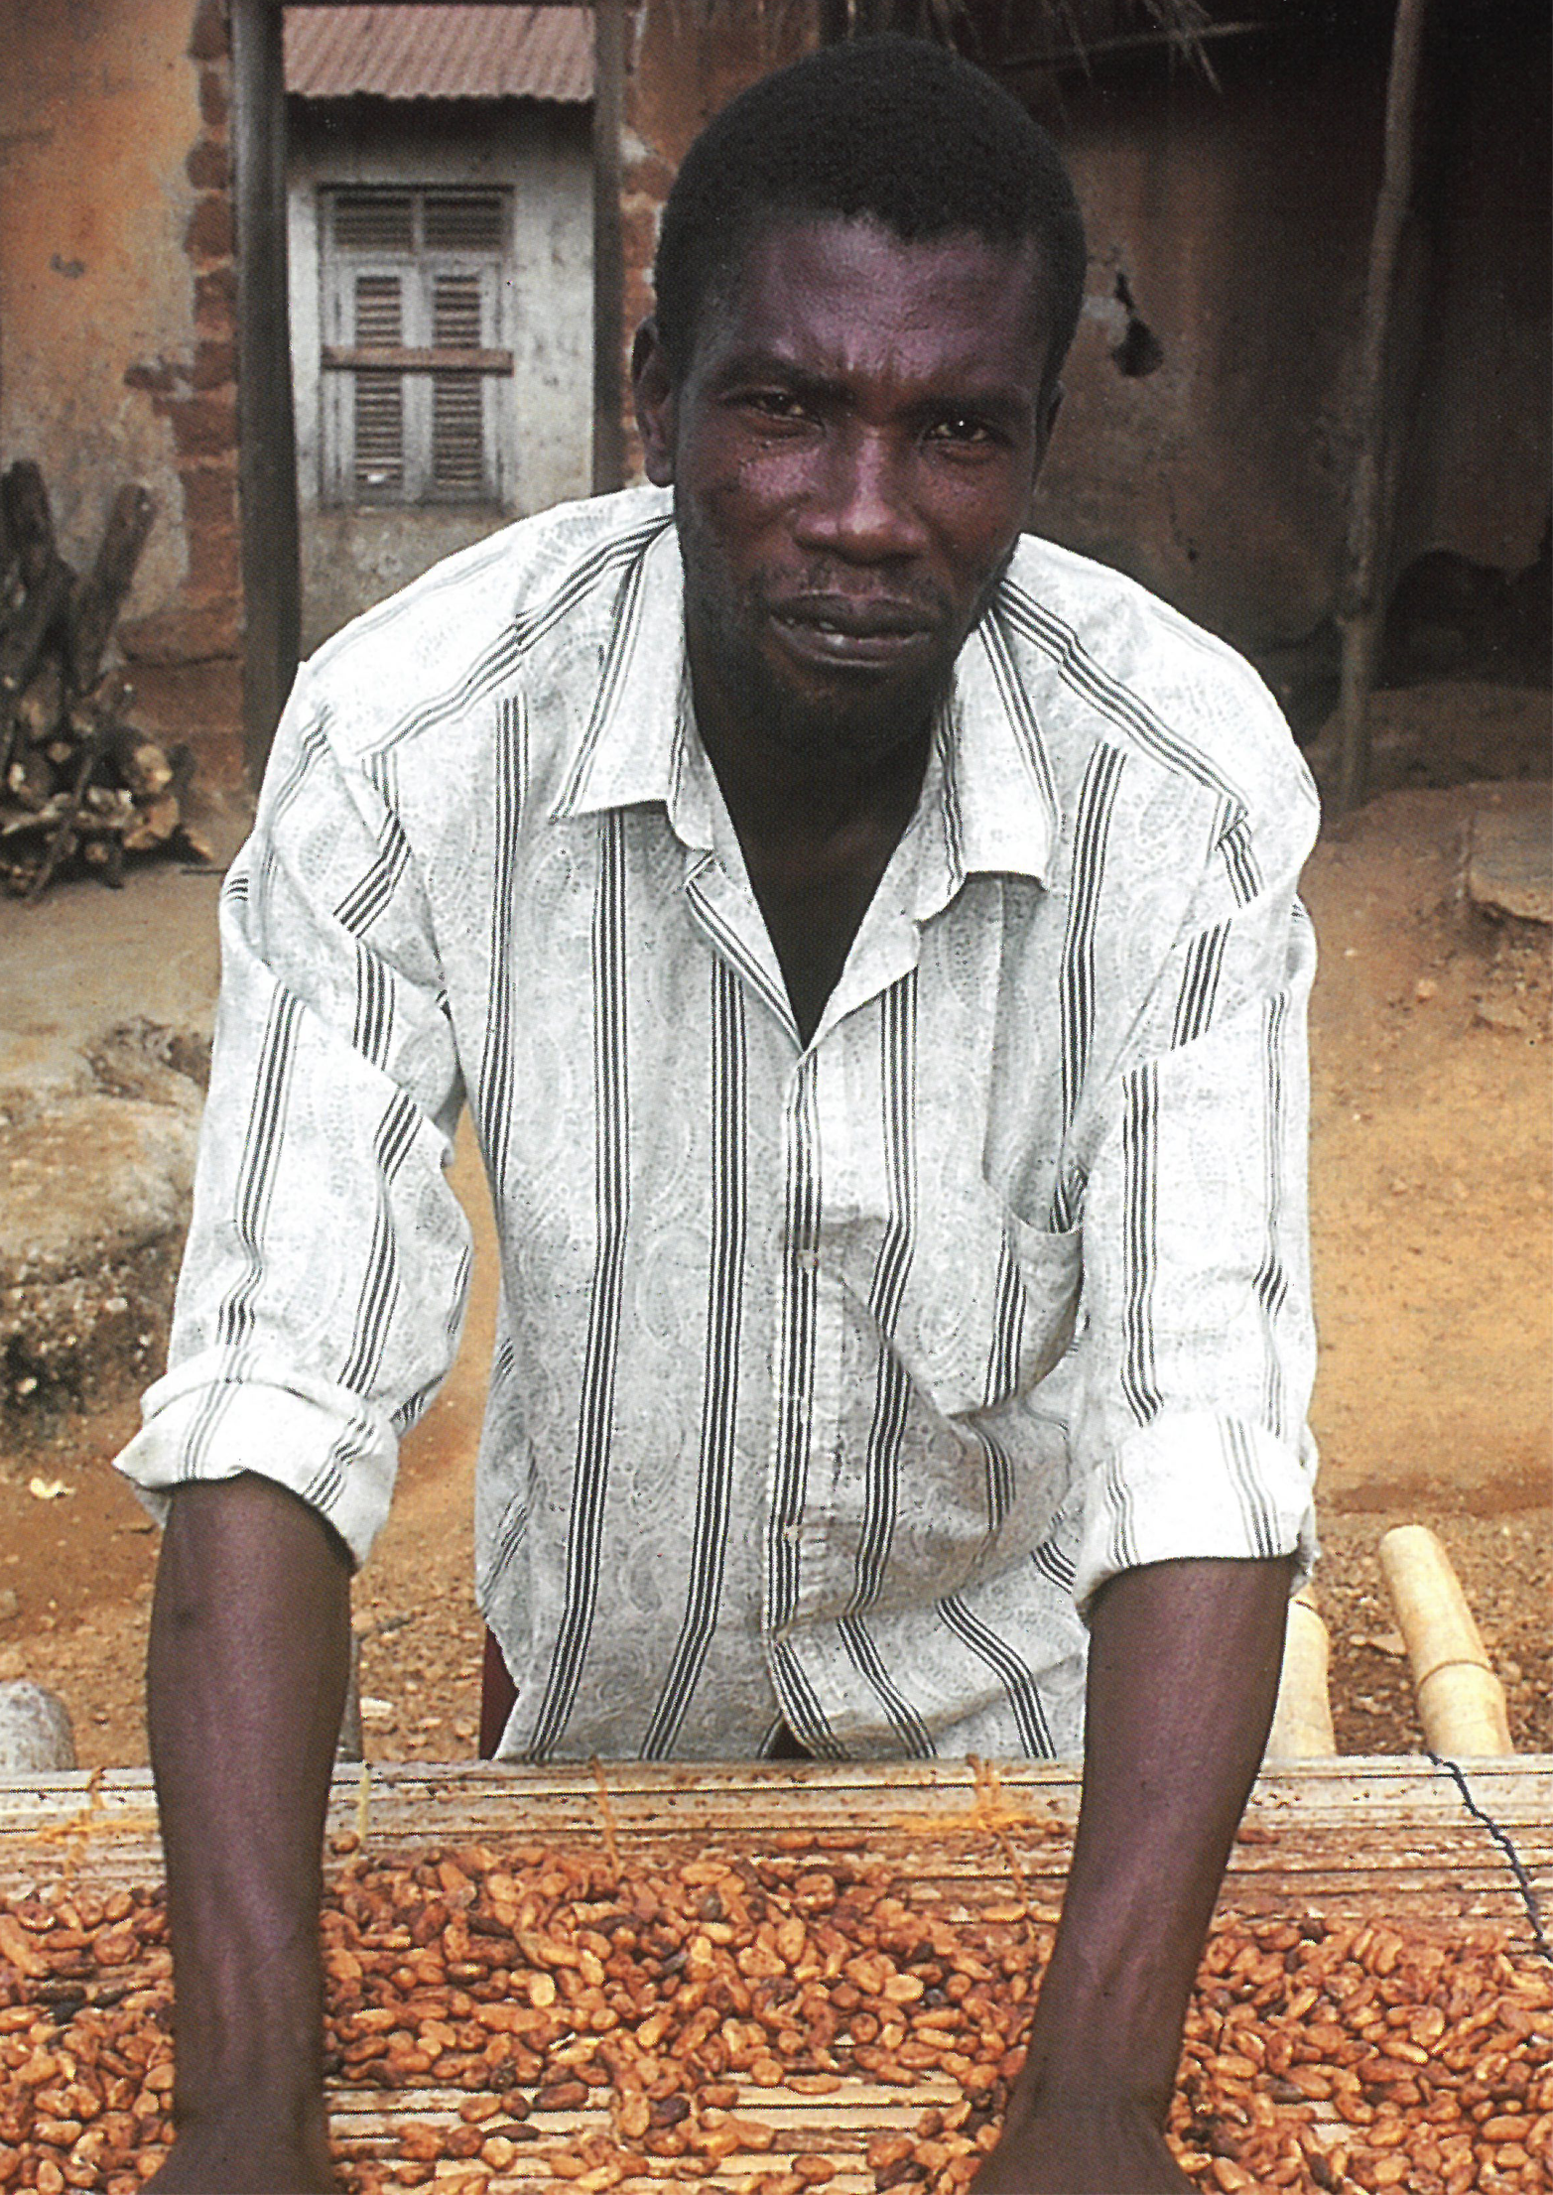
Notes:
Kwaku Owusu

Slide 3
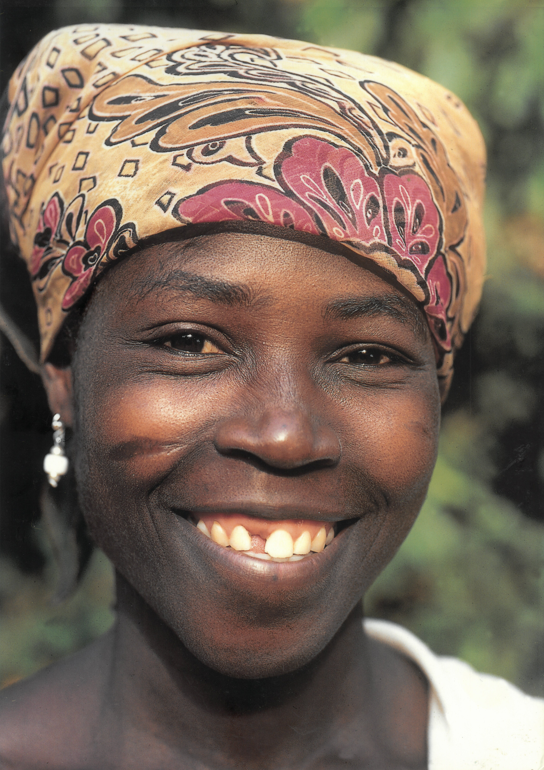
Notes:
Ama Swerwaa

Slide 4
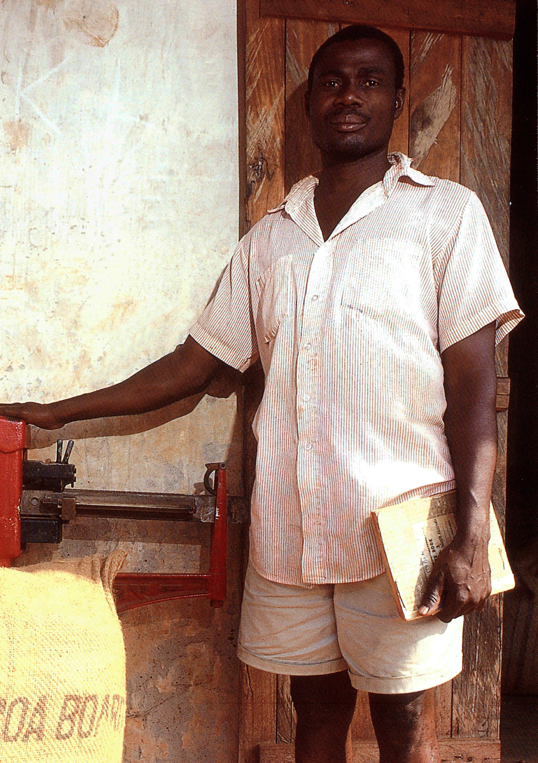
Notes:
Joseph Addae Mensah

Slide 5
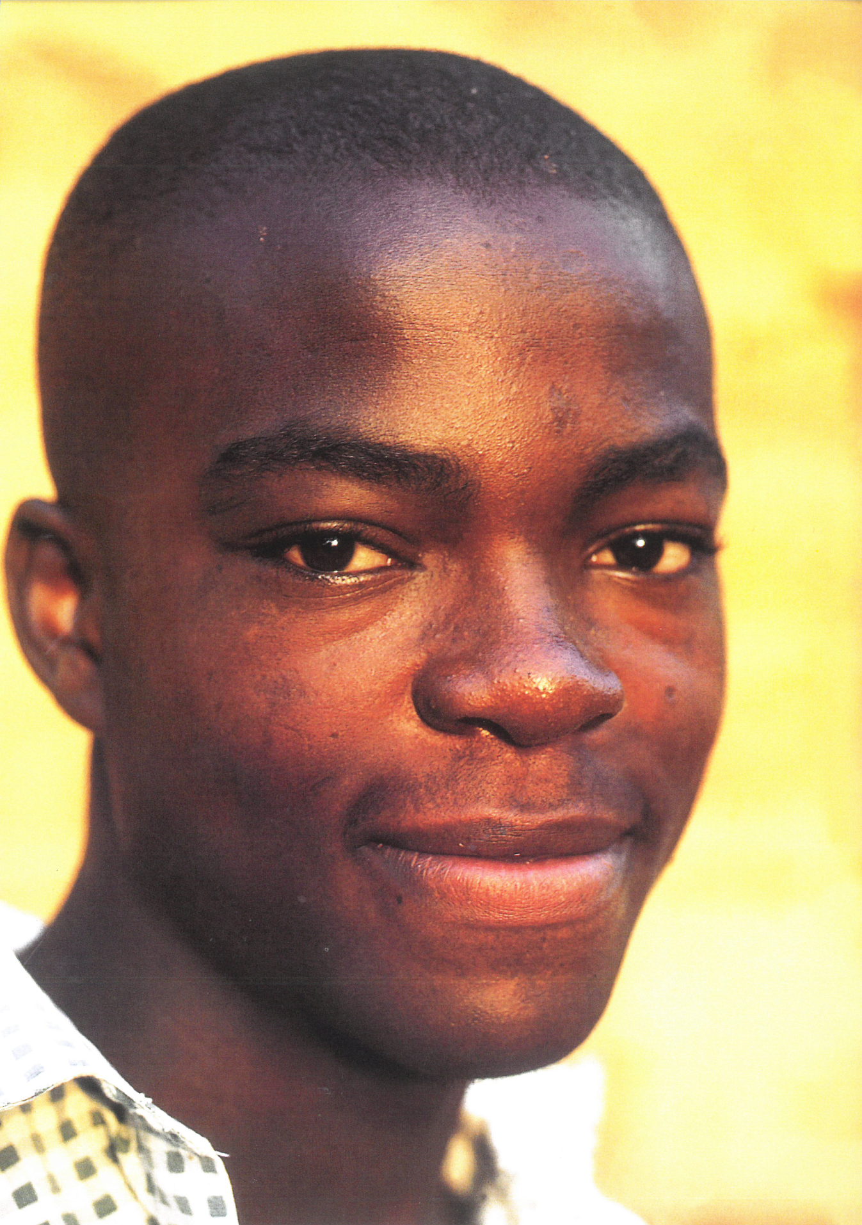
Notes:
Victor Owusu

Slide 6
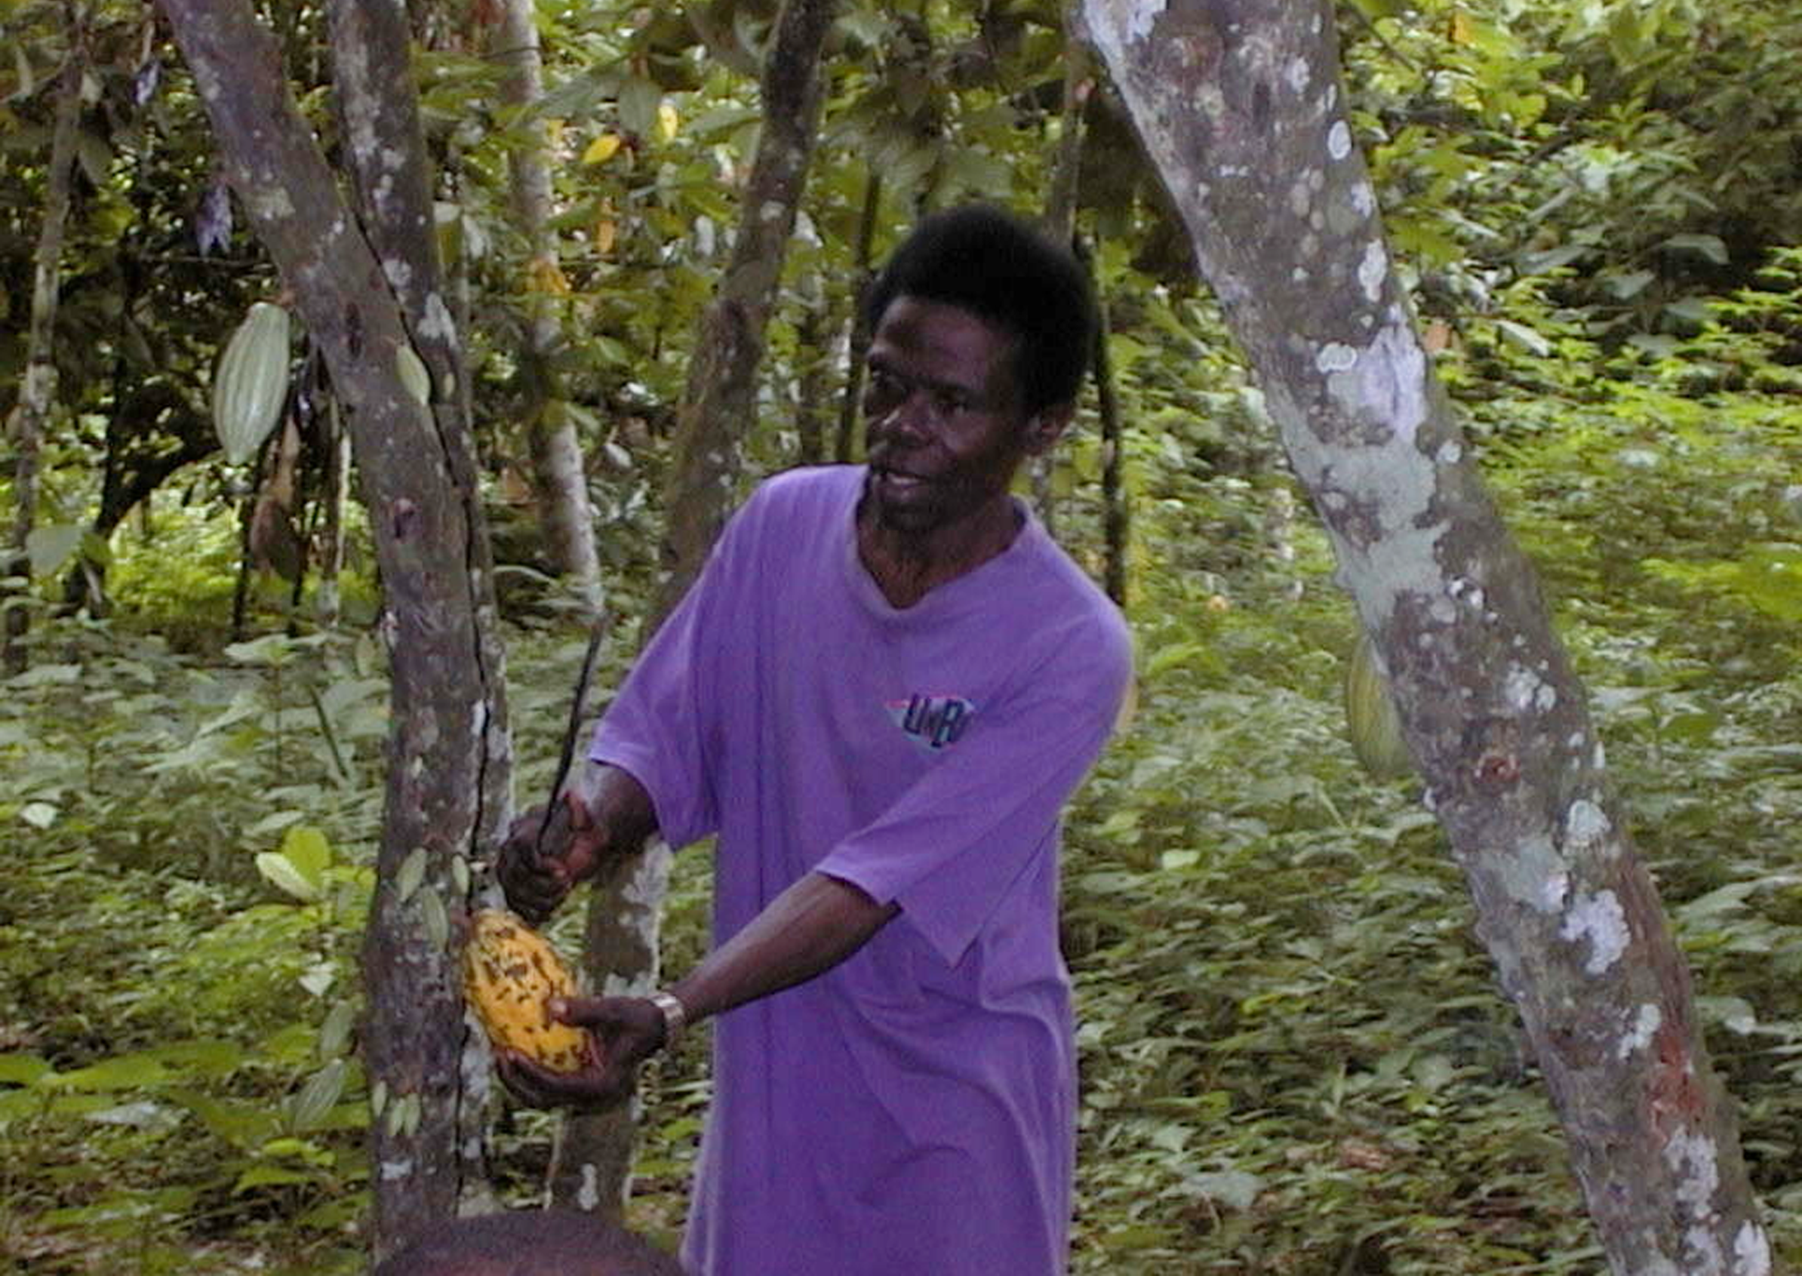
Notes:
Kopanyin Gyimah

