Slide 1
Divine Chocolate: A Fairtrade company co-owned by cocoa farmers
Notes:
This presentation focuses on Divine Chocolate, as an example of a successful social enterprise. The presentation was created by Trading Visions and can be downloaded from www.papapaa.org.

Slide 2
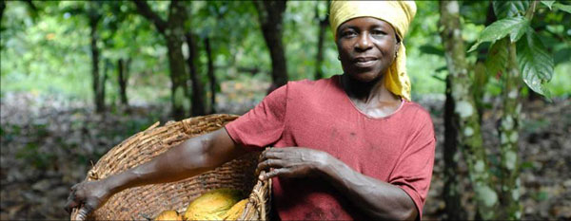
What is Divine’s Social Mission?
Improving the lives of cocoa farmers
To grow a successful, global, farmer-owned chocolate company, using the amazing power of chocolate to delight and engage, and bring people together to create dignified trading relations, thereby empowering producers and consumers.
Notes:
So what is Divine Chocolate’s social mission?
“To grow a successful, global, farmer-owned chocolate company, using the amazing power of chocolate to delight and engage, and bring people together to create dignified trading relations, thereby empowering producers and consumers.”

Slide 3
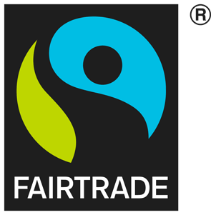
Divine is a 100% fairtrade company
All Divine Chocolate’s products carry the Fairtrade Mark.
The Fairtrade Mark is an independent guarantee that producers in developing countries get a fair deal.
That means farmers get a fair price for their products and their communities receive a Fairtrade premium.
Notes:
As well as being a social enterprise, Divine is 100% committed to the fair trade movement.
All Divine’s chocolate products carry the Fairtrade Mark which is an independent guarantee that producers in developing countries get a fair deal. This means the farmers earn enough to cover their costs and provide for their families. There is a well defined audit process so that consumers can have confidence that the claims made by Fairtrade are true.
Most cocoa farmers grow their cocoa beans without knowing whether they will earn enough to cover their costs because the price for beans is always going up and down, and have little reliability of being paid at all.
By selling cocoa beans as Fairtrade, the co-operative of cocoa farmers is guaranteed a minimum price and long term contracts. This means the co-operative can plan ahead and invest in its business.
Fairtrade cocoa beans also earn the co-operative a ‘Fairtrade premium’ to be used on something which the community decides it wants or needs. For example, this may be a well for clean water, educational facilities for the children, farming equipment like machetes, training to improve the quality of production, or diversifying into another product to supplement incomes.
3

Slide 4
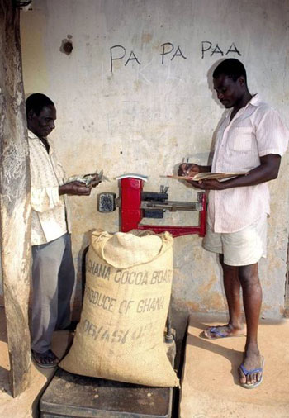
The Divine Story
Begins with cocoa farmers in Africa . . .
Ghanaian cocoa farmers typically earn about £1 each day
Farmers have little control over the price they receive for their cocoa beans
Wanting to gain more control, farmers pooled resources to create a co-operative of cocoa farmers, known as the Kuapa Kokoo Farmers Union
Kuapa Kokoo means ‘good cocoa farmer’ in Twi, the language of the cocoa farmers
Notes:
The story of Divine begins with the cocoa farmers in Ghana. Cocoa farmers in Ghana have always been vulnerable to being cheated by unscrupulous government or private company cocoa buying agents.
Farmers grew tired of unethical bean weighing practices and wanted more control over the price they got for the beans. Ghanaian cocoa farmers typically earn £1 a day¹ and they have little control over the price they receive for their cocoa beans.
So the farmers pooled resources to create a co-operative of cocoa farmers, known as the Kuapa Kokoo Farmers Union. Together they found they had a stronger negotiating position with the big chocolate companies.
Kuapa Kokoo means ‘good cocoa farmer’ in Twi, the language of the cocoa farmers.
The picture shows the Kuapa Kokoo co-operative scales for weighing sacks of cocoa beans. One of the first things that Kuapa Kokoo did to establish their good reputation with farmers was to invest in good scales. A local member of the co-operative is appointed in every village to do the weighing and the farmers know these scales are accurate because they have the right to check them with a 25kg weighing stone. This way they can be sure they not being cheated of their income.
1. This figure is based on: the average smallholder farmer producing 5 sacks of cocoa a year at £76 per sack. (Farm gate price of cocoa in Ghana = 475 cedis per sack in 2017/2018. Average exchange rate for year to 31/12/18 = 0.1599)

Slide 5

The Divine Story
Kuapa Kokoo
Together the farmers of Kuapa Kokoo provide over 1% of world cocoa output
The Fairtrade market is not yet large enough for them to be able to sell all of their beans on Fairtrade terms
As demand for Fairtrade products rise farmers are able to sell more of their crop through Fairtrade channels
The Kuapa Kokoo slogan, Pa Pa Paa, means “best of the best”
In 1997 Kuapa Kokoo made the major and innovative decision to set up a chocolate company in the UK in order to get more value from their cocoa.
Notes:
Kuapa Kokoo produces over 1% of world cocoa output and sell around 2% of that on Fairtrade terms.¹ The Fairtrade chocolate market is not yet large enough for them to be able to sell all their beans on Fairtrade terms.
As demand for Fairtrade products rises, farmers are able to sell more of their crop through Fairtrade channels.
Kuapa Kokoo is democratically organised with elected representatives from village to national level. Initially there were 2,000 members in 22 communities, but this has now grown to 100,000 members in 1,300 communities.
In 1997, Kuapa Kokoo took the major – and innovative – decision to create a chocolate company in the UK so that they would get a proportion of the money earned from a chocolate bar.
This means they get a greater share of the money generated from chocolate production and sales than they would ever get from just selling the cocoa beans. For cocoa farmers, selling cocoa is not particularly profitable. It is at the other end of the supply chain where all the money is to be made: manufacturing the branded chocolate products that we see on the shelves. Because the cocoa farmers in Ghana co-own the company, Divine Chocolate benefits them by moving them up the value chain.
In 2012/13, 3.93m tonnes of cocoa produced globally and 48,283 tonnes produced by Kuapa Kokoo. Kuapa Kokoo sell around 1,000 tonnes annually on Fairtrade terms.

Slide 6
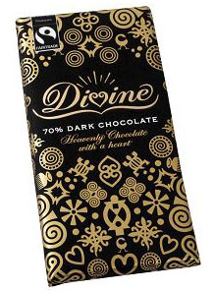
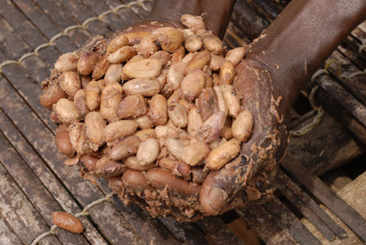
The Divine Story
…Then moves to the UK where Divine is created
Divine produces and sells chocolate made from Fairtrade cocoa beans bought from Kuapa Kokoo
The better Divine performs the more it can spend on improving the supply chain, paying dividends to its farmer-shareholders, and on education
The more Fairtrade beans are sold the more the farmers income increases and the more social premium is earned to the benefit of the community
Farmers sell Fairtrade cocoa beans to Divine Chocolate
Notes:
The Divine story then moves to the UK where Divine Chocolate Ltd was created, although it was called the Day Chocolate Company at first and only changed to Divine Chocolate Ltd in January 2007 to more closely align the company with its leading branded chocolate bar.
In the autumn of 1998, Divine, the first ever Fairtrade chocolate bar aimed at the mass market was launched onto the UK confectionery market.
Using this exciting new business model, the co-operative of cocoa farmers in Ghana owned shares in the company making the chocolate bar.
So the better Divine performs, the more the company can spend on improving the supply chain, paying dividends to its farmer-shareholders, and investing in education for cocoa farmers and for consumers in the UK.
It means that in Ghana the more Fairtrade beans are sold to Divine, the more the income of the farmers increases and the more Fairtrade Premium is earned for the benefit of the whole community.

Slide 7
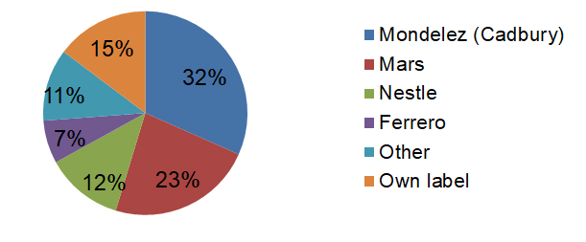
The Divine Story the chocolate market
Global Market
Part of the huge confectionary market.
Global chocolate market worth £60.36 billion
Global cocoa market worth £5 billion
UK market
Three companies control 67% of the £4.1bn UK confectionary market
The average UK family spends more in a year on chocolate in a year than a cocoa farmer earns in a year
Notes:
Chocolate is part of the major multi-billion dollar confectionary industry. It is dominated by enormous multinational conglomerates, such as Mars Inc, Mondelez International, Ferrero Group and Nestlé. The global chocolate confectionery market was worth around £60.36 billion in 2010¹ while the global cocoa market is worth only £5 billion.² Because cocoa makes up such a small proportion of the value of the chocolate market, there is very little money to be made selling cocoa despite chocolate being such a profitable product.
The UK confectionary market is also very competitive and largely controlled by three companies: Mondelez (who own Cadburys), Nestle and Mars. These three companies control 67% of the £4.1bn UK confectionary market.³ If you add up the market share of the top four companies (including Ferrero) and supermarket own label chocolate, these account for 89% of the market.
In a ferociously competitive market, being a relatively small company can be a daunting prospect. But as so many people adore delicious chocolate, the potential for Divine's success is huge. There are hundreds of chocolate brands available in the UK, and the biggest companies spend up to 10% of their profit margins – tens of millions of pounds – in their fight to retain their brands' positions in the Chocolate Top Ten.
Divine has been developed to appeal to the British public's palate, and it tests favourably against all the market leaders.
The UK has one of the highest per capita levels of consumption of chocolate in the world as the average person in the UK eats 10kg each year⁴ and therefore, capturing even a small proportion of this market translates into real benefits for cocoa farmers. A very good thing too, as the average UK family spends more on chocolate in a year than a cocoa farmer earns in a year.
Source: Fairtrade Foundation UK, 2011, ‘Commodity Briefing’
Source: ICCO (September 2009) Personal communication
Source: Mintel (2017) ‘Chocolate Confectionery – UK – May 2017’
Source: Datamonitor (2006) http://www.guardian.co.uk/uk/2006/apr/13/foodanddrink
7

Slide 8
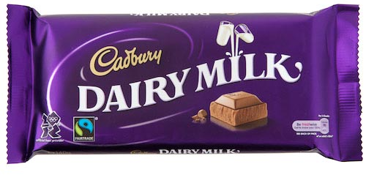
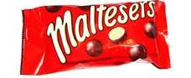
The Divine Story
Big companies join Fairtrade
… but commitment is half hearted
Cadbury
Cadbury Dairy Milk, the UK’s favourite chocolate bar, went Fairtrade in 2009, tripling Kuapa Kokoo’s Fairtrade cocoa sales.
In 2016, Mondelēz, the multinational that owns Cadbury, replaced the Fairtrade Mark with their ‘in-house’ fair trade scheme, Cocoa Life.
Mars
In 2012 Mars’ Maltesers became Fairtrade.certified.
In 2015 Mars Bars carried the new Fairtrade Cocoa Program Mark, sourcing Fairtrade cocoa but not Fairtrade sugar.
Nestlé
In 2010, the UK’s favourite chocolate biscuit bar, Kit Kat, went Fairtrade.
Notes:
As part of the Fairtrade campaign in the UK, Divine has helped drive forwards a movement that has seen sales of Fairtrade certified products grow rapidly. Rising consumer demand has meant that other companies became interested. A number of large well known brands switched whole product ranges to Fairtrade – Tate & Lyle sugar, Starbucks espresso-based coffees, bananas in Sainsbury, Waitrose and Co-op, and many others.
In 2009 Cadbury switched its best selling Dairy Milk bar to Fairtrade. This resulted in a huge increase in Fairtrade cocoa sales, with Kuapa Kokoo’s sales to Fairtrade tripling. In 2010, Nestlé switched Kit Kat to Fairtrade, and in 2012, Maltesers became Fairtrade. For a while, the biggest selling three chocolate products in the UK were all certified Fairtrade.
The initial excitement of these big gains for the Fairtrade movement were tempered by subsequent developments. Cadbury was taken over by US multinational Kraft, which then became Mondelēz International. In 2016, Mondelēz replaced the Fairtrade Mark with their own ‘in-house’ fair trade scheme, Cocoa Life. Cocoa Life provides many benefits to farmers, but there is no independent third-party auditing of its claims, nor any meaningful accountability to farmers or consumers, unlike with Fairtrade.
Mars Maltesers remains Fairtrade certified, but when Mars adopted Fairtrade certification for Mars Bars in 2015, they opted for a Fairtrade Sourcing Program Mark, under which the cocoa is sourced on Fairtrade terms, but not the sugar.
Nestlé continue to source the cocoa, sugar and vanilla for Kit Kat on Fairtrade terms, but have switched in 2017 to using the Fairtrade Sourcing Program system. Rather than have the Fairtrade Mark on the front of the pack, they have the Fairtrade Sourcing Program Mark on the back of the pack and have moved their in-house sustainability programme, Cocoa Plan, on to the front of the pack. It is a similar move to Mondelēz and represents a general shift by big corporates towards own brand sustainability programmes rather than third party independent verification by civil society.
8

Slide 9
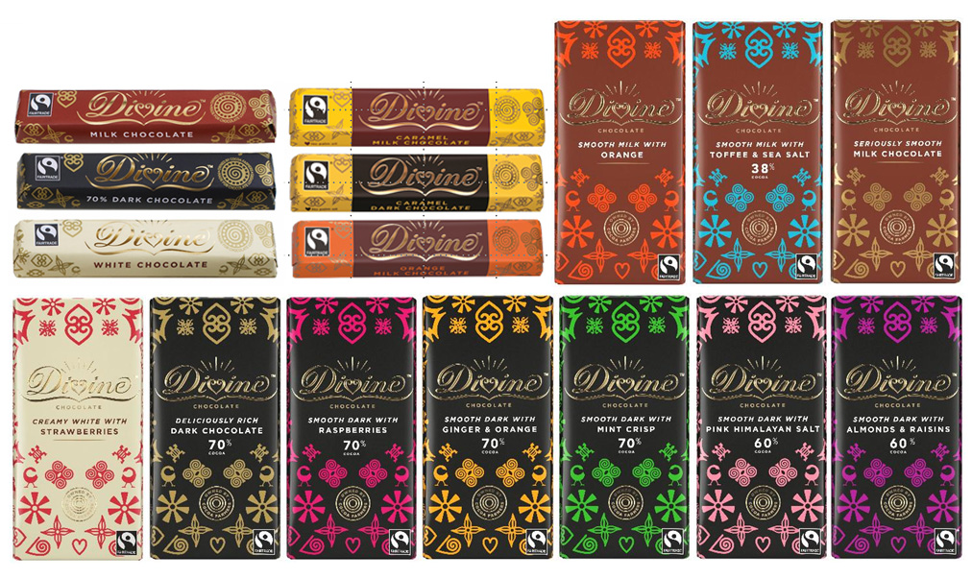
Divine Branding
Adinkra symbols
Notes:
Since introducing the first mainstream Fairtrade chocolate bar into the UK market, the Divine product range has grown considerably. There are now 32 all-year-round products and a changing range of seasonal products, including easter eggs, mini eggs, advent calendar and chocolate coins. Seasonal products, particularly the Christmas range, make up a large proportion of Divine Chocolate’s sales.
The Divine brand is based around traditional West African ‘adinkra symbols’, which represent Divine’s Ghanaian roots. Adinkra symbols are carved, woven and printed on traditional craft and fabrics in Ghana and each one has its own special meaning.
Divine products are stocked in Waitrose and The Co-op, as well as a wide range of other outlets, including Booths, Wholefoods, Oxfam shops and many independent shops.

Slide 10
What Success looks Like
for divine chocolate
Divine Chocolate Ltd is profitable with good sales growth and has been able to pay dividends to shareholders
Year | Turnover | Net profit
2015/16 | £12,062,000 | £443,000
But sales and profits are only one measure of success
Notes:
Divine Chocolate Ltd wants to show that it really is possible to be a commercial success and still do business differently, putting social objectives at the heart of the company.
This slide shows that in commercial terms Divine Chocolate Ltd is a success. The company is profitable and able to pay dividends to shareholders. In 2015/16 the turnover was over £12m and profits amounted to £443,000¹.
But sales and profits are only one measure of success.
1. Source: Divine Chocolate (2017) Annual Report 2015-16

Slide 11
What Success looks Like
Social objectives
Year | Tonnes of Fairtrade cocoa used | Tonnes of Fairtrade sugar used | Tonnes of Fairtrade almonds used | Tonnes of Fairtrade mangos used
2015/16 | 882 | 307 | 6.1 | 2.6
Divine sources Fairtrade ingredients from seven different countries worldwide
If the Fairtrade Mark is on a product it means that any ingredient that can be Fairtrade must be Fairtrade
“It has always been our aim to source as many Fairtrade ingredients as possible for our products, thereby delivering benefits to an increasing number of farmers.”
Sophi Tranchell, Divine Group CEO, 2017
Notes:
Divine’s core mission is to improve the lives of cocoa farmers, so one measure of success is the amount of Fairtrade cocoa beans the company purchases. In 2015-16, Divine purchased 882 tonnes of cocoa beans, almost all from Kuapa Kokoo in Ghana. Some came from Uganda, where Divine is supporting a small vanilla cooperative to diversify their business into cocoa.
Some of the business decisions Divine makes are informed by the objective of selling more cocoa beans. For example, the company has been developing a range of higher cocoa content bars such as its 85% Dark bar and higher cocoa content milk chocolate bars. These both tap into the growing trend among consumers for higher cocoa content chocolate and ensure that more Fairtrade cocoa beans are purchased to benefit cocoa farmers.
As well as cocoa, there are other ingredients from Fairtrade farmers that go into the Divine chocolate range:
Sugar from Malawi
Almonds from Pakistan
Vanilla from Madagascar
Mangos and coconut from Burkina Faso
Brazil nuts from Peru

Slide 12
What Success looks Like
Divine income to Kuapa Kokoo
Year | Fairtrade sales | Fairtrade Premium | Producer support | Shared profits
2015/16 | $2,700,000 | $176,000 | £241,000 | £69,000
“For us, farmer ownership always made Divine Chocolate special. For the first time our members benefit as owners of a wonderful chocolate brand, and not only as suppliers of excellent fairly traded cocoa.”
Mr Ohemeng Tinyase, MD of Kuapa Kokoo Ltd until 2009
Kuapa Kokoo sold 882 tonnes of Fairtrade cocoa beans to Divine Chocolate in 2015/16
There are four different income streams from Divine Chocolate to Kuapa Kokoo
Notes:
This slide shows how Divine Chocolate sales have benefitted Kuapa Kokoo in Ghana. As you can see, Kuapa Kokoo receives four different income streams from Divine Chocolate.
In 2015/16, Kuapa Kokoo farmers sold 882 tonnes of cocoa beans to Divine Chocolate, with a sales value of approximately $2.7 million. ¹
From these Kuapa Kokoo earned $176,000 in Fairtrade Premium, to be spent collectively by the co-operative on projects for their communities.
Note that Fairtrade sales and the Fairtrade Premium are always calculated and paid in US dollars, for all commodities.
In addition, Divine returns a percentage of its turnover (2% of wholesale sales) every year to Kuapa Kokoo for ‘producer support and development’, helping Kuapa Kokoo to develop as an effective cocoa buying business. In 2015/16 this amounted to £241,000.
Finally, shared profits. As part owners of Divine Chocolate, with 44% of the company’s shares, Kuapa Kokoo receive 44% of distributable profits when a share dividend payment in made. The first ever payment was made in 2007, when all 45,000 farmers in the co-operative received $1 each. In 2015/16, the share dividend to Kuapa Kokoo was £69,000.
Divine's farmer ownership model not only delivers the two income streams additional to Fairtrade – ‘producer support and development’, and ‘shared profits’ - but also delivers business knowledge and experience and a real voice in the chocolate industry.
The asset of co-owning Divine Chocolate has also helped Kuapa Kokoo by opening the door to additional finance. Kuapa Kokoo has to borrow a lot of money every year so that it can pay its members upfront for their cocoa, before it has been sold. As bank loan interest rates in Ghana are 25%-30%, this is very expensive. Kuapa have used their shares in Divine Chocolate as security to borrow hard currency at 5% interest, saving them in interest charges.
1. Source: The sales value is an approximate figure, derived by multiplying the volume of cocoa sold by Kuapa Kokoo to Divine by the average world market price for cocoa over this financial year, $3,159 per tonne.

Slide 13
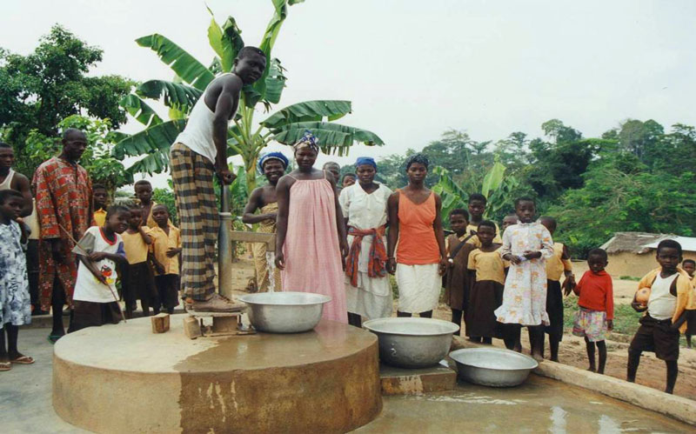
What Success looks Like for the community – water wells
Notes:
As a consequence of the success of the Kuapa Kokoo co-operative, the community directly benefits. This water well was funded from the Fairtrade Premium earned by Kuapa Kokoo from Fairtrade cocoa sales.
A water well can have ripple effects beyond just having clean, readily available water in the community. Families experience the benefits of a reduction in water borne diseases. Because it is girls who usually go to fetch the water, the reduced walking time needed to fetch water means that girls have more time for education, which means they have better prospects and more power when they grow up.

Slide 14
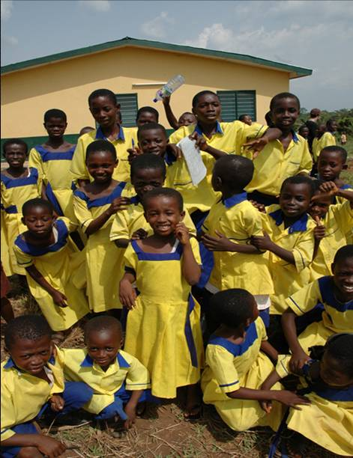
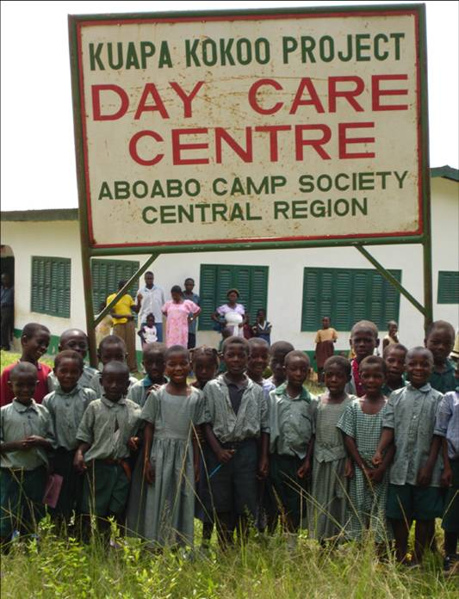
What Success looks Like for the farmers’ children - schools
Notes:
The picture on the left is Great Fammis School which is attended by the children of the Kuapa Kokoo farmers. The school is named after the founder of Kuapa Kokoo and was built with money earned from the sale of Divine chocolate. Kuapa Kokoo have been involved in the development of 8 schools across Ghana.

Slide 15
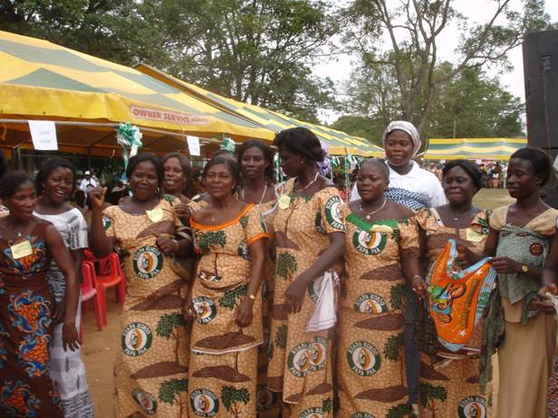
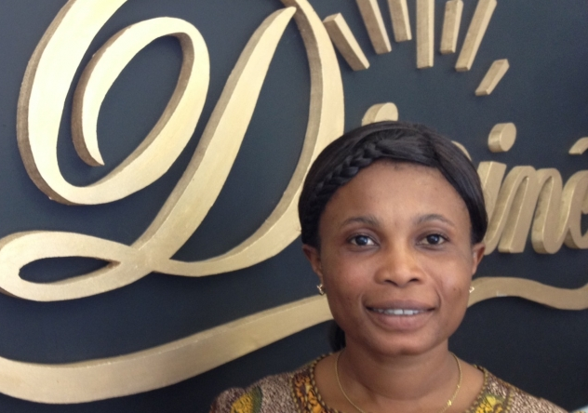
What Success looks Like
For women - empowerment
Fatima Ali
President of Kuapa Kokoo
Notes:
Women also benefit. Kuapa Kokoo aims to encourage the active and effective participation of women in decision making throughout the organisation.
The Kuapa Kokoo constitution specifies that 3 out of 7 of the elected board members of local Kuapa village societies must be women. At the Kuapa Kokoo Annual General Meeting, every village sends one woman and one man to the meeting.
Over time this has ensured women have more influence and make more contributions to the organisation. In 2014, Fatima Ali was elected as the second female president of Kuapa Kokoo. This means she is leading a farmers’ cooperative in Africa with 100,000 members in 1,300 village societies, buying over 30,000 tonnes of cocoa and turning over just under $50 million a year.
As Christiana Ohene Agyare, the former president, said: “Being a member of Kuapa Kokoo has taught me that whatever a man can do, a woman can also do and even better.”
In addition, the co-operative has encouraged education about nutrition, child care, health and credit facilities and supported other income generating activities for women to supplement their incomes and to make them less dependent on the men as well as provide money for the family during the off season whilst the cocoa is growing.

Slide 16
What Success looks Like
for the cocoa farmers themselves
Tangible benefits for farmers
Move up value chain
Sit on the Divine Board
Part of decision-making process
Profit share
Access to capital
Intangible benefits for farmers
Pride
Respect
Status
Reputation
Inclusion
Knowledge
A ‘seat at the table’
Ownership in Divine
Notes:
One of the main ways in which Divine is different from other companies, and even other social enterprises, is that the farmers are part owners of the company. The Kuapa Kokoo cooperative owns 44% of the shares of the company.
This provides benefits for the farmers in many ways; some are tangible while others are less so.
Among the tangible benefits is the way that ownership in Divine Chocolate allows them to move higher up the value chain, to use the industry jargon. This means they get a greater share of the money generated from chocolate production and sales than they would ever get from just selling the cocoa beans.
It also allows them to contribute to decisions made about Divine and, in the process, learn more about the chocolate market.
As Kuapa Kokoo earns ‘hard’ currency (i.e. dollars and pounds) they now have access to other sources of funds (i.e. capital) which allows them to expand and invest. Most smallholder farmers in countries such as Ghana own almost nothing and only earn money in their local currency and this means they have almost no access to capital.
Aside from the tangible benefits of co-ownership, the farmers have been empowered and have grown in pride and reputation.

Slide 17
in Summary
Divine Chocolate Limited has shown that it is possible for smallholder farmers from Africa to co-own a successful company in one of the most competitive and mature markets in the world.
Notes:
When Divine Chocolate was launched in 1998, no one thought it would be possible to start a social enterprise like this in the highly competitive UK chocolate market. But Divine has shown that it is possible for smallholder farmers from Africa to co-own a successful company in one of the most competitive and mature markets in the world.
It’s taken partnership, a lot of passion, and even more persistence, but Divine Chocolate is now a multi-million pound company with cocoa farmers sharing the profits.

