Slide 1

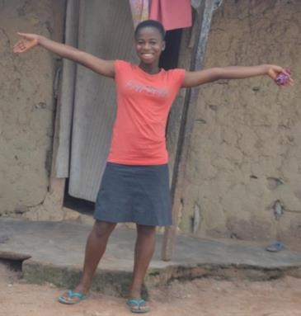



Esther Awusi
Aged 16
Bayerebon No. 3
www.tradingvisions.org
www.papapaa.org
www.divinechocolate.com
Notes:
“My name is Esther Awusi. I’m 16 years old and I come from Bayerebon No.3 in Ghana.”
This is a presentation by Esther Awusi, a 16 year old girl from the village of Bayerebon No. 3 in the cocoa growing belt of rural Ghana. She visited the UK in 2016. This is the presentation she gave when she was travelling around the country.

Slide 2
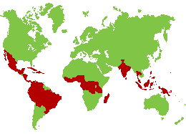
Notes:
“This is a map of the world. The red places are the countries where they grow cocoa.”
The main ingredient in chocolate is cocoa. Farmers grow cocoa trees on small farms in hot, rainy environments, mostly in areas on or near the equator. On the world map, the red countries are cocoa producing countries.

Slide 3
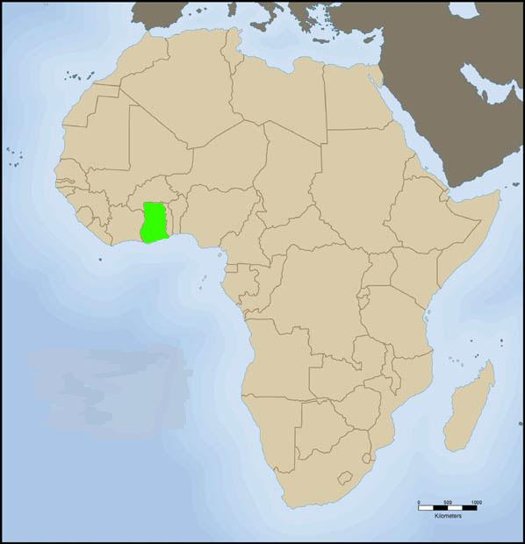
Ghana
Notes:
“This is a map of Africa. The green place shows the location of Ghana.”
Ghana is a country of 27 million people in West Africa. As well as local languages, everyone speaks English. It was a British colony and was the first African nation to achieve independence from European rule in 1957. The country’s main exports are gold, timber and cocoa.

Slide 4
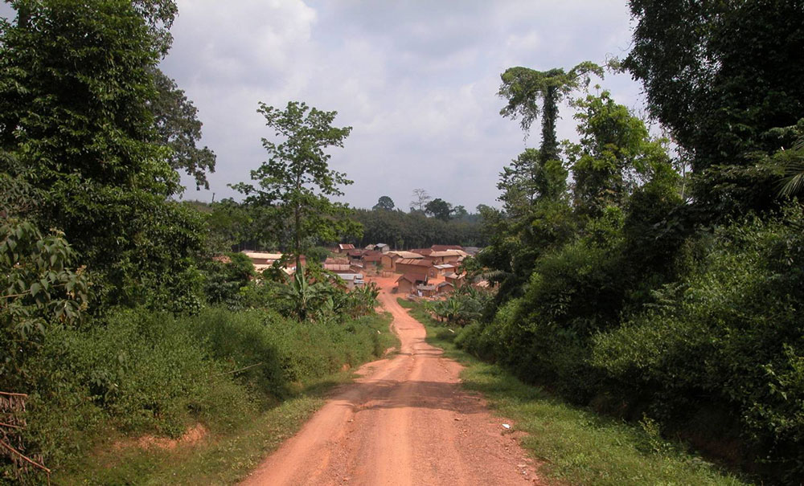
Notes:
“This is the road that leads you to my village, Bayerebon No. 3.”
Bayerebon No. 3 is a cocoa farming village in Ghana, in a clearing in the rainforest. It is hot and humid here.
Bayerebon No. 3 has many farmers who belong to Kuapa Kokoo. Kuapa Kokoo is a co-operative of cocoa farmers in Ghana whose beans are made into Divine Chocolate. Kuapa Kokoo is an association of more than 85,000 cocoa farmers, spread across 1,250 villages in Ghana. ‘Kuapa Kokoo’ means ‘good cocoa farmer’ in the local Twi language. Their motto is ‘Pa Pa Paa’, which means ‘best of the best’ in Twi.
Esther’s mother is a member of Kuapa Kokoo.

Slide 5
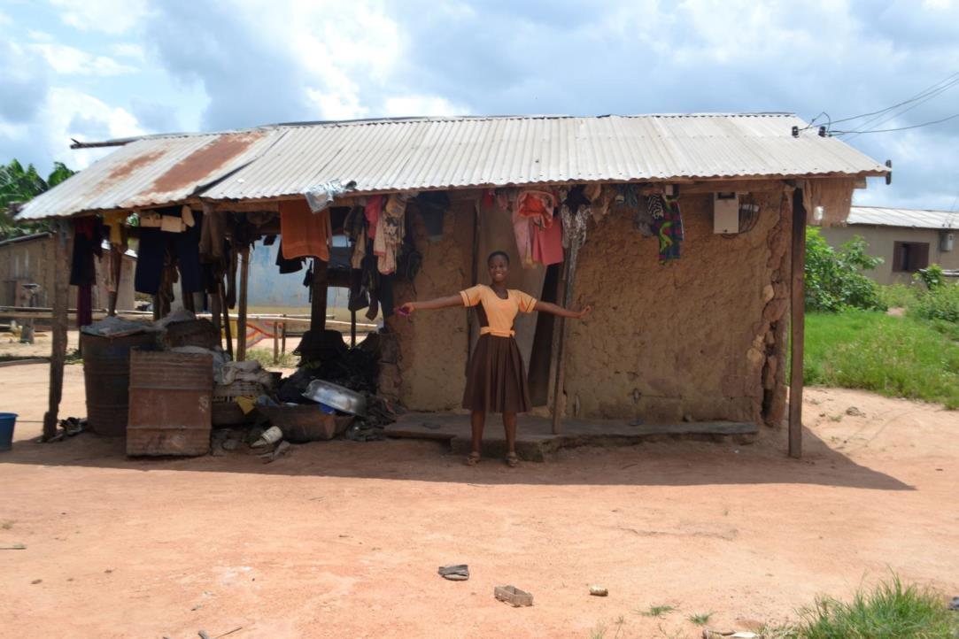
Notes:
“In this picture, I was standing in front of our house and expressing myself.”
Esther’s house is a simple building made of mud brick with a corrugated iron roof. Notice the electricity line coming into the house on the right.

Slide 6
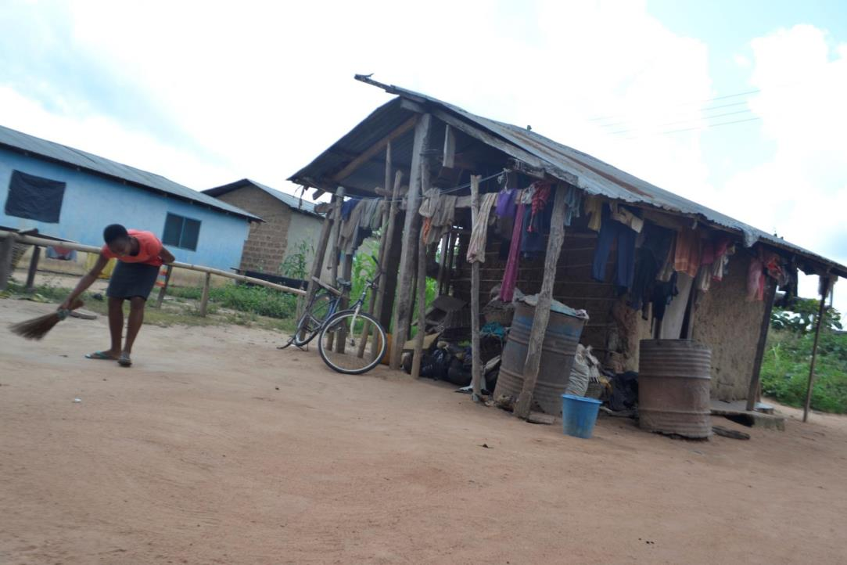
Notes:
“Every morning I sweep the compound around my house.”

Slide 7
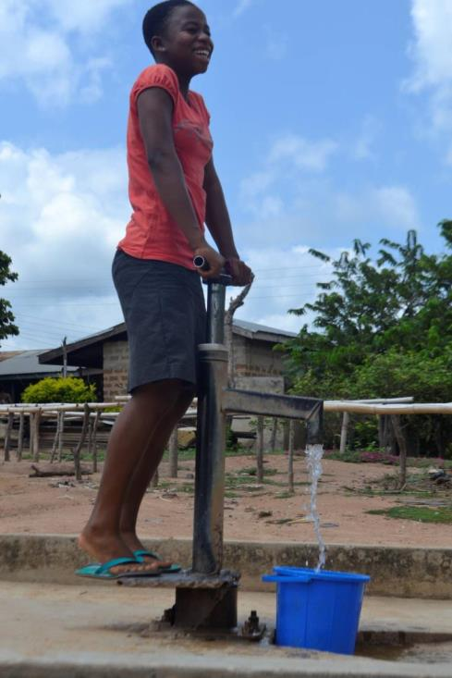
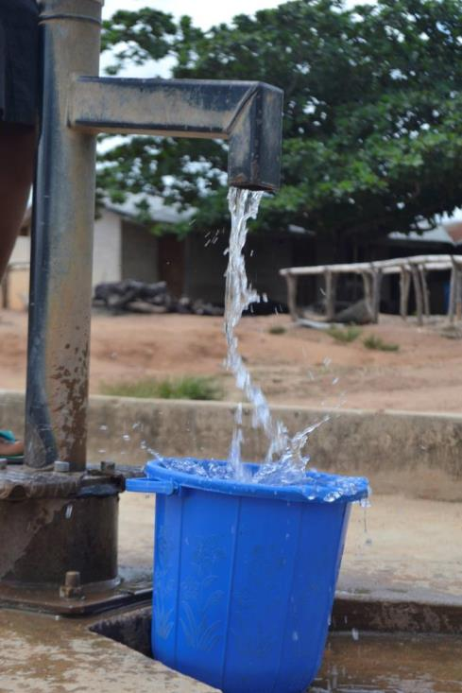
Notes:
“I was fetching water for my mother.”

Slide 8
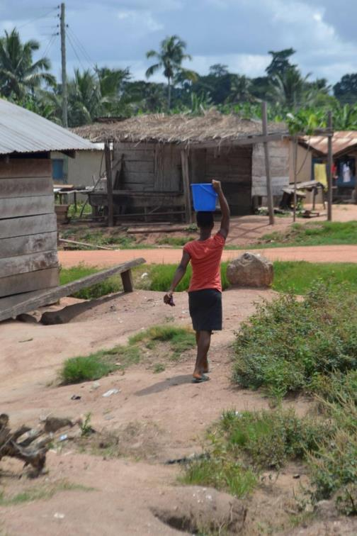
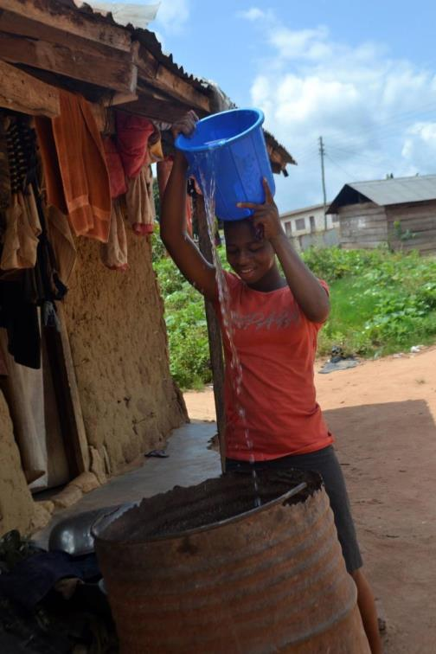
Notes:
“I was carrying water home, and I was pouring water in the barrel.”
The family store water for everyday use in the barrel outside their house.

Slide 9
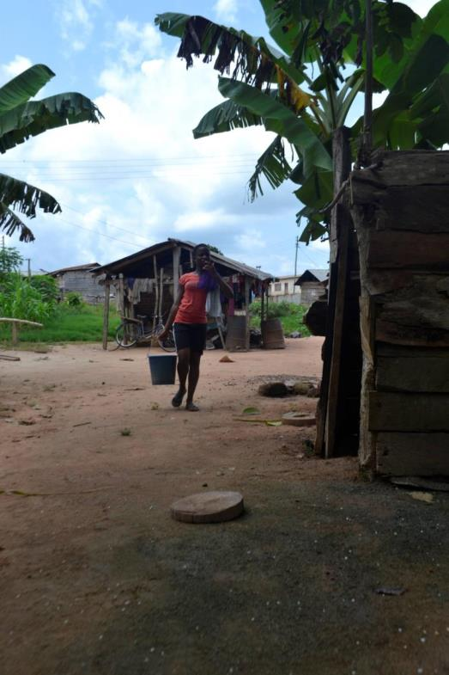
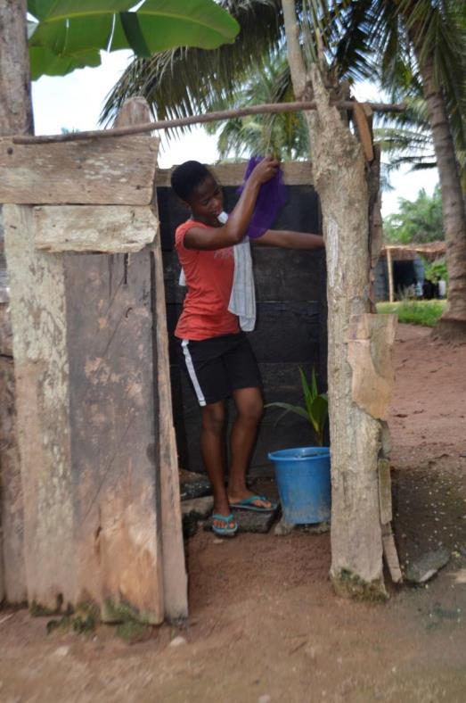
Notes:
“I use some of the water to bathe.”
There is a simple structure near Esther’s house where her family go to wash every morning.

Slide 10
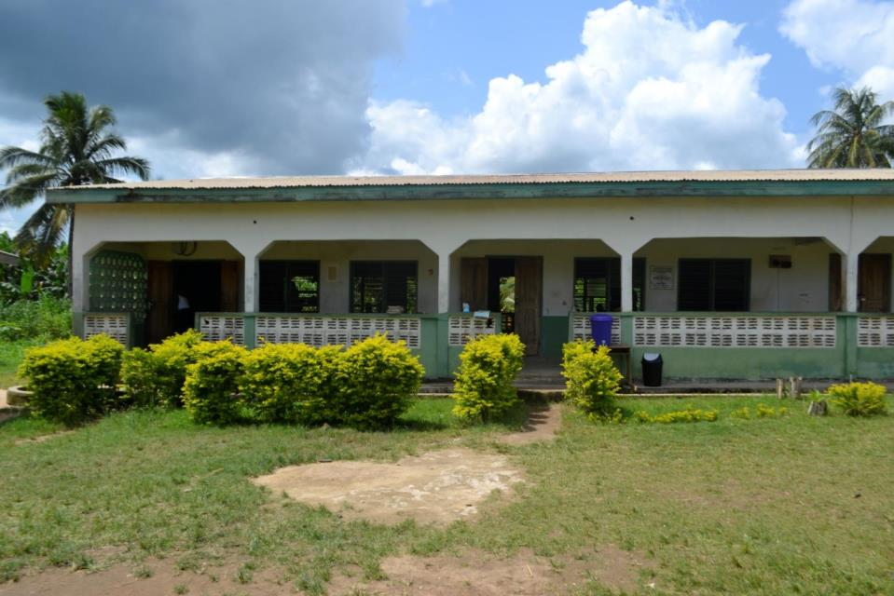
Notes:
“This is my school. The name of my school is Bayerebon No. 3 D/A Basic School.”
D/A stands for District Authority. Basic School means it covers Kindergarten, Primary school and Junior High School, aged 4-15 yrs. Basic Education up to 15 is free and compulsory in Ghana. To attend secondary school, your parents have to pay fees.

Slide 11
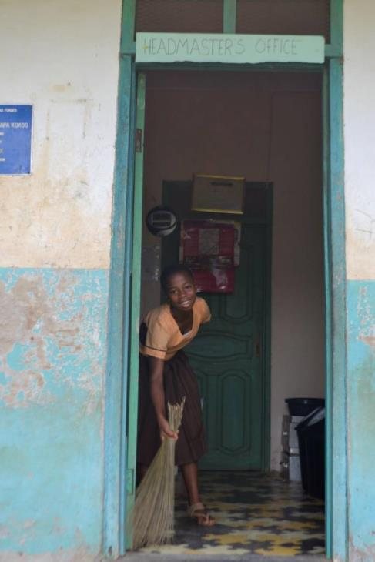
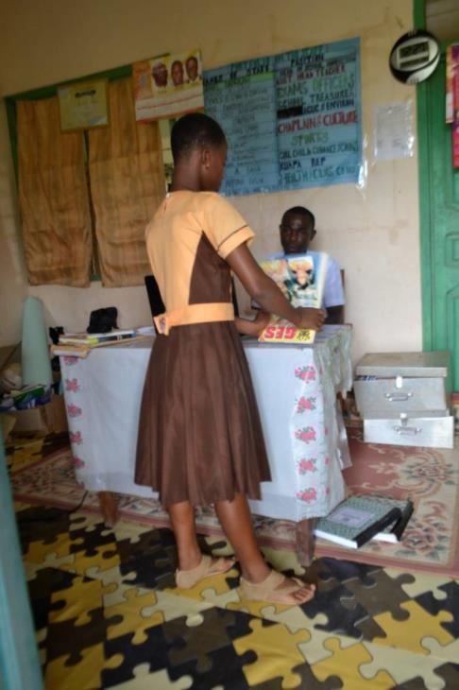
Notes:
“When I go to school, I sweep the headmaster’s office and arrange his books.”
Many of the children have chores to do when they arrive at school before lessons start.

Slide 12
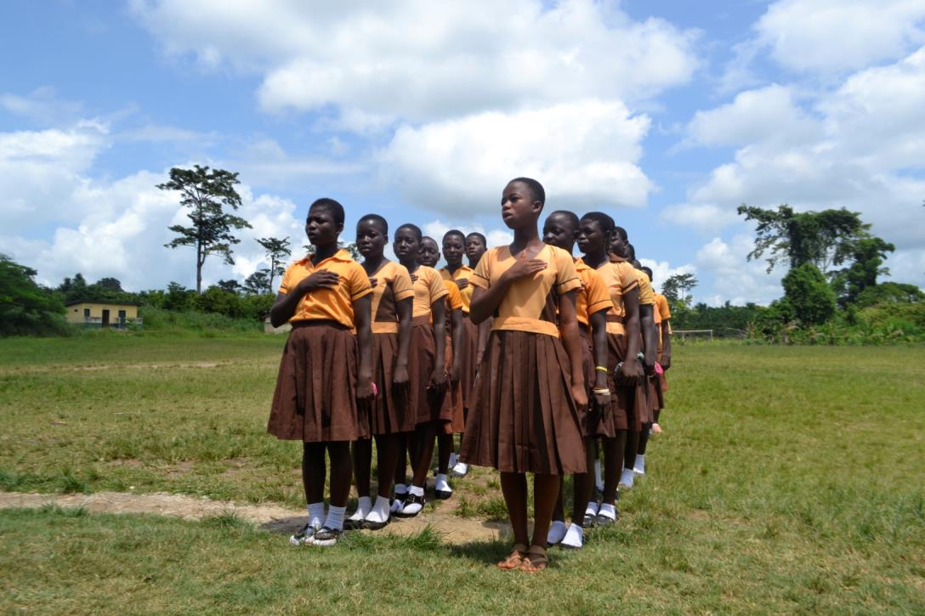
Notes:
“Before we start our lessons, we recite the Ghana National Pledge. I will now recite it for you:
I promise on my honour
to be faithful and loyal to Ghana my motherland.
I pledge myself to the service of Ghana
with all my strength and with all my heart.
I promise to hold in high esteem our heritage,
won for us through the blood and toil of our fathers;
and I pledge myself in all things
to uphold and defend the good name of Ghana.
So help me God.”

Slide 13
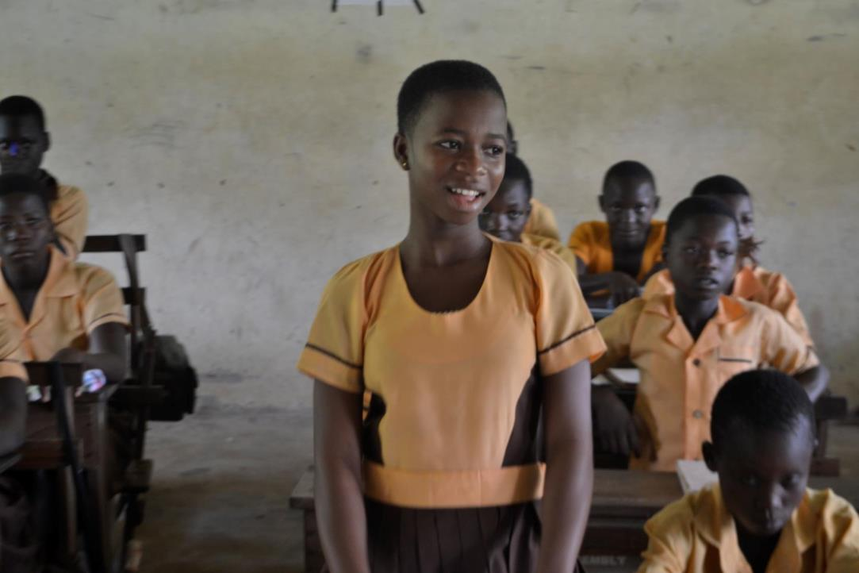
Tom Allen
Trading Visions
www.tradingvisions.org
www.papapaa.org
www.divinechocolate.com
Notes:
“Over here I was answering questions in classroom.”

Slide 14
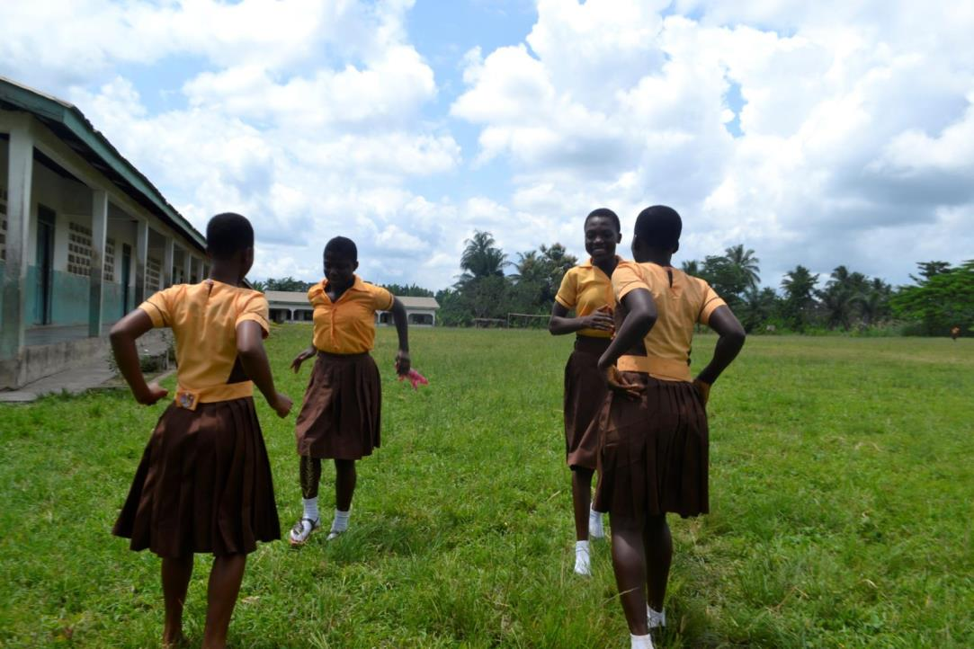
Notes:
“Over here I was playing ampe with my friends. Ampe is a traditional game that we play in Ghana.”

Slide 15
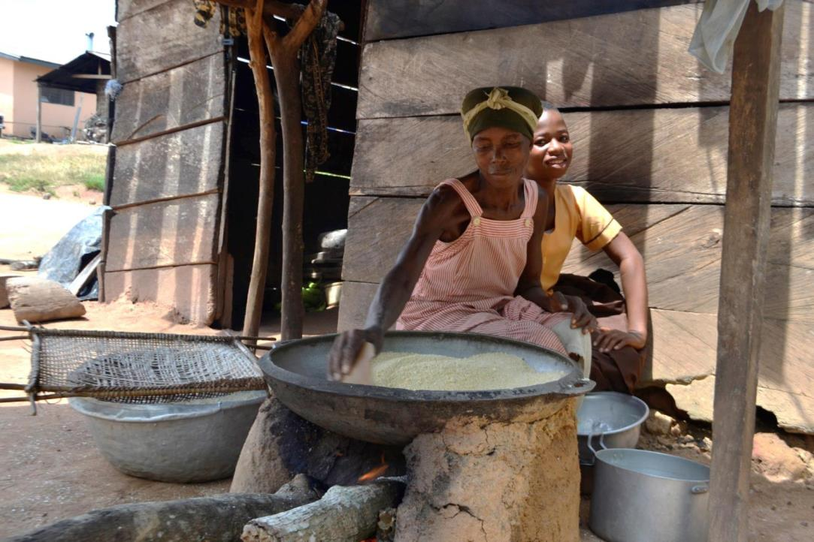
Notes:
“Over here, I was sitting with my mother. My mother is frying gari. Gari is one of the foods we eat in Ghana.”
Gari is a popular staple food across West Africa made from cassava tubers. It can be cooked in many different ways, but you mostly eat it like rice or couscous.

Slide 16
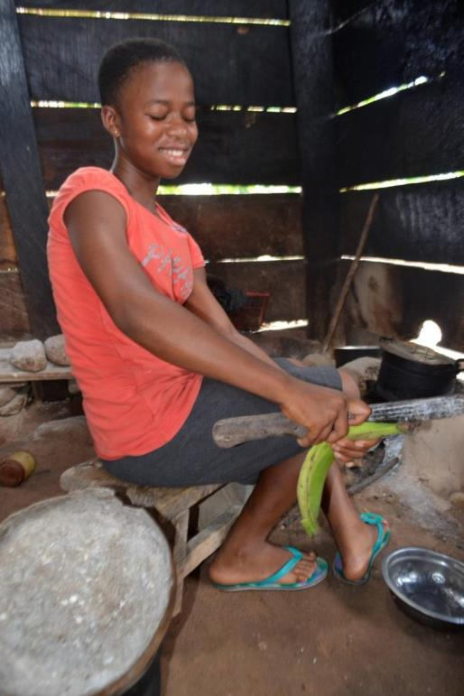
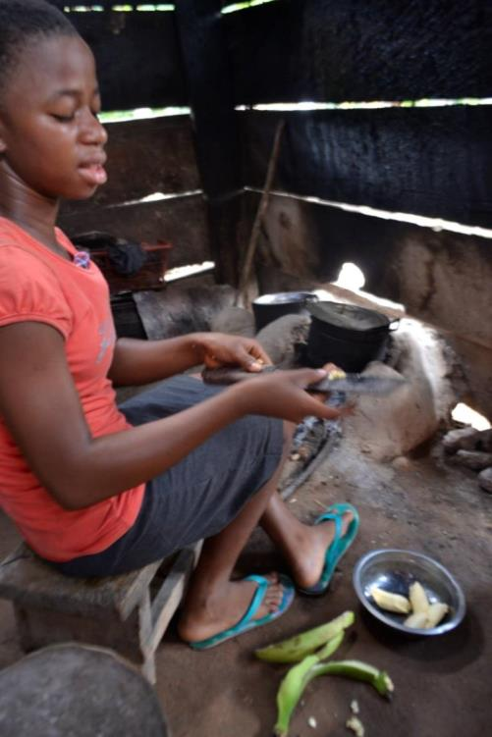
Notes:
“In this picture, I am preparing ampese. Ampese is a dish with plantain.”
Ampese is boiled plantain, or it can be boiled yam, cocoyam or cassava. Ampese is served with some sort of stew or sauce.

Slide 17
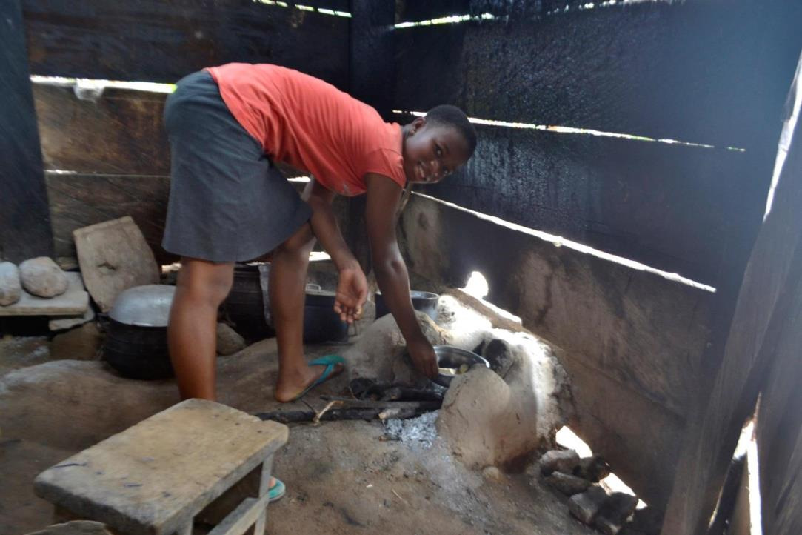
Notes:
“Over here, I was cooking ampese on the fire.”

Slide 18
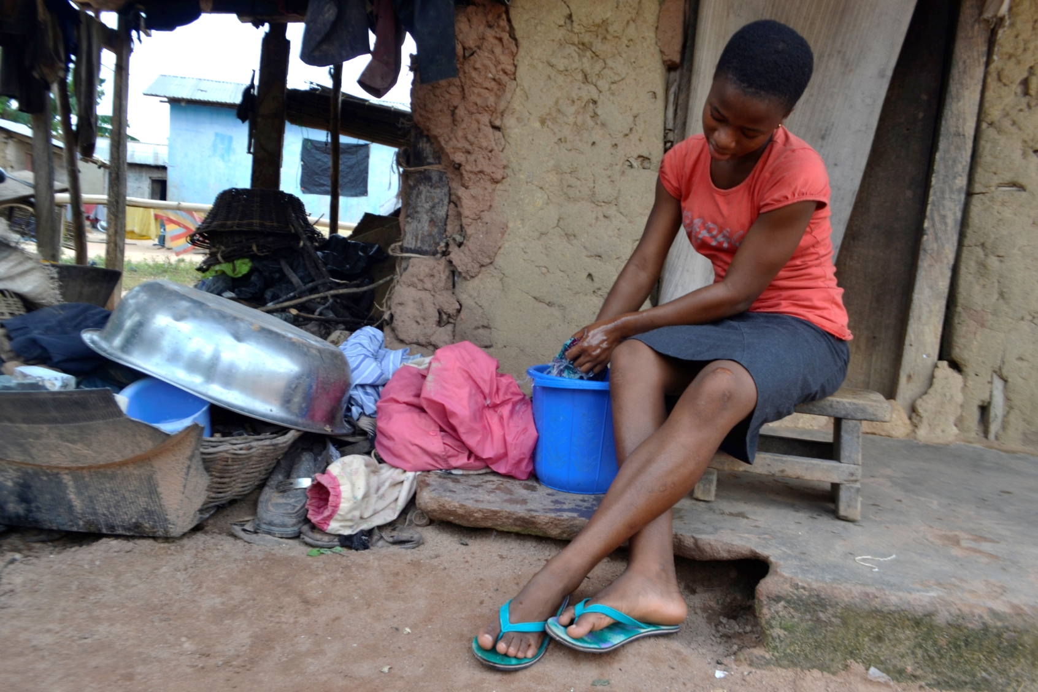
Notes:
“Every Saturday, I wash my dirty clothes.”

Slide 19
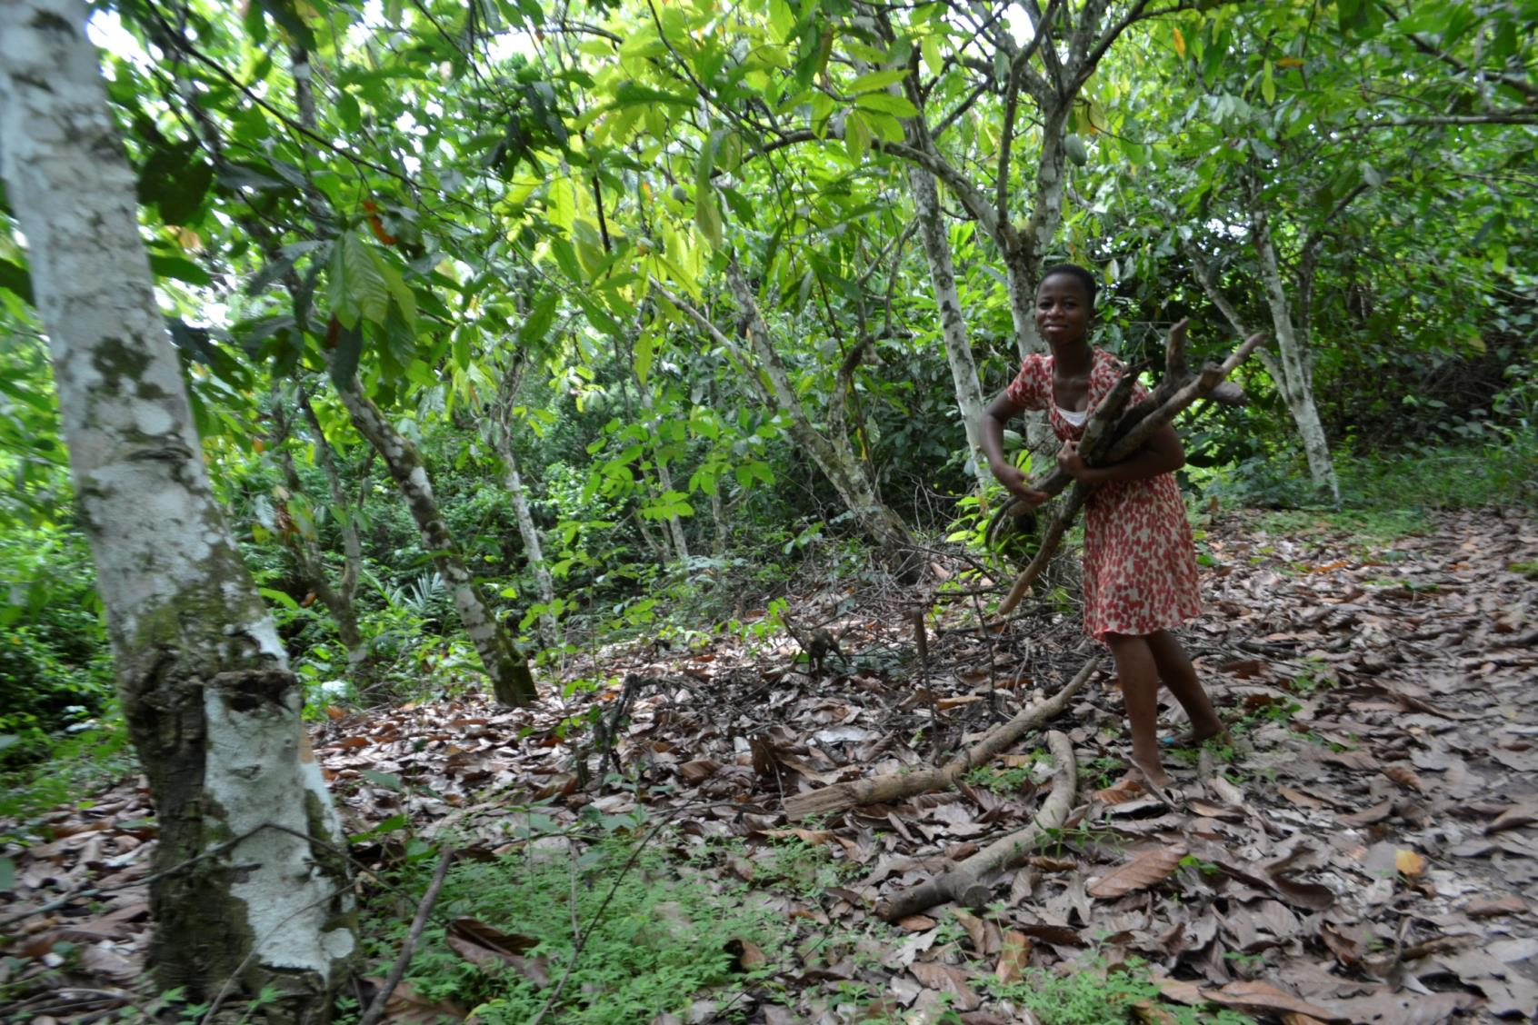
Notes:
“After washing my clothes, then I go to the farm and fetch firewood for my mother.”

Slide 20
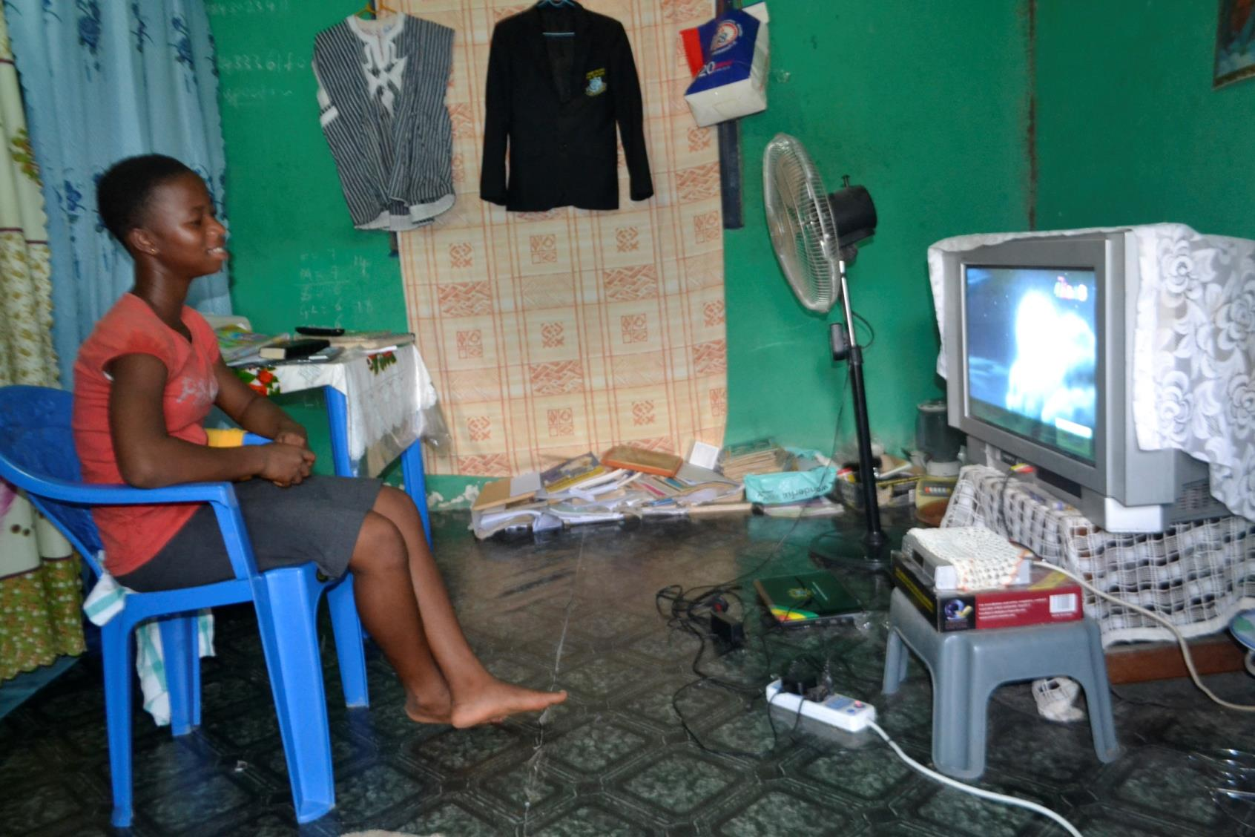
Notes:
“On Saturday afternoon, I often watch Ghana cartoons.”

Slide 21
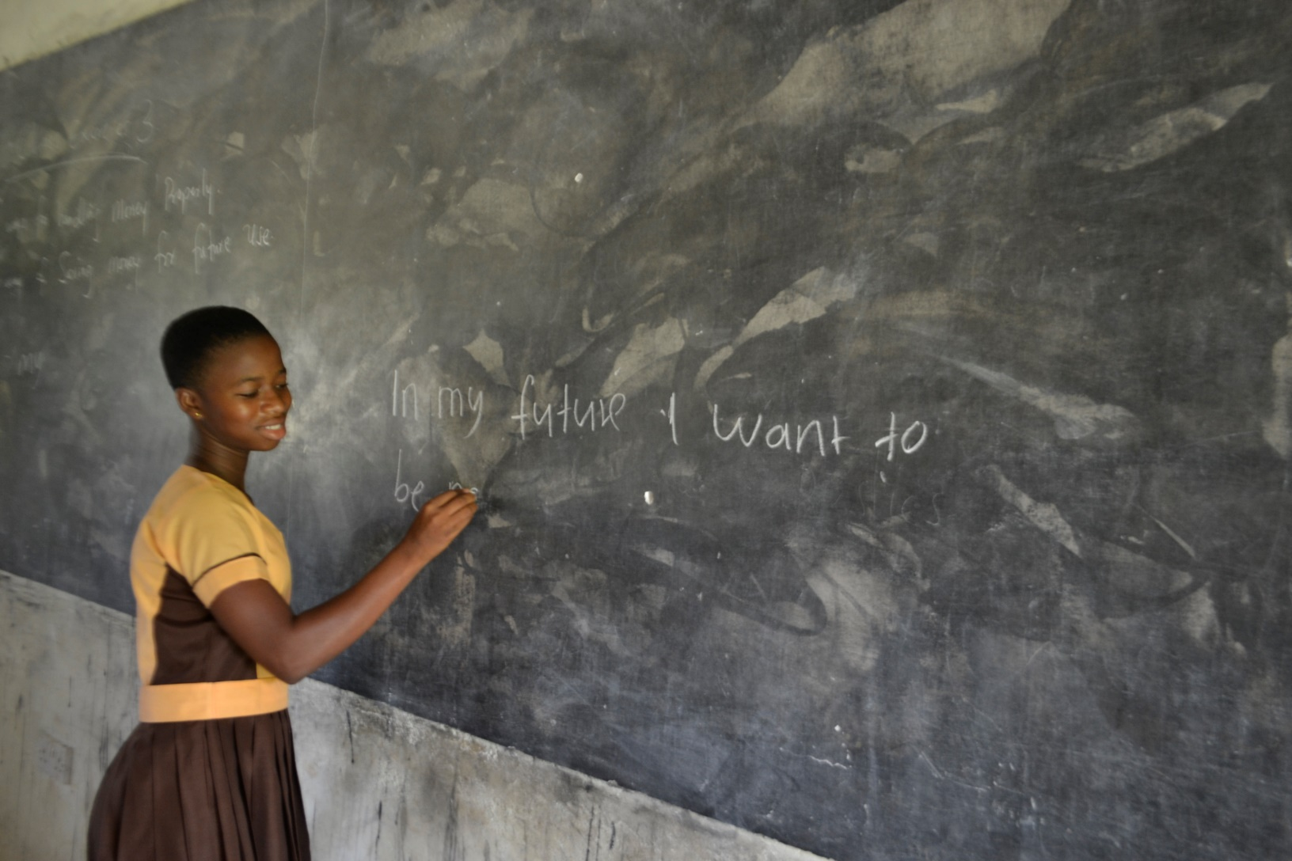
Notes:
“I was writing what I want to be in future. I want to be a doctor in future.”

Slide 22
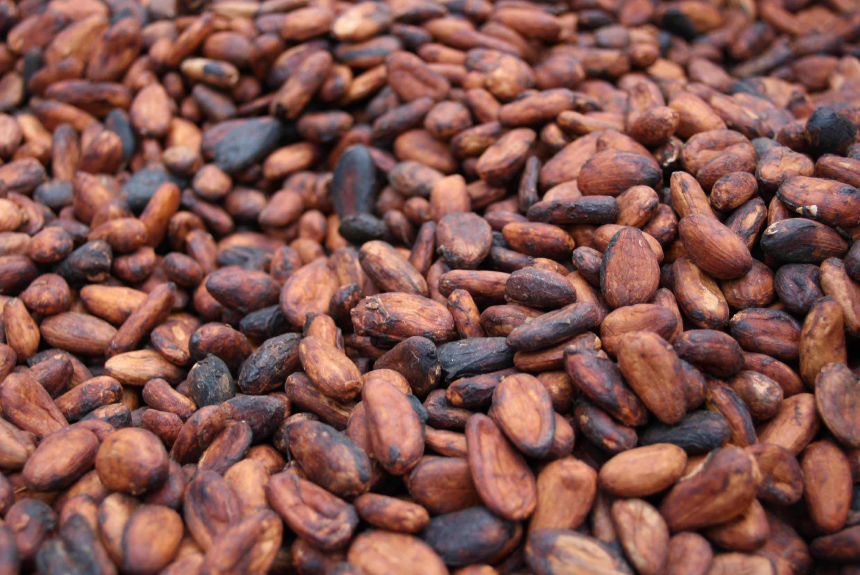
Growing Cocoa
Notes:
“That was about myself. Now, I am going to talk about cocoa growing in Ghana.”

Slide 23
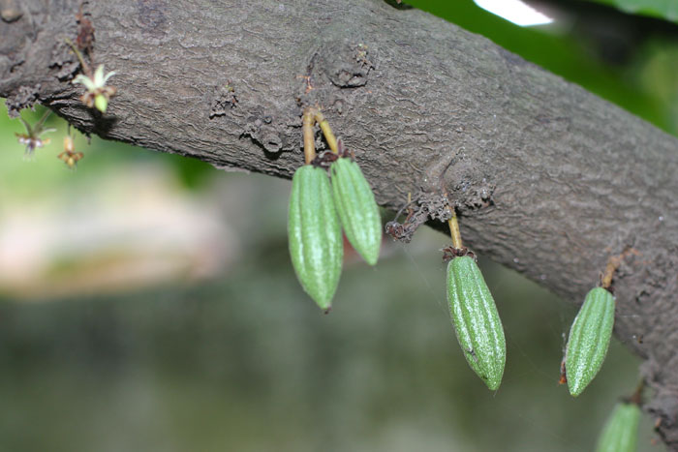
Notes:
“Cocoa is a fruit and it grows on cocoa trees. These are tiny cocoa pods when they first appear on the trees.”
Cocoa trees produce little white and pink flowers, some of which turn into cocoa pods after they are pollinated by midges.

Slide 24
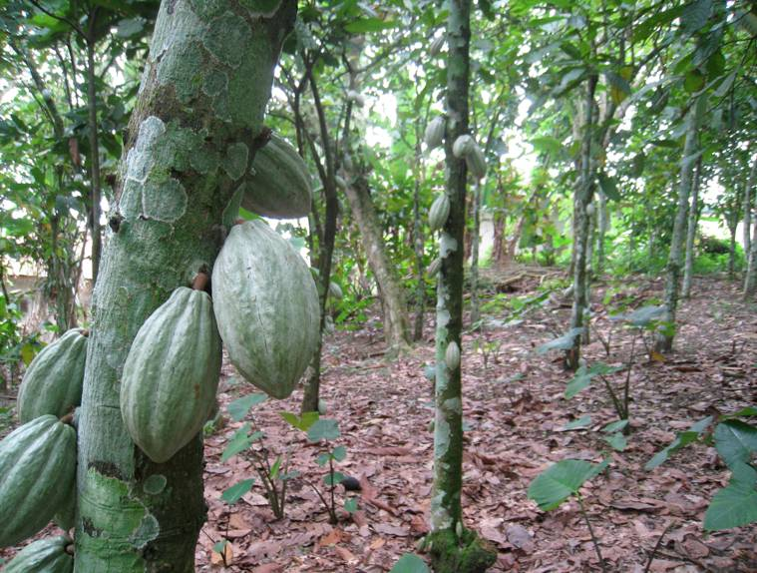
Notes:
“These are pods when they have grown bigger. Cocoa trees can produce between 50 and 80 cocoa pods per year.”
Cocoa trees grow up to five metres tall and they need shade, so farmers plant the seedlings under the rainforest canopy. They also plant other useful tall crops in amongst the cocoa trees, like banana plants and palm nut trees. When the cocoa trees are young, the ground around them needs to be well weeded, as weeds can smother the trees. Three to five years after planting, cocoa trees will begin to fruit, just 10 to 20 pods a year at first but increasing in subsequent years if the tree is well looked after. Notice how the pods grow directly out of the trunk or branches of the tree.

Slide 25
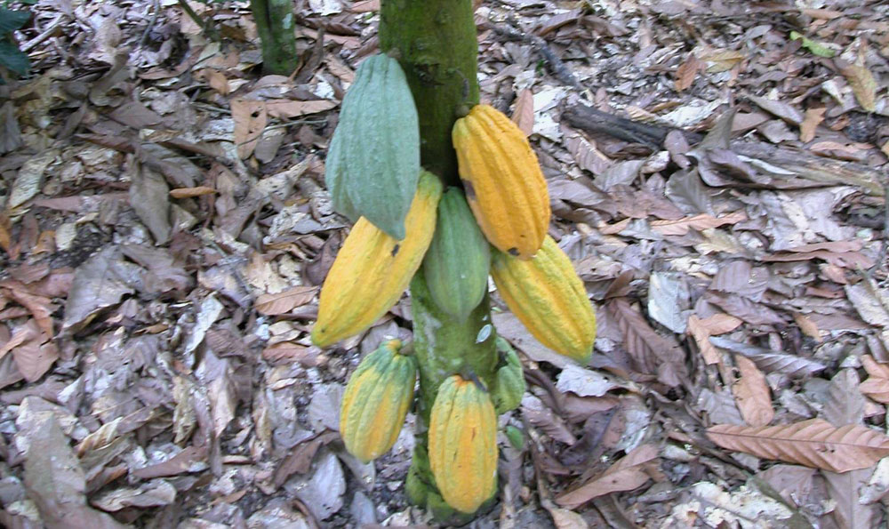
Notes:
“When the cocoa is mature to harvest, it turns to these.”
The cocoa pods grow up to 20cm-30cm in length, and turn yellow when they are ripe. Cocoa beans, the seeds, grow inside the cocoa pods. There are generally about 40 beans in a pod.

Slide 26
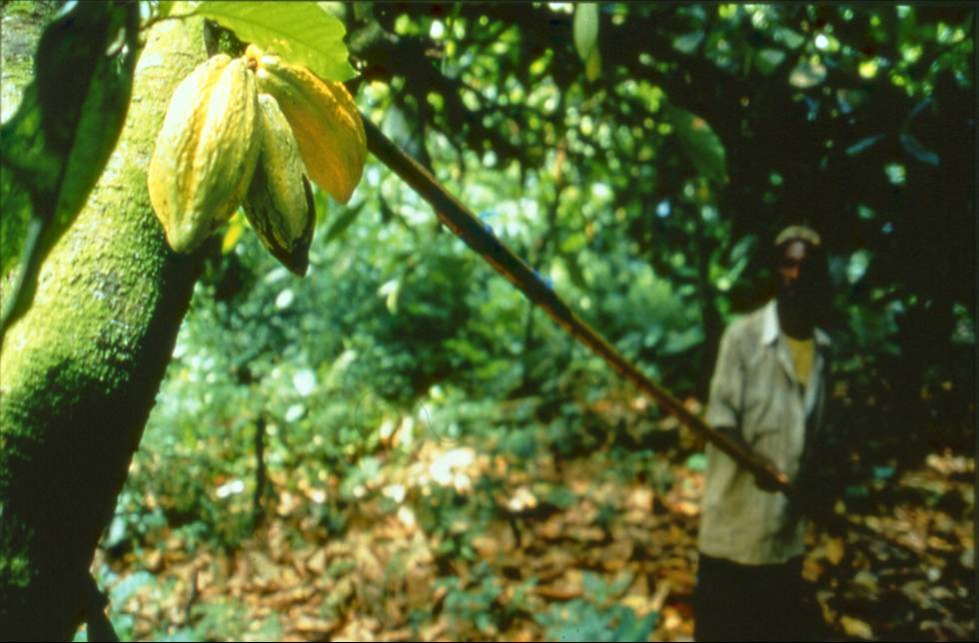
Notes:
“When the pods are ready, the farmers cut them down from the trees. In this picture, a farmer is using a tool with a sharp blade on the end. This is known as a ‘go-to-hell’.”
The cocoa pods are harvested twice a year using a machete or a ‘go-to-hell’, a long stick with a sharp blade on the end. The main harvest is October to February, and there is a smaller one in June/July.

Slide 27
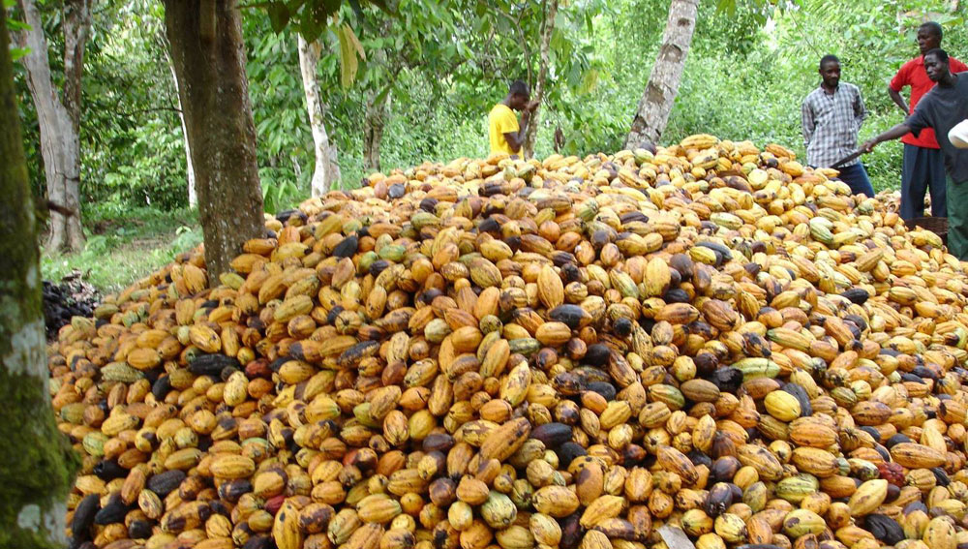
Notes:
“After harvesting their cocoa, they gather each one and use a cutlass to break the pods open.”
Farmers travel to each other’s farms to share the work between them and support each other to get more done, faster.

Slide 28
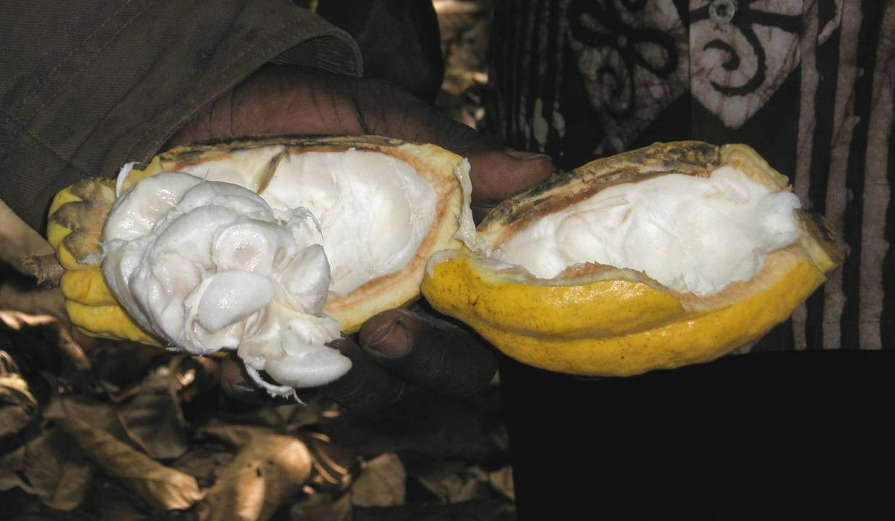
Notes:
“This is the inside of the cocoa pod.”
The cocoa beans are in a gooey white fruit pulp inside the cocoa pod.

Slide 29
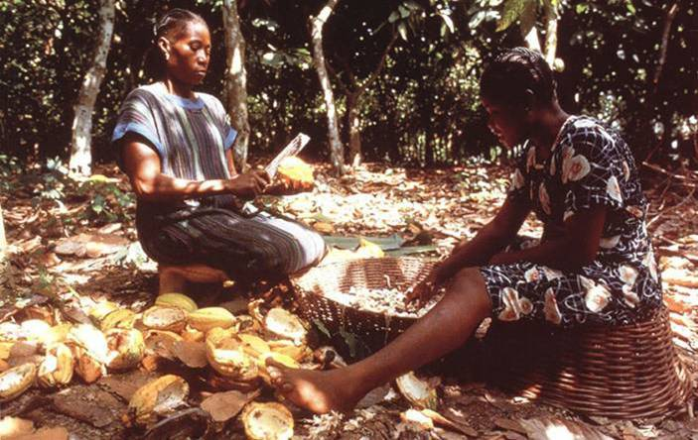
Notes:
“This is two farmers breaking their cocoa pods and removing the beans into the basket.”
This is a farmer and her daughter sitting in a clearing on their cocoa farm. They have cut down the pods from the tree with the machete; now they are splitting the pods and scraping out the sticky white beans. The women have brought a spare basket with them so that they have something to sit on.

Slide 30
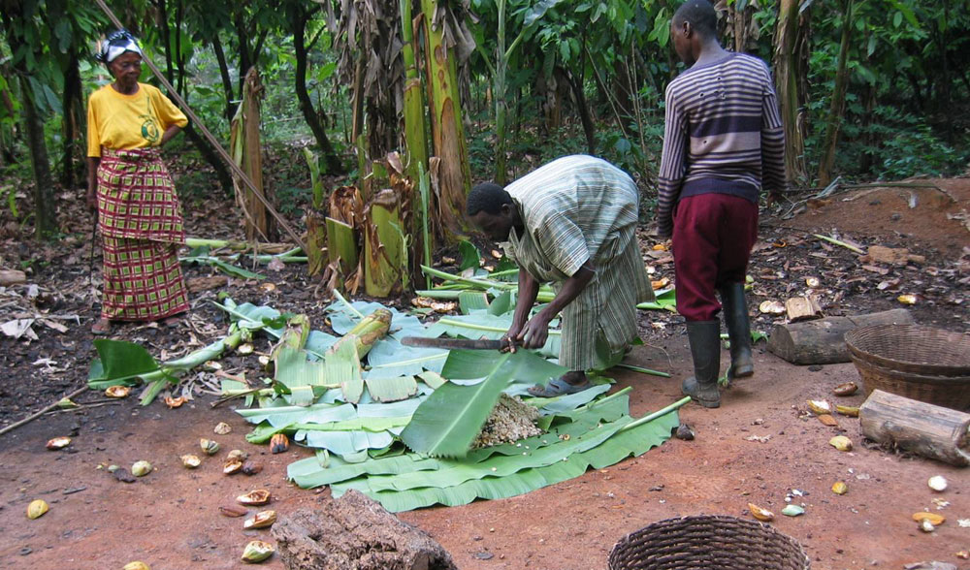
Notes:
“Cocoa farmers often have plants around their farm. They use the long leaves from the plantains to ripen their cocoa beans.”
Having collected the cocoa beans, the farmers tip the beans on to banana leaves, and then wrap the beans up in the leaves. They leave the cocoa beans in a warm, shady place in the rainforest to ferment for about 7 days.

Slide 31
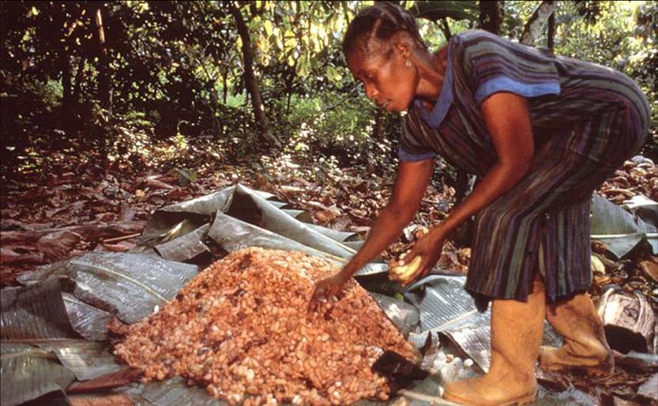
Notes:
“This is fermented cocoa beans.”
They check the beans from time to time. You can see in this picture how the beans are starting to ferment – the sticky goo on the leaves shows the process has begun. Fermentation makes the pile of beans quite hot, and it has a strong yeasty chocolatey smell. Fermentation is what gives chocolate its distinctive chocolatey taste and colour.

Slide 32
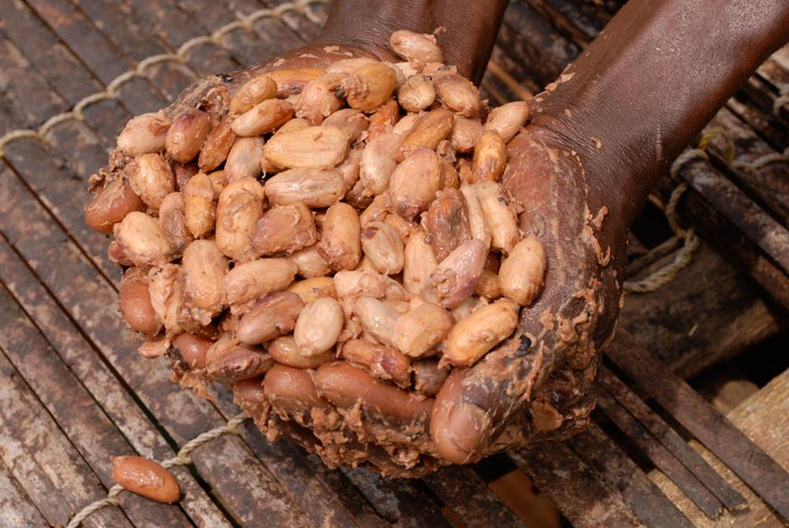
Notes:
“Once the beans have ripened in the plantain leaves, they leave the beans to ferment on the forest for 6 to 7 days.”
After about 7 days of fermentation, the sticky beans are taken back to the village.

Slide 33
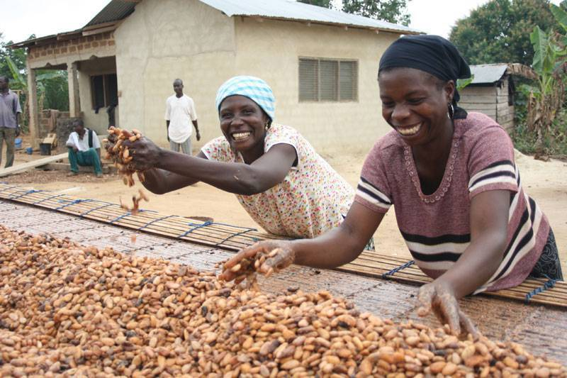
Notes:
“When the cocoa is fermented, they bring it home and dry it on a raffia mat for 6 to 7 days.”
In the village, the beans are laid out in the direct sunlight to dry on special long drying tables made of locally grown bamboo. It takes about 7 days in the hot sun for the cocoa beans to dry completely. Farmers need to turn the beans every few hours to stop them sticking together in clumps, picking out poor quality beans as they go along.

Slide 34
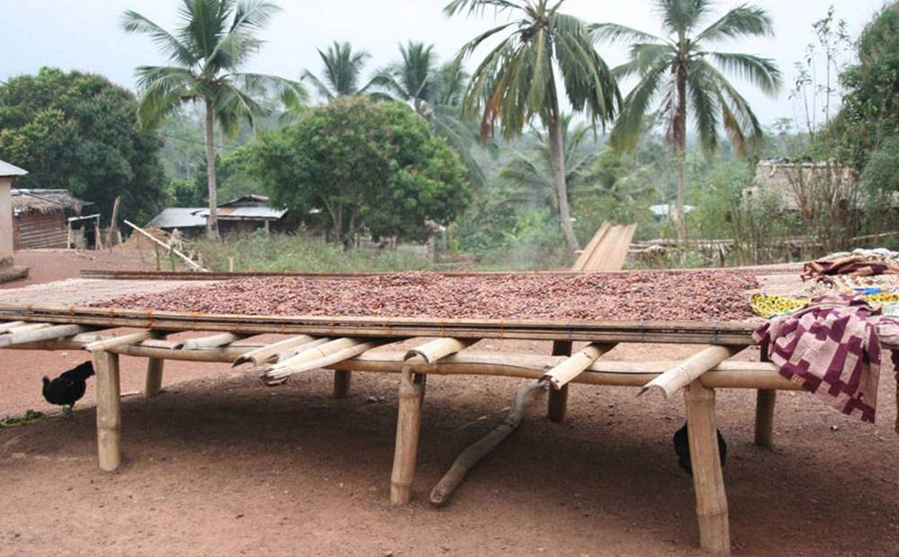
Notes:
“This is dry cocoa. It turns into brown colour.”
After a week, these sun dried cocoa beans are a lovely dark brown colour.

Slide 35
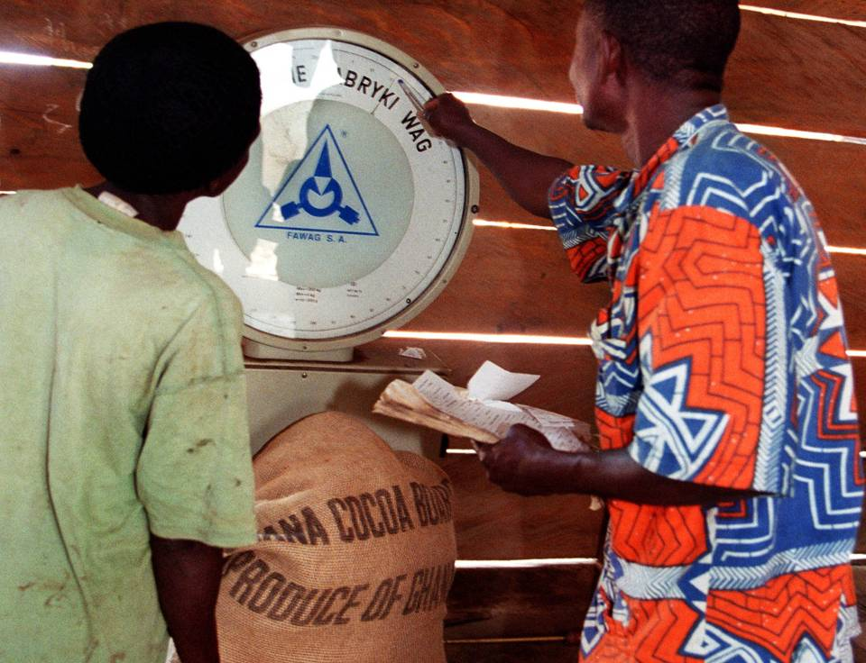
Notes:
“The cocoa beans are ready to sell. In this picture, the farmers have brought a sack of cocoa beans to the Kuapa Kokoo recorder. The recorder is elected by all the farmers to record how much cocoa they sell and to pay them a fair price. My mother sold 9 sacks of cocoa last year.”
Once the beans are dry, farmers pack them into jute sacks and take them to the Kuapa Kokoo recorder. The recorder is elected every four years by the other farmers in the village and is responsible for weighing and paying for the cocoa that local Kuapa Kokoo farmers bring to them. The recorder uses the scales to check that each sack weighs exactly 62.4kg, and pays the farmer half of what they will earn. The other half is paid when the cocoa is accepted by COCOBOD, the government cocoa board. The farmers can inspect the scales at any time to give them confidence that they are not being cheated. Each sack is printed with ‘Ghana Cocoa Board, Produce of Ghana’ and with a unique number that shows the cocoa comes from a specific village.

Slide 36
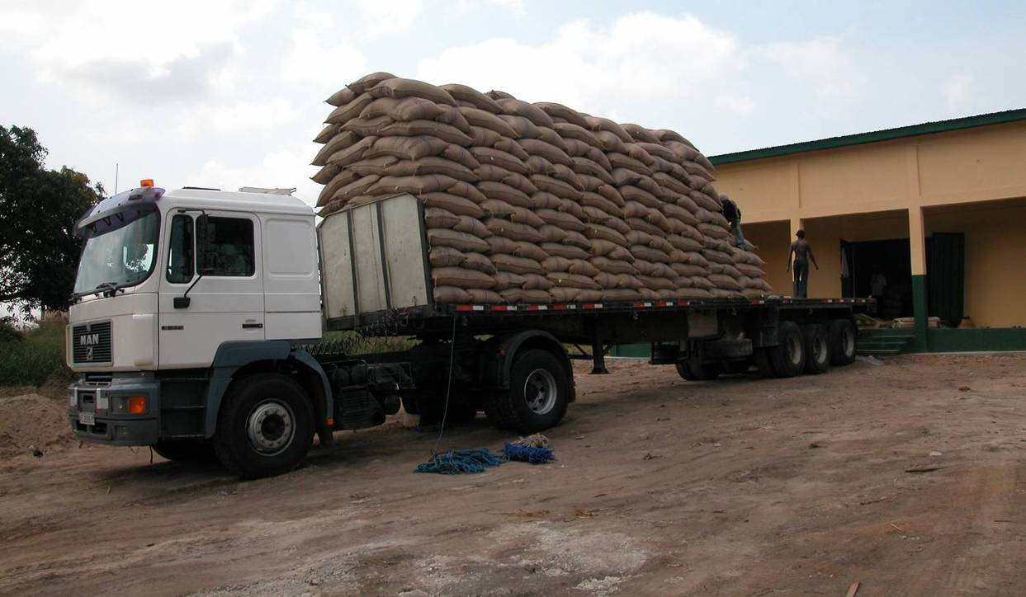
Notes:
“After this, the cocoa sacks are transported on a lorry to Tema, a harbour on the coast of Ghana.”
The sacks are loaded on to a big truck; each truck can carry 180 sacks. The sacks have to be stacked like this to ensure that the weight is evenly balanced, otherwise the truck would tip over on the pot-holed roads. They are taken to the Kuapa Kokoo warehouse, and then to Tema, the port close to Accra, Ghana’s capital city, for export by ship.

Slide 37
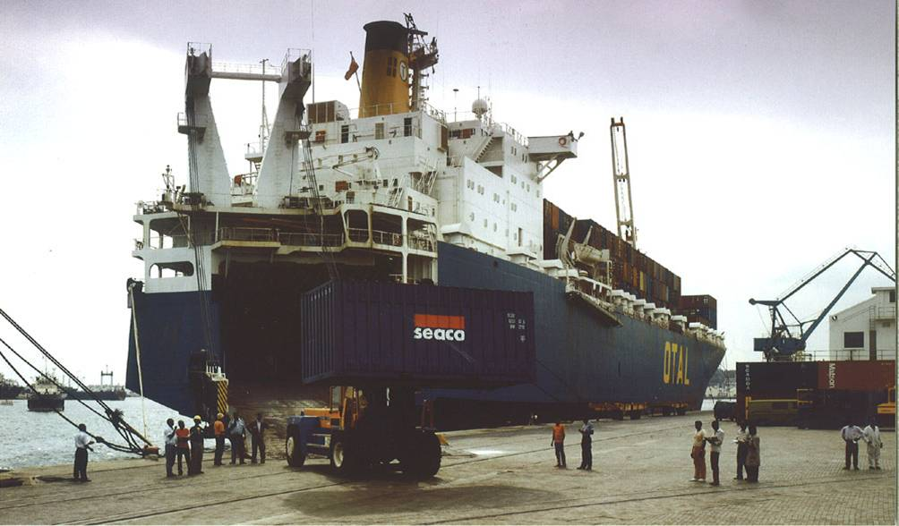
Notes:
“This is a ship taking the cocoa to Europe.”
Tema is the biggest port in the country, and it’s from here that most of Ghana’s cocoa is exported. Containers are loaded on to ships, which carry cocoa to Europe, where it will be used to make chocolate.

Slide 38
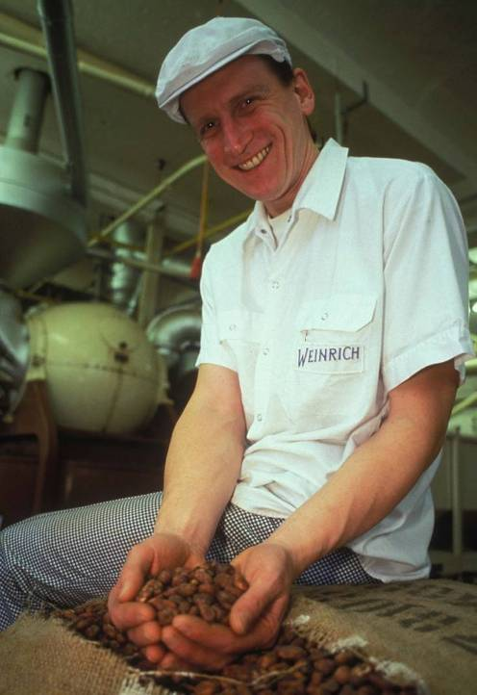
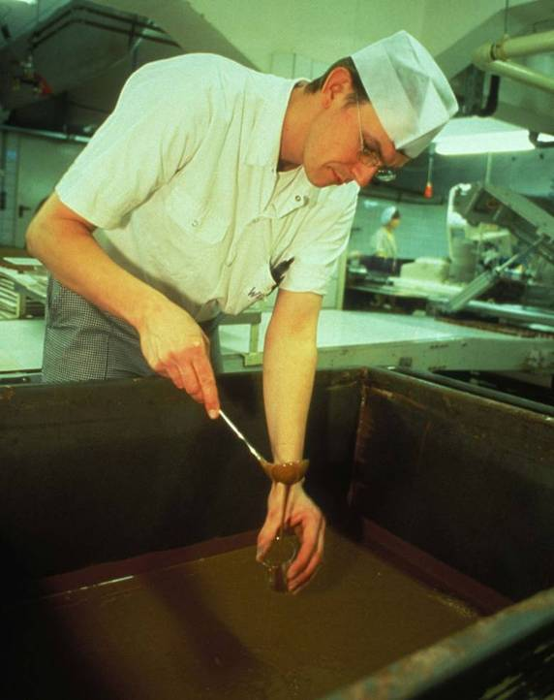
Notes:
“This is the chocolate factory.”
After the cocoa beans arrive at the European port, they are taken by lorry to the chocolate factory. This is Weinrich factory in Germany, which makes Divine chocolate. Here the cocoa beans are roasted and winnowed (to get rid of their shells), and turned into cocoa butter and cocoa liquor. These are then mixed together in a process called conching. Milk, sugar and flavourings are mixed in at this stage to a specific and secret recipe. The liquid chocolate is then tested to make sure the consistency and flavour are right.

Slide 39
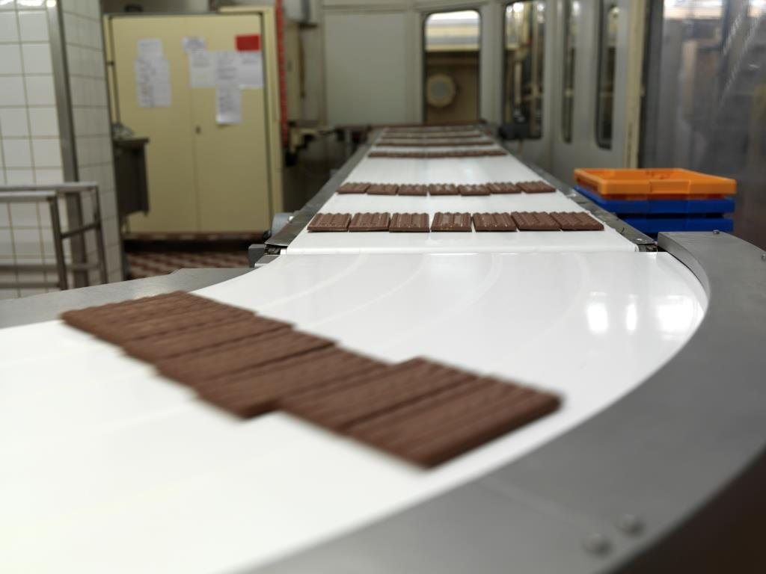
Notes:
“The chocolate is poured into moulds.”
The bars are then formed by pouring liquid chocolate into moulds, and sent down the production line to be wrapped in Divine wrappers. They will then be transported by ship to the UK.

Slide 40
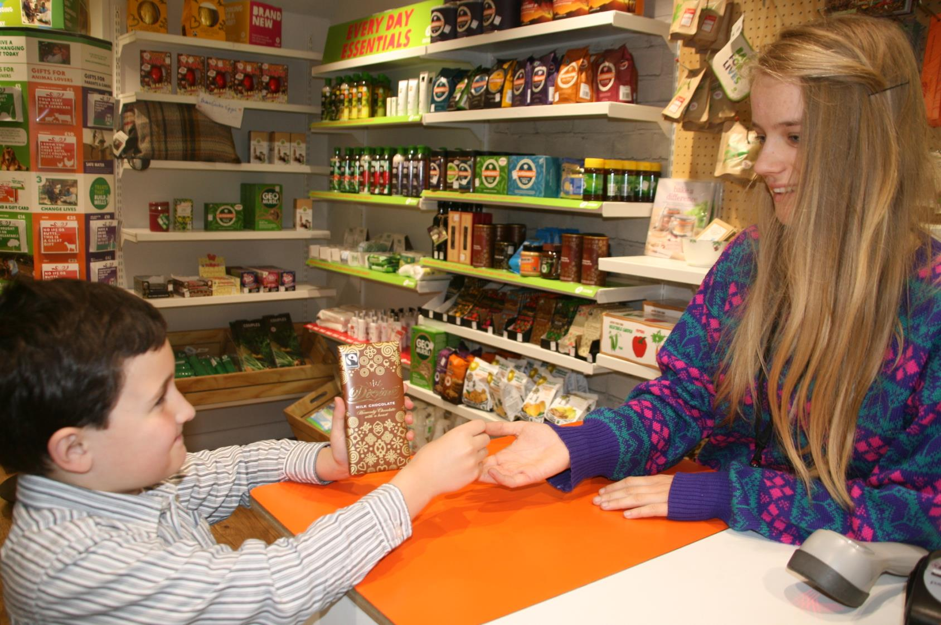
Notes:
“Then it is transported to the shops for you to buy.”
This is the very final stage of the chocolate chain. The final link in the bean to bar story is you, the buyer. The choices you make have an influence all the way back through the chain to its very beginning, the cocoa farmer. Lots of hard work has gone into your chocolate bar. It takes around 30 beans, or one whole cocoa pod, to make a bar of Divine milk chocolate like the one in this picture!

Slide 41
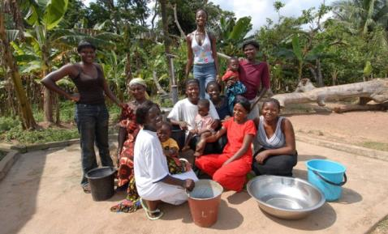
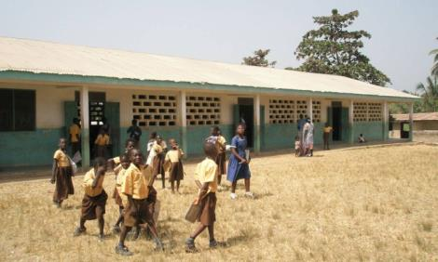
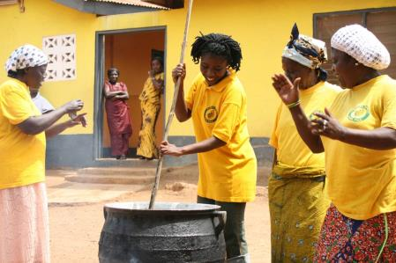
Benefits of Fairtrade
Fairtrade water pumps for clean water in the village
New Schools – This school block was built with Fairtrade premiums.
Alternative income generation projects like soap-making for women’s groups.
Notes:
“For every tonne of cocoa sold, Kuapa Kokoo receives $200 of Fairtrade Premium. The farmers decide together how to spend this Premium.”
When you buy Fairtrade products, the farmer at the other end is helped because he or she earns a fair amount for their crop. Their community also earns a ‘Fairtrade Premium’, an extra amount that they can use to spend on projects which help everyone.
You could spend some time thinking through things that cocoa farming communities might need. What would they spend their Fairtrade premiums on?
Here are some examples of what Kuapa Kokoo have spent Fairtrade premiums on:
Direct payments to farmers in the form of an end-of-year bonus;
Wells and bore holes for drinking water;
Construction of public toilets;
Mobile health clinics to visit villages;
Construction of two day-care centres;
Construction of a block of six classrooms;
Purchase of two mobile cinema vans for a farmers' education programme;
Construction of warehousing to store cocoa at Tema port;
Initiation of alternative income generating activities for the lean seasons in between the cocoa harvests, such as soap making, and snail farming;
A new machete for every farmer in Kuapa Kokoo.

Slide 42

Notes:
“Fairtrade built a water pump for my community.”
Notice that nearly all the people in the picture are women. Women and girls tend to do the work of fetching water. A water pump in the community means that instead of having to walk into the forest to a stream or pond to fetch water every day they have more time and energy for other things. Girls can get to school on time.
Kuapa Kokoo has built hundreds of water pumps in cocoa growing villages. Water from a pump is much cleaner than water from streams and ponds. There is a video on our Pa Pa Paa LIVE website which shows what water from the forest looks like: http://www.papapaalive.org/videos/water

Slide 43

Notes:
“This is a brand new block, that Fairtrade built for my school.”
This is a school block built with Fairtade Premium money. Traditionally school buildings are made of mud. This building of concrete blocks and with a corrugated iron roof is much more robust.

Slide 44

Notes:
“Because cocoa is a seasonal crop, the farmer needs income at other times of the year. Fairtrade trained our mothers on income generating activities, like soap making and tie-dye making.”
Fairtrade funds alternative income generation projects for women’s groups: like soap-making, setting up food selling stalls, clothes selling, and tie-dye batik.

Slide 45
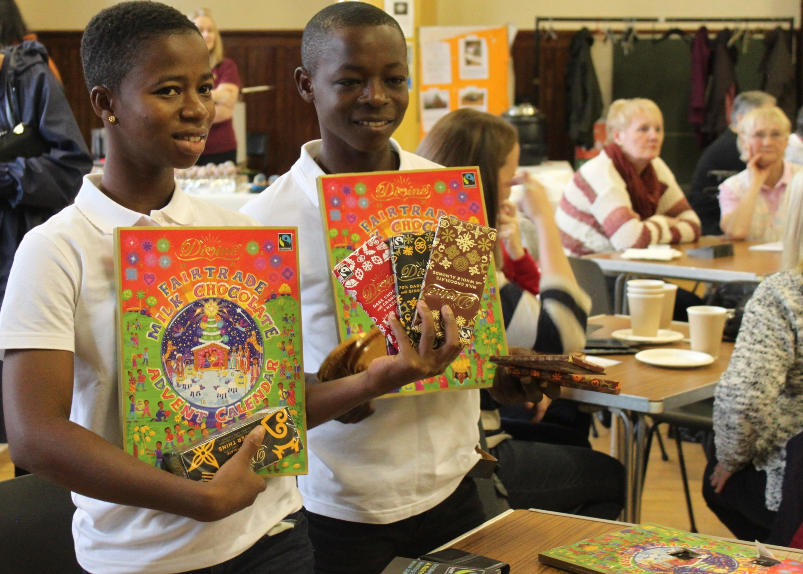

Notes:
“Because of all this, we want you to buy more Divine chocolate. Thank you very much!”
Divine Chocolate is an extra special company. Not only is it 100% Fairtrade, but the cocoa farmers in Ghana actually co-own the company. The farmers own 44% of the shares, and share in the profits.
This is a picture of Esther and Samuel when they visited the UK in 2016. They are at an event organised by Fairtrade campaigners in Paisley.

