Slide 1
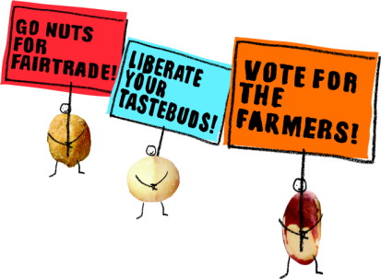
The world’s first and only farmer-owned Fairtrade® nut company
Notes:
When people think of Fairtrade they usually think of bananas or coffee or maybe tea or chocolate… but over the past few years a new Fairtrade market has emerged – for nuts. People are literally going NUTS for Fairtrade!
At the centre of this is a new company which is completely focused on the farmers and gatherers who produce the nuts and marketing their produce into nutritious and tasty products for European consumers. Us.

Slide 2
What is a social enterprise?
A social enterprise is a business.
Social enterprises use the power of business to bring about social change.
A social enterprise will typically have identified a specific social and/or environmental problem and it’s primary mission will be to address that problem, not simply to make a profit.
Profits are re-invested in the enterprise or community which the social enterprise serves.
Notes:
In the UK there is support across all main political parties for social enterprises and the social enterprise sector is growing rapidly. But what is a social enterprise?
Well first of all, a social enterprise is a business like any other; but their owners have chosen to do business differently.
Businesses, or companies, are legal entities designed to provide products or services to consumers. Most are privately owned and exist to make money for their owners. They provide products and services that meet the needs of consumers, and they may spend a great deal of money on marketing to make sure that consumers know they need a product! But ultimately, if consumers do not want what they have to sell then a company will go out of business.
Social enterprises operate along the same lines as a normal business but with one distinct difference: most of their profits are put towards a social or environmental mission. Their primary goal is not just to make a profit, though that is important.
Or another way of putting it is that the people who set up the business have recognised that there is a problem that needs to be solved and that business methods can be part of the solution.
A social enterprise is often partly or wholly owned by the community which it aims to help. Profits are usually ploughed back into the social enterprise, thereby helping this community.
2

Slide 3
Why learn about Liberation?
Liberation Foods CIC is an excellent example of a social enterprise.
  There is a clear social problem which Liberation seeks to address.
  Ownership of the social enterprise is shared by the communities it seeks to serve.
  The business operation of Liberation is tangible as the company has a range of products on sale in major supermarkets.
  There are inspiring examples of how the profits have been re-invested to help the communities which Liberation serves.
Notes:
Many social enterprises in the UK are relatively small and local, serving a specific community. However, social enterprises can come in all shapes and sizes.
Liberation Foods CIC is an excellent example of a social enterprise because the problem it seeks to solve is clearly identified, the business operation can be easily understood, and the benefits deriving from the enterprise are explicit.
As the products which it sells are widely available and some are promoted by a well known celebrity, it makes for a very accessible case study about social enterprise.
3

Slide 4

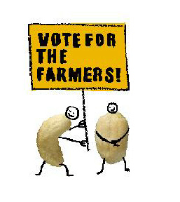
What is Liberation?
Liberation Foods CIC is a Fairtrade nut company owned by the co-operatives who grow and gather the nuts.
Its mission is to strengthen and empower smallholder farmers in the global south by creating direct market access via an innovative business.
Liberation supplies 85% of the UK’s Fairtrade nuts under its own brand name and to supermarkets for ‘own-label’ products.
Notes:
Liberation’s full legal name is Liberation Foods CIC. It is a Fairtrade nut company owned by the producer organisations or co-operatives who grow and gather the nuts.
Liberation Foods and the organisations which founded it have helped to establish supply chains in Brazil nuts, peanuts and cashews. Liberation supplies them to most of the major supermarkets and other outlets. The company accounts for 85% of the UK’s Fairtrade nuts. These are not only sold through its own Liberation brand, but through supermarket own label products and through other companies who use them for products like peanut butter or snack bars.
The nut producers are smallholder farmers or gatherers, working hard to provide a future for their families and communities. Their farming organisations are shareholders in Liberation Foods CIC.

Slide 5
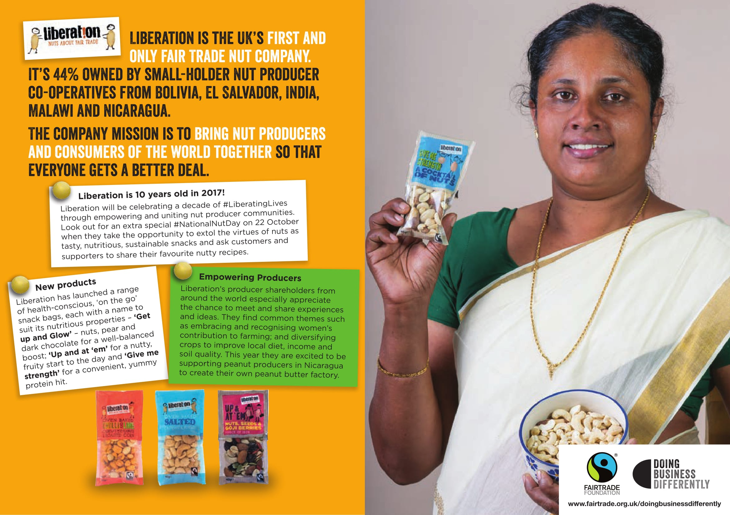
Notes:
Liberation is part of a group of Fairtrade social enterprises ‘doing business differently’.
Liberation is the UK’s first and only Fair Trade nut company, founded in 2007. It’s 44% owned by small-holder nut producer co-operatives from Bolivia, El Salvador, India, Malawi and Nicaragua. The company mission is to bring nut producers and consumers of the world together so that everyone gets a better deal.

Slide 6
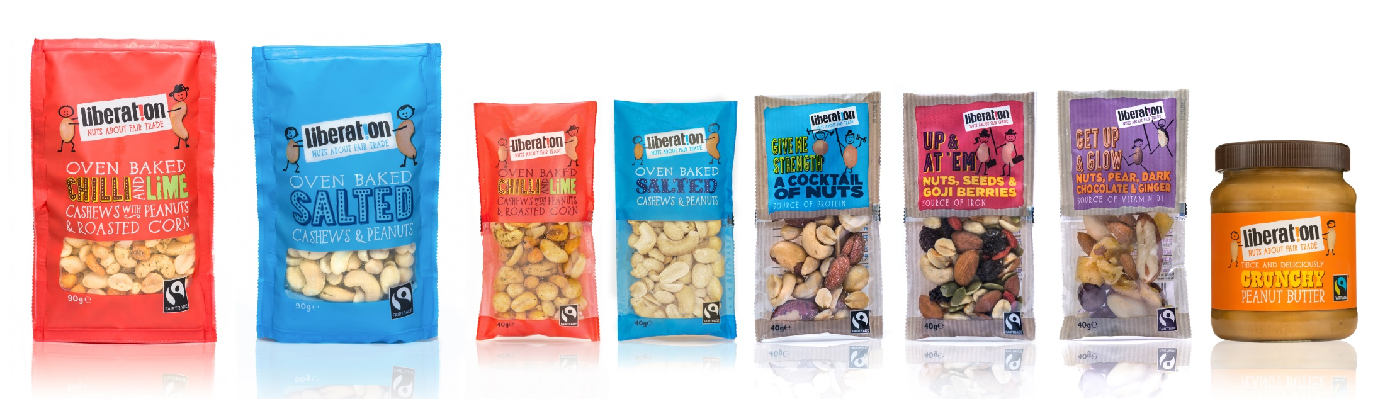
Liberation branded products
Look out for them!
Notes:
The company’s own branded products are called ‘Liberation’. They can be bought at Waitrose, Oxfam and from fair trade shops and stalls via Traidcraft – a fair trade company which supplies products to many outlets.
6

Slide 7
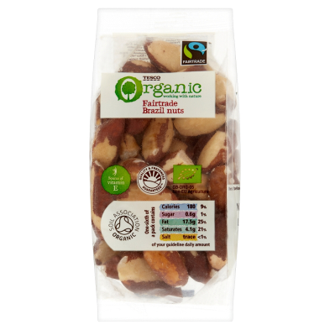
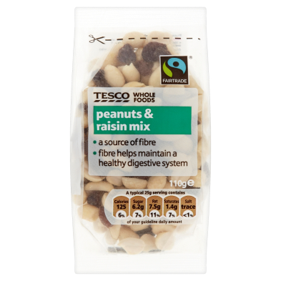
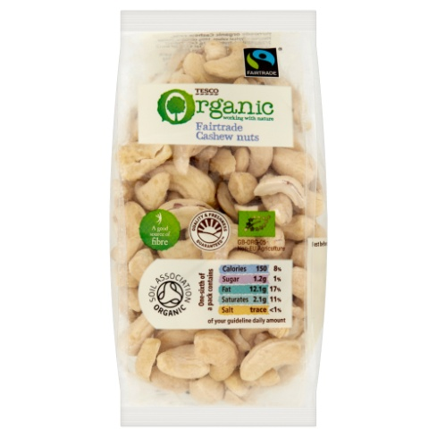
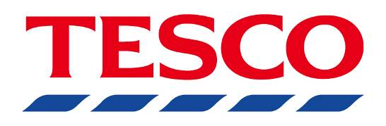

Supermarket own label
Notes:
Liberation supplies all of the ‘own label’ Fairtrade nut range for Tesco and Sainsbury’s. All the products produced by Liberation carry the Fairtrade Mark.
7

Slide 8
8
Origins and company structure

Slide 9
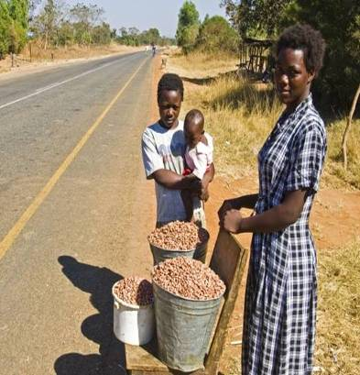
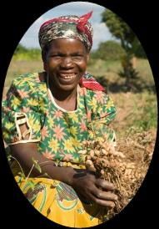
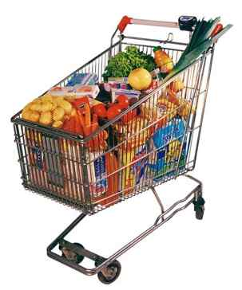
Problems faced by nut farmers
Nut farmers often live in remote, rural areas in developing countries.
Local selling at the roadside
Getting their produce to market can be difficult.
They don’t earn enough money to be able to invest in the future of their produce.
They struggle to keep up with trends in the market such as quality standards imposed by developed countries, consumer preferences and new farming techniques.
International markets
Nut farmers
Some farmers, such as peanut farmers, have to compete with subsidised US farmers.
Notes:
A social enterprise usually exists to solve a specific social or environmental problem.
This slide explains some of the problems faced by nut farmers. What the people who set up Liberation recognised was that the problems experienced by smallholder nut farmers were similar whether they were Brazil nut gatherers in South America, peanut farmers in Africa or cashew farmers in Asia. This meant that a single business model could be used to help all of them.
What all the farmers needed was investment to improve the quality of their nut production and improve the reliability of their supply chains.
The solution was to create a vertically integrated company, i.e. a business that is engaged in every aspect of production along the supply chain, from producing raw materials, to manufacturing, transportation, marketing and dealing with retailers.
9

Slide 10
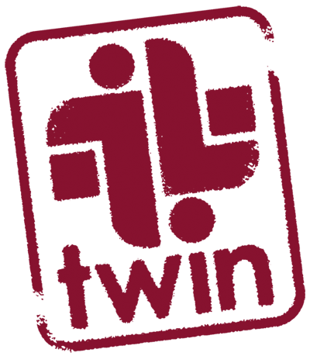

Origins of Liberation
Two pioneering organisations saw an opportunity to help small scale nut farmers on the other side of the world by creating a single company to market Fairtrade nuts in Europe.
Twin and Equal Exchange UK set up Liberation Foods as a social enterprise and developed a business plan with the nut producers who were to become joint owners of the project.
Notes:
So a company was created to market Fairtrade nuts in Europe – Liberation Foods CIC.
The business was set up by two pioneering organisations called Twin and Equal Exchange. Twin and Equal Exchange have been working with small scale farmers in developing countries for years, using trade to improve livelihoods in producer communities. They were also behind the creation of two other innovative Fairtrade social enterprises – Divine Chocolate and Cafédirect.
Their work with nut farmers and gatherers on different continents helped them to realise that there were common problems and helped them identify a common solution.
They set up Liberation Foods as a social enterprise which would improve the livelihoods of nut producers in poorer countries. They developed a business plan for Liberation, with the nut farmers and gatherers who were to become joint owners of the project.
Farmer empowerment was the ultimate driver behind Liberation. Ethical responsibility is not an add-on but is at the heart of what the company does. Its founders aimed to create an alternative business model that delivers benefits along the supply chain to all stakeholders.
10

Slide 11

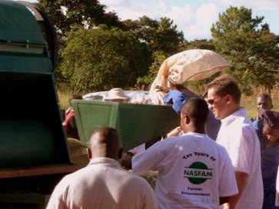
Improving access to markets
I can sell my nuts by the side of the road…
Or I can sell them in Sainsbury’s!
Notes:
This slide captures the vision for Liberation. Without access to markets and without quality control processes, small scale farmers often have no option but to sell their crops locally. The top picture shows a woman selling her peanuts at the roadside – literally for peanuts.
With better access to markets and reliable supply chains, the same farmers can have access to international markets. The lower photo shows Justin King, CEO of Sainsbury’s, visiting the Fairtrade peanut farming group in Mchinji, Malawi. He is examining peanut processing equipment that was paid for by the Sainsbury’s Fair Development Fund to help farmers spend more of their time farming and less doing the repetitive and painful work of shelling peanuts. Shelling peanuts by hand leads to blistering on their fingers but they have to carry on working through the pain – it is surprisingly hard and laborious work.
11

Slide 12
Company structure
Liberation was set up in the UK in 2007 as a Community Interest Company (CIC).
A CIC must be run 100% for the benefit of its ‘Community of Interest’.
For Liberation Foods CIC, the community of interest is smallholder nut farmers and gatherers in developing countries.
Like any other business, CICs aim to make a profit.
Unlike ordinary businesses the profits go to the community the company has been set up to benefit.
Notes:
Liberation was set up as a Community Interest Company (CIC). Not every social enterprise is a CIC but many are.
A CIC must define its ‘Community of Interest’ and be run 100% for its benefit. For Liberation Foods CIC, the community of interest is smallholder nut farmers and gatherers in developing countries.
Like any other business, CICs aim to make a profit. Unlike a conventional business, the profits go to the community the company has been set up to benefit.
12

Slide 13
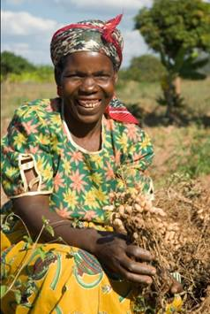
Company ownership
Nut farmer groups from eight countries, and representing more than 35,000 people, own 44% of Liberation.
Their shareholding was paid for by The Hunter Foundation, Comic Relief and Twin.
The rest of the shares are owned by Twin, Equal Exchange, Equal Exchange USA and other ethical investors, including individuals.
Notes:
In order to ensure that the nut farmers that Liberation was set up to help really have a say in how the business is run, the farmers themselves own a large part of the company – in fact the biggest shareholding.
To ensure the widest possible representation by nut farmers, rather than having nut farmers as individual shareholders, instead the associations which the nut farmers belong to are the shareholders and have formed into a co-operative, the International Nut Co-operative (INC). More than 35,000 nut farmers from 5 countries are part of the INC which owns 44% of Liberation.
13

Slide 14
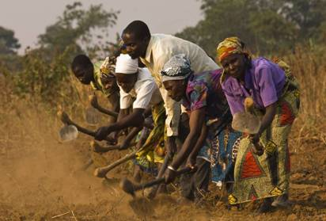
The importance of ownership
As shareholders the farmers have a say in decision making.
When a profit dividend is paid they will receive their share.
The farmer groups are also members of the International Nut Co-operative (INC), and the INC is represented on the Board of Liberation.
Notes:
Being owners of the company means that they have a say in how the company is run and what happens to the profits. Rather than simply sell their nuts, they now have an interest in the whole supply chain, from nut production, to where the nuts are sold, and how they are marketed in Europe.
All the nut farmers groups are also members of the International Nut Co-operative (INC) and the INC is represented on the Board of Liberation.
The INC was in part paid for by Comic Relief. Most people know that Comic Relief gives money to help people in the UK and in Africa. One of the ways they have helped has been to support people wanting to trade their way out of poverty and this includes the nut producers who co-own Liberation.
14

Slide 15
15
The business plan

Slide 16
Liberation’s objectives
To increase incomes for nut farmers.
To create sustainable supply chains.
To improve the quality and consistency of nuts so the farmers improve their business reputation and sell more.
To provide access to local and international markets.
To create a way of doing business which helps nut farmers see nut farming as a long-term opportunity.
To help rural farmers build networks for support and to increase their power in the market.
Notes:
Marketing and selling nuts in Europe is a very commercial business so it is vital that Liberation has a clear and sound business plan.
The starting point for a good business plan is knowing exactly what you are in business for and being able to state it clearly.
This list describes the objectives of Liberation Foods.
- To increase incomes for nut farmers.
- To create sustainable supply chains.
- To improve the quality and consistency of nuts so the farmers improve their business reputation and sell more.
- To provide access to local and international markets.
- To create a way of doing business which helps nut farmers see nut farming as a long-term opportunity.
- To help rural farmers build networks for support and to increase their power in the market.
16

Slide 17
Creating a virtuous circle
Liberation buys nuts from INC
Farmers improve quality of nuts
Markets and sells Fairtrade nuts in UK & Europe
Increased interest in farming nuts
Consumerhas more choice
Farmers increase incomes
Farmers have access to new markets
Notes:
The business model aims to create a ‘virtuous circle’ as shown on the slide.
Liberation buys the nuts from the farmers.
Liberation then markets and sells them in Europe.
This gives the consumer an ethical choice when it comes to buying nuts – the packs of nuts carry the FAIRTRADE Mark.
It also means the farmers have direct access to European markets which might not have been possible otherwise.
With access to new markets, and with suitable marketing, the farmers can sell their nuts for more and improve their incomes.
With better incomes from nut farming, it becomes a more viable option for smallholder farmers and nut gatherers in these countries.
When nut farming provides a more reliable income for farmers they are more interested in investing in their future which means they can improve the quality of what they produce.
And the better the quality of the nuts and the better the marketing, then the more nuts Liberation is able to buy from the farmers.
17

Slide 18
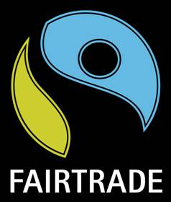
Why Fairtrade?
Fairtrade guarantees farmers a fair price.
Farmers receive a ‘Fairtrade Premium’ - extra money that goes to the community and the farmers decide how it is spent.
Farmers selling Fairtrade need to work as a group – the process of organising themselves helps empower them.
The Fairtrade Mark is trusted in the UK as an ethical label and differentiates the nuts from others in the market.
Notes:
It was important to Liberation that all the products would meet the criteria required to carry the Fairtrade Mark. As the Fairtrade Mark is a highly trusted ethical certification scheme, this communicates the ethical standards behind the products and gives consumers confidence in the products.
The Fairtrade Mark guarantees fair prices for the farmers and a Fairtrade Premium – an extra amount of money which goes to farmers’ organisations and can be used for the benefit of the organisation or the wider community. Farmers decide collectively how to spend the Fairtrade Premium – they might spend it on improving the quality of the nuts, so they can make more money from their crop, or on social projects in their communities.
One of the requirements for selling products with the Fairtrade Mark is the need for the farmers to organise themselves and work as a group. Studies have shown that this really helps the farmers. The process of forming an organisation and working together empowers them and shows them how much they can achieve when they co-operate.
Much of Fairtrade in the UK now comes to us in the form of well known brands such as Kit Kat, Cadbury’s Dairy Milk and Tate & Lyle. Liberation Foods is one of the 100% Fairtrade companies which go much further than the big brands when it comes to empowering and benefiting farmers. Fairtrade to its very kernel.
18

Slide 19
19
Business facts & figures

Slide 20
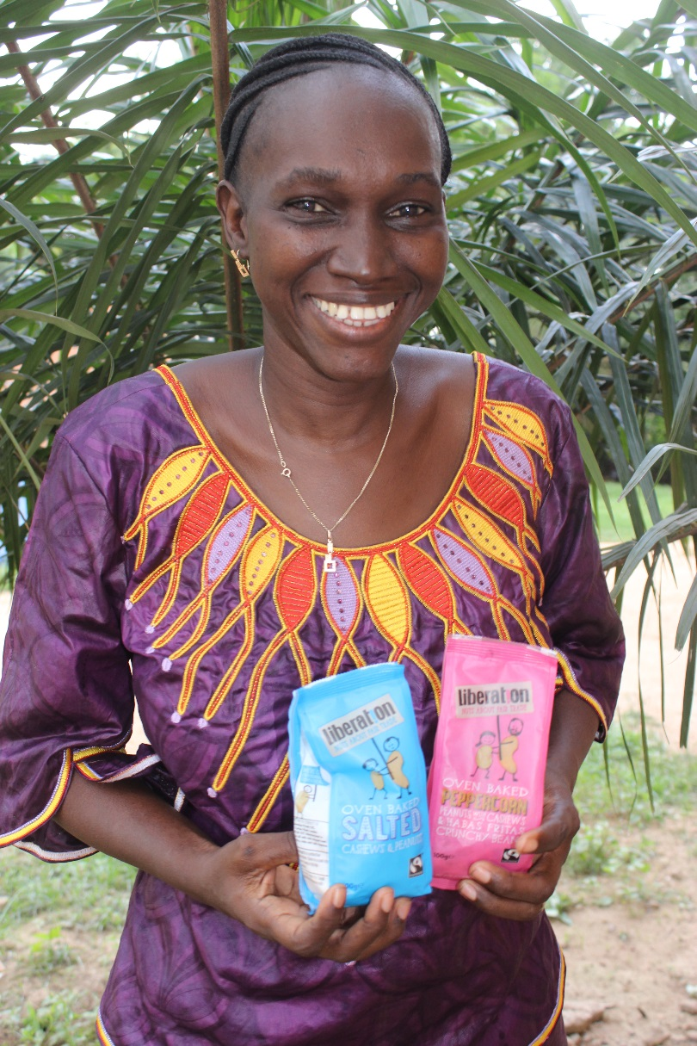
Profitable and transforming lives
2016 turnover was £3.95 million
Liberation imports hundreds of tonnes of Fairtrade nuts every year
Over $1 million Fairtrade Premium paid since 2007.
Notes:
Liberation was founded in 2007 and has been profitable every year since 2010. In 2014, the company’s turnover was £3.5 million.
Liberation has paid more than $800,000 of Fairtrade Premium since 2007.

Slide 21
21
Impact of Liberation for nut farmers

Slide 22
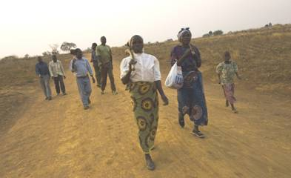
Peanut farming in Malawi
Peanut farming used to be a thriving business in Malawi.
Smallholder farmers were unable to keep pace with quality demands from developed countries.
Many turned to growing tobacco but as Westerners give up smoking their export crops and livelihoods are again at risk.
Notes:
Here are some of the places the nuts come from.
Malawi used to be a peanut exporter but trade fell away in the 1970s as other countries, such as China and the US, and then Argentina, won market share.
Smallholder farmers in Malawi were unable to keep pace with trends in the market and other demands:
- New quality standards,
- New varietal preferences,
- New farming techniques,
- Subsidies, such as to US peanut farmers,
Higher demands by the EU re food standards
Alternative suppliers.
Many farmers turned to growing other crops, particularly tobacco. However, there are major disadvantages in growing tobacco, such as fluctuating prices, health concerns, soil degradation and food insecurity.
Liberation has helped show farmers that there is a future in peanut farming after all.

Slide 23
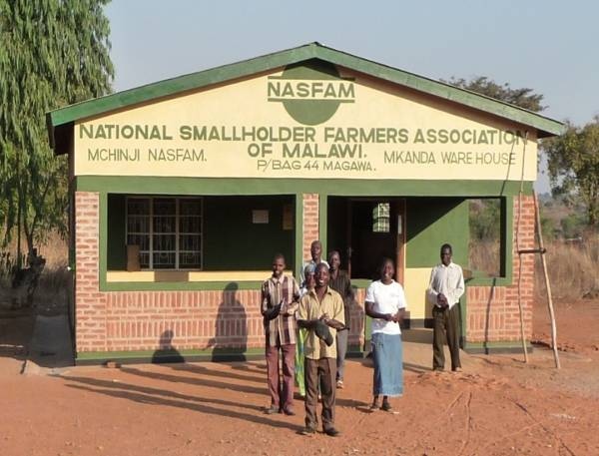
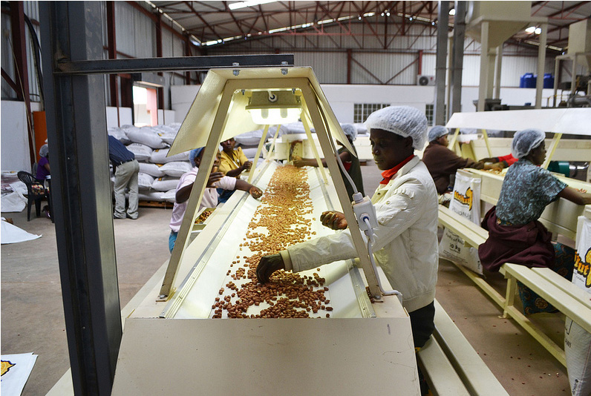
Liberation in Malawi
Liberation is part owned by the National Smallholder Farmers Association (NASFAM) of Malawi.
Farmers participate at each level of the business, from growing and harvesting, through processing and packing to marketing in the UK.
The Fairtrade Premium has been used by farmers to build secure storage for nuts, a shelter at a hospital, and more.
NASFAM, Twin and Liberation have established a new peanut processing plant in Malawi.
Notes:
The peanut farmers in Malawi belong to the National Smallholder Farmers Association (NASFAM) of Malawi, which owns shares in Liberation. Farmers participate at each level of the business, from growing and harvesting, through processing and packing to marketing in the UK.
The Fairtrade Premium has been used by farmers to build secure storage for nuts, a shelter at a hospital, and more.
In 2012, Liberation, NASFAM and Twin helped launch Afri-Nut Ltd, a peanut processing plant in Lilongwe, the capital of Malawi. Afri-Nut will process peanuts for export to the UK under Fairtrade terms and for use in ‘ready-to-use therapeutic food’, the paste given to malnourished children in humanitarian programmes across Africa. It will be the first time that the peanut paste in humanitarian sachets will come from Africa!

Slide 24
Cashew nut farming in India
Two thirds of Liberation’s cashews come from the farming group Fair Trade Alliance Kerala (FTAK).
These cashews have been declared ‘elephant friendly’ – some of the Fairtrade Premium has been used to build solar powered fences. These are a barricade to stop elephants destroying cashew trees and the farmers defending their trees from the elephants.
"This company is tremendously motivating for our farmers. The farmers say: 'We are selling to ourselves! We cannot ever compromise on quality.’ If someone brings along low quality nuts he will have others telling him we need to be more careful - our future is in the high quality of what we provide to Liberation, the company far away in the UK where consumers will buy this product.” Tomy Mathew FTAK
Notes:
Liberation also works with cashew nut farmers in Kerala, India.
Fair Trade Alliance Kerala (FTAK) was set up in 2006 by farmers to tackle the widespread problem of farmers' indebtedness and food security. FTAK’s members in Kerala have used some of their Fairtrade Premium to pay for a disaster management fund. This is very important especially for the farmers on the hillsides. At monsoon time there are landslides which can wreak havoc. Government aid is often delayed and inadequate and the farmers need immediate assistance especially when they are left homeless and their crops destroyed.
Much of the Fairtrade Premium is being spent on facilities for adding value to crops, something which will benefit the entire community. For example most of the farmers also grow Fairtrade spices and the farmers who produce pepper find that white pepper sells for a higher price than black. So there is a proposal to create a white pepper manufacturing unit as a common facility, one that can be used by everyone.
Wild elephants trespass on the farms from the local forests. Wanting to protect their cashew trees, the farmers often fight back and are mauled by the animals or injure the animals first. FTAK believes farmers, their trees and the elephants need to be protected and have studied ways of keeping the animals at bay without hurting them. They came up with the idea of investing the Fairtrade Premium in solar panel powered electric fencing around the farms. This provides a very mild shock which deters but does not injure the elephants. So FTAK and Liberation are proud suppliers of ‘elephant friendly’ cashews!
24

Slide 25
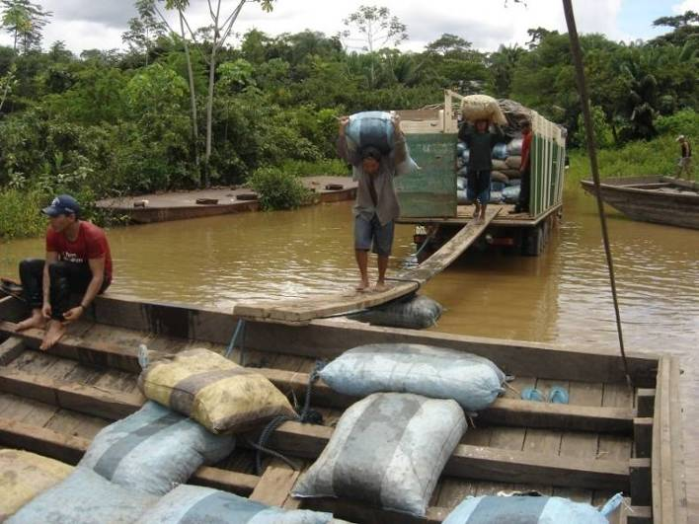
Brazil nut gathering in Bolivia
Brazil nut producers in Bolivia gather nuts from the floor of the Amazonian rainforest.
The Fairtrade Premium has been used for the construction of places to keep nuts safe from water, animals, petrol and chemical contamination, to ensure the quality of the nuts is maintained.
I hear the Americans use aeroplanes
Notes:
In the Amazon, Fairtrade Brazil nuts come from Bolivia, Brazil and Peru. In fact despite the name, most are from Bolivia.
The Fairtrade Premium has been used for the construction of ‘payoles’ – places to keep nuts safe from water, animals, petrol and chemical contamination, to ensure the quality of the nuts is maintained. Here they can be safely stored, cleaned and selected for export. It has also been used to help with medical expenses (the first high quality medical care these families will have had) and for scholarships so some children can go on to university. Because they are guaranteed a fair price for the nuts they gather, the Brazil nut producers are not tempted to cut down the precious timber of the rainforest to make extra money, very important for our environmental future.

Slide 26
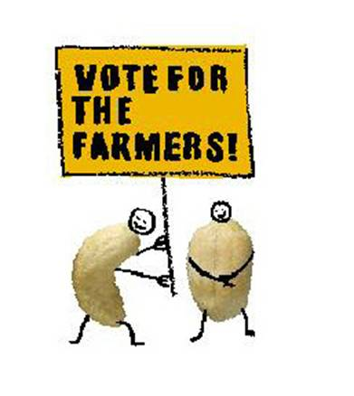
The difference Liberation makes
Since we started the co-operative it’s as if we’ve gained our freedom. It feels like we’re not slaves any more. We have more income, more work and more dignity.”
- Benedicto Gonzalez, Brazil nut gatherer, Bolivia

Slide 27
Thank you

