Slide 1

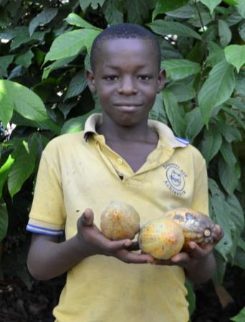



Samuel Awuni
Trading Visions
www.tradingvisions.org
www.papapaa.org
www.divinechocolate.com
Notes:
“My name is Samuel Awuni. I come from a village called Agyeikrom. I was born on the 7th of September 2001.”
Samuel, the son of a cocoa farmer, visited the UK in 2016. This is the presentation he gave when he was travelling around the country.

Slide 2
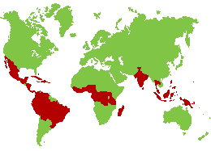
Notes:
“This is the map of the world. All the red areas show the countries who do cocoa growing.”
The main ingredient in chocolate is cocoa. Farmers grow cocoa trees on small farms in hot, rainy environments, mostly in areas on or near the equator. On the world map, the red countries are cocoa producing countries.

Slide 3
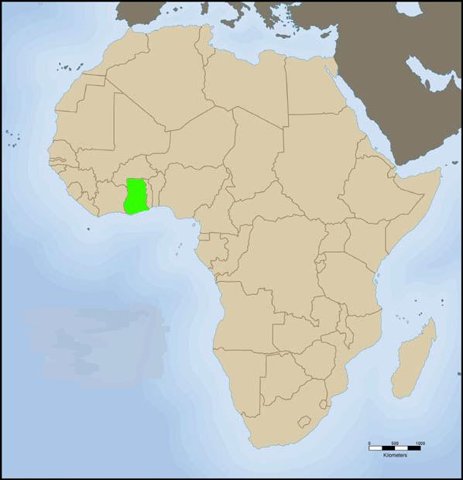
Ghana
Notes:
“This is the map of Africa. The green area shows where Ghana is.”
Ghana is a country of 27 million people in West Africa. As well as local languages, everyone speaks English. It was a British colony and was the first African nation to achieve independence from European rule in 1957. The country’s main exports are gold, timber and cocoa.

Slide 4
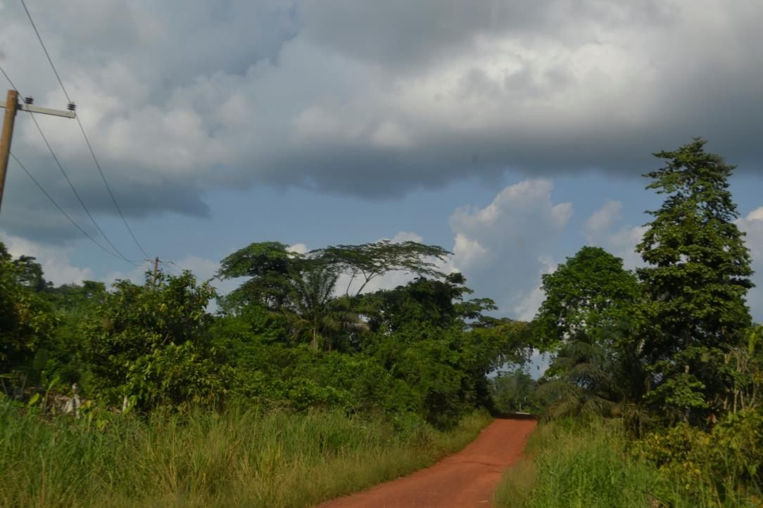
Notes:
“This road will lead you to my village Agyeikrom.”
Agyeikrom is a remote cocoa farming village in the Western Region of Ghana. It is hot and humid here.

Slide 5
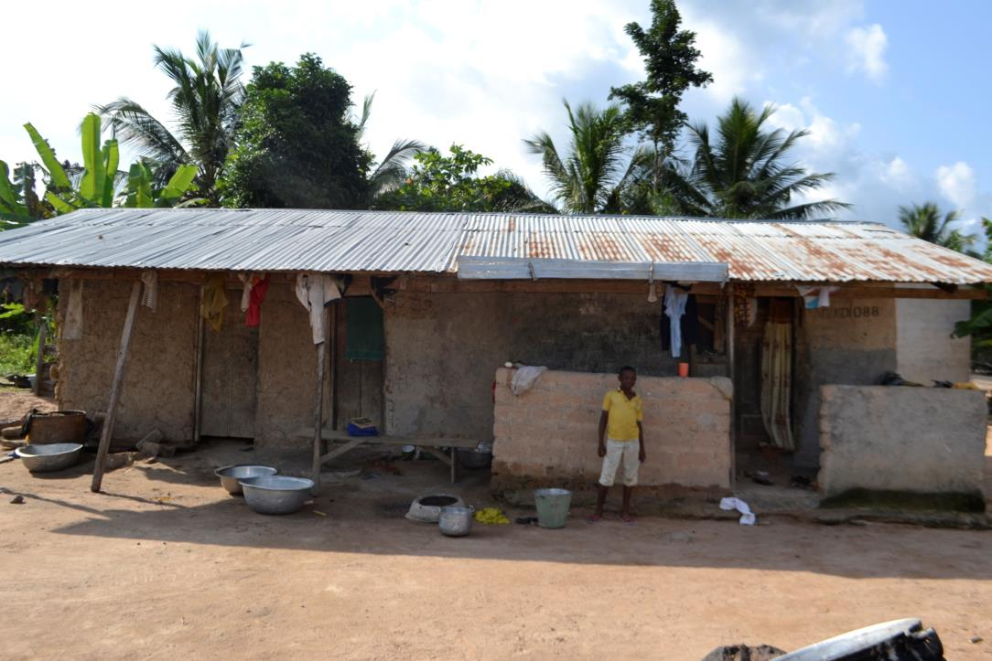
Notes:
“In this picture I was standing in front of our house.”
Samuel’s house is a simple building made of mud brick with a corrugated iron roof.

Slide 6
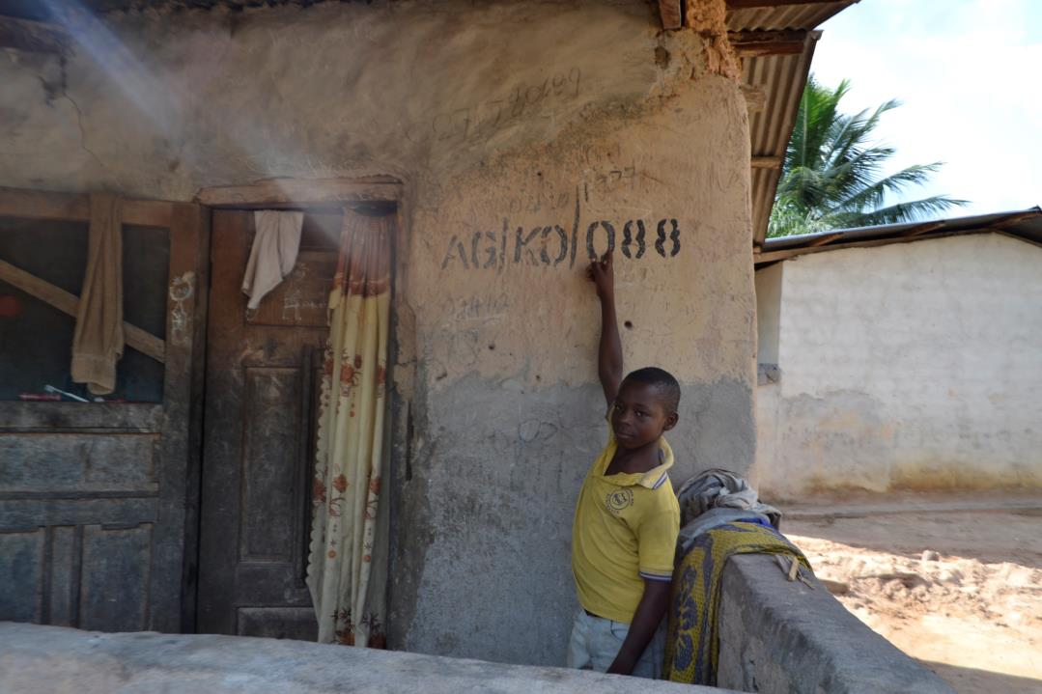
Notes:
“Here I was pointing to my house number.”

Slide 7
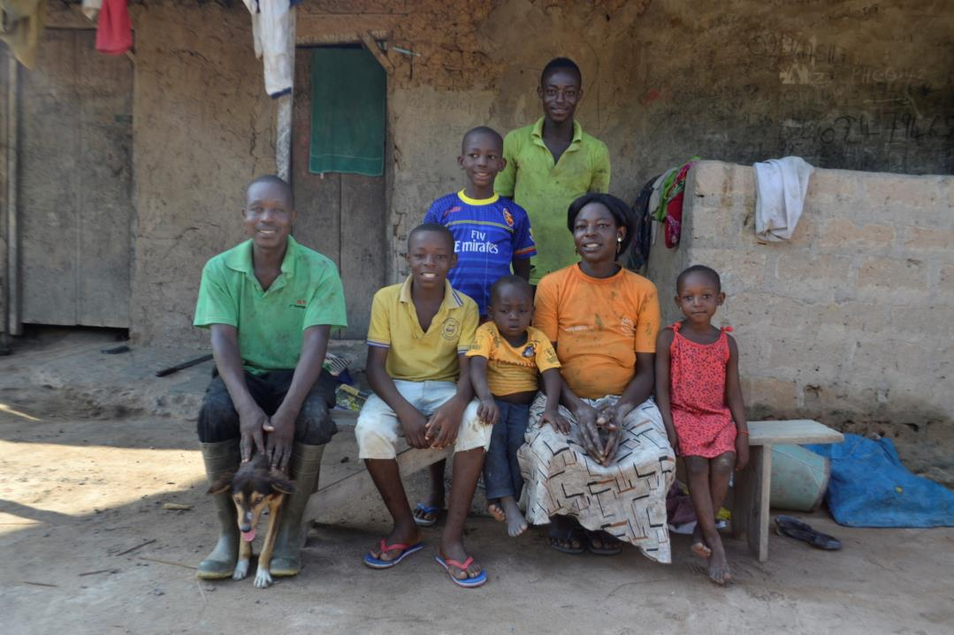
Notes:
“This is my family members. The man with the green shirt is my father. And the woman with the yellow shirt is my mother. My youngest brother is sitting between me and my mother. The name of my father is Awora Awuni. And the name of my mother is Alima Awuni. They are all members of Kuapa Kokoo.”
Kuapa Kokoo is a co-operative of cocoa farmers in Ghana whose beans are made into Divine Chocolate. Kuapa Kokoo is an association of more than 85,000 cocoa farmers, spread across 1,250 villages in Ghana. ‘Kuapa Kokoo’ means ‘good cocoa farmer’ in the local Twi language. Their motto is ‘Pa Pa Paa’, which means ‘best of the best’ in Twi.

Slide 8
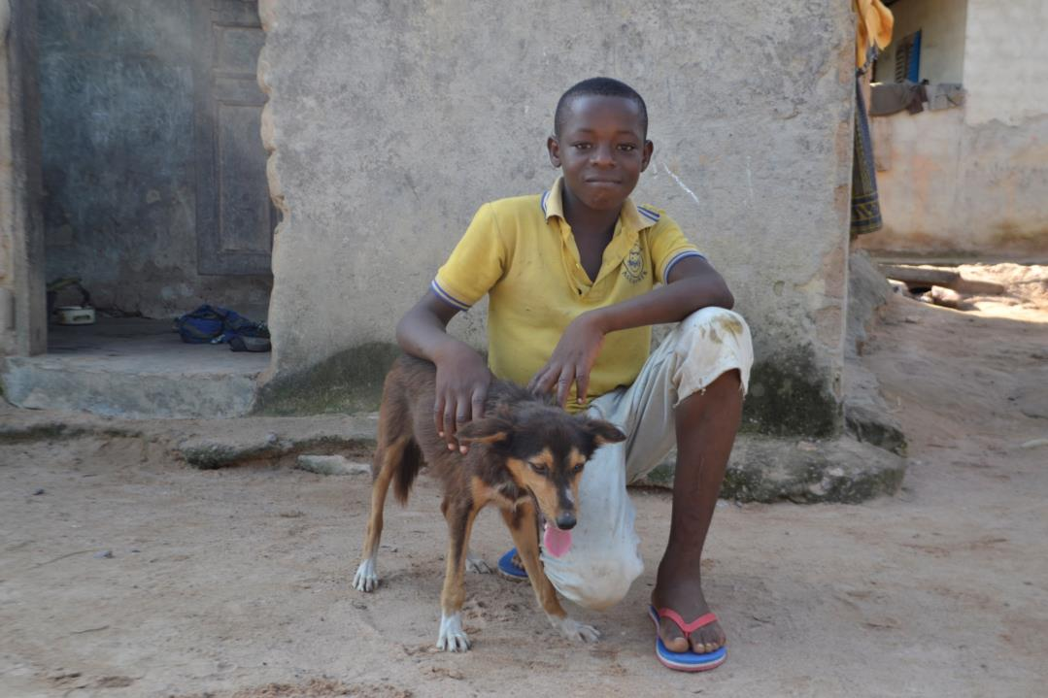
Notes:
“This is my dog. The name of my dog is Beginning. I call my dog Beginning because everything has a beginning and an end. I like my dog, because he always catches grasscutters for me to prepare for food.”
People tend to keep pets in Ghana that perform a useful function around the home. Samuel’s dog Beginning catches grasscutters for him. The grasscutter is a large rodent, it looks like a guinea pig. They are eaten in Ghana, often in soup, and are considered a delicacy similar to rabbit in the UK.

Slide 9
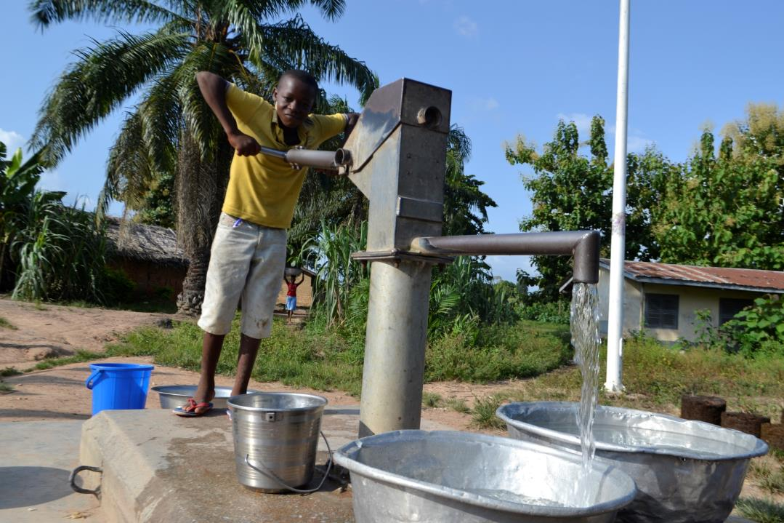
Notes:
Here I was fetching water. I always fetch water every morning and evening for family use.”

Slide 10
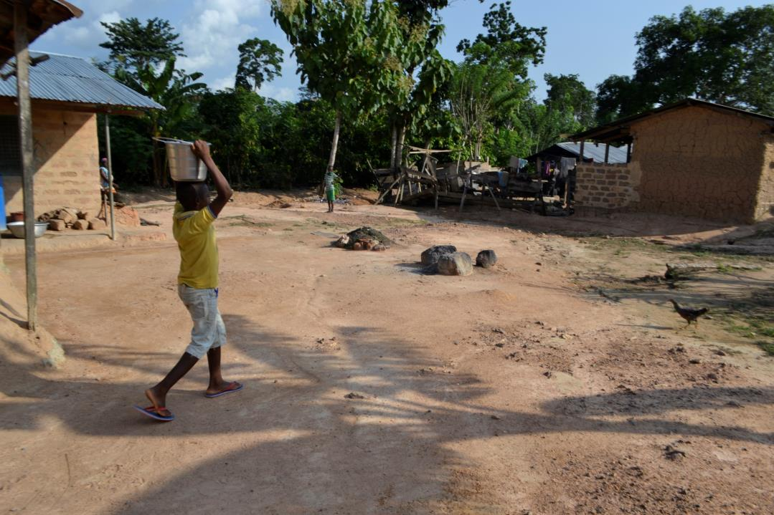
Notes:
“I was carrying the water home.”

Slide 11
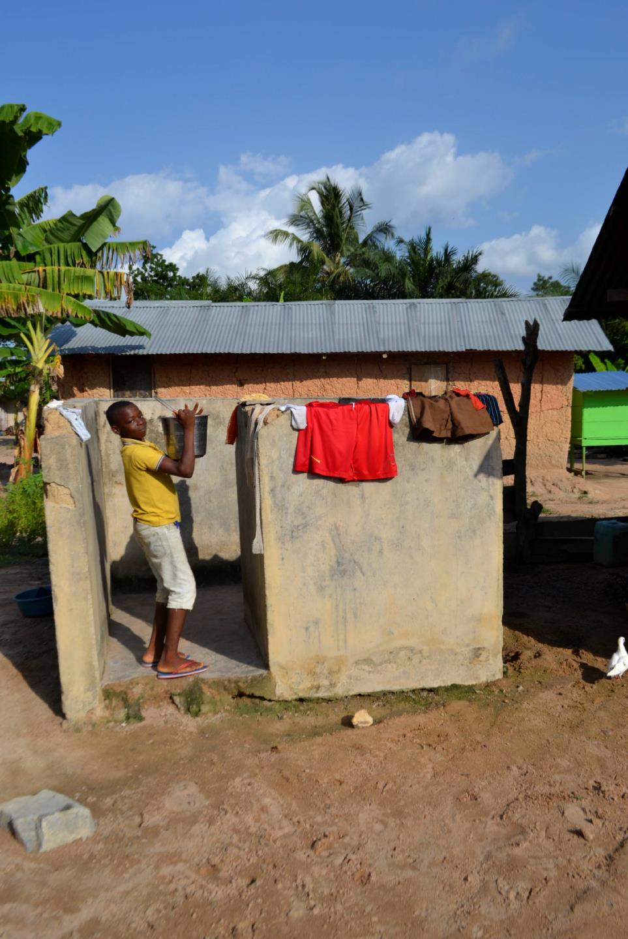
Notes:
“Here I was using some of the water to bath and wash my school uniform.”
There is a simple structure near Samuel’s house where his family go to wash themselves and their clothes.

Slide 12
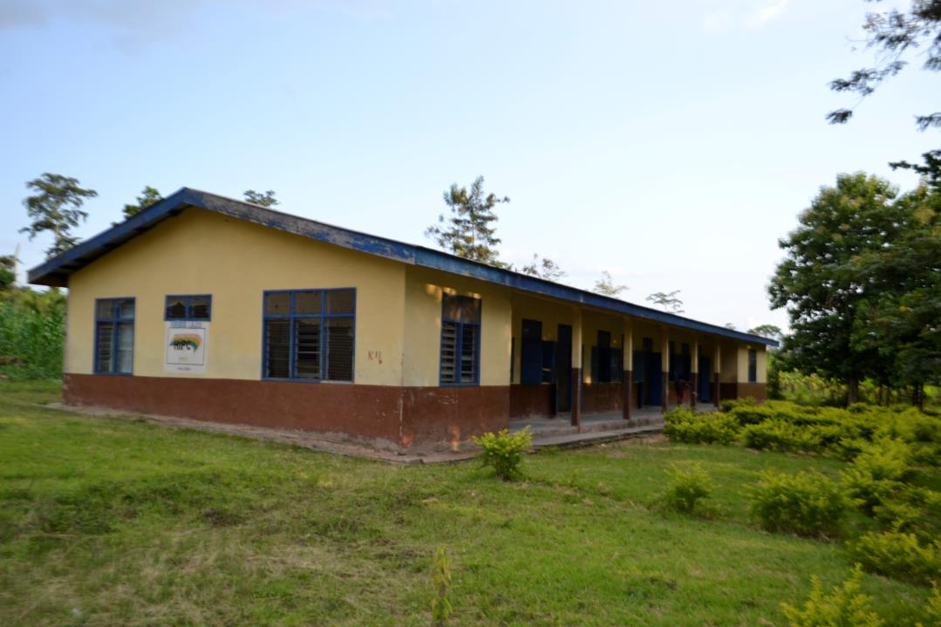
Notes:
“This is my school. The name of my school is Boafoyena D/A JHS.”
D/A stands for District Authority. JHS stands for Junior High School, it covers ages 12-15 yrs. Education up to 15 is free and compulsory in Ghana. To attend secondary school, your parents have to pay fees.

Slide 13
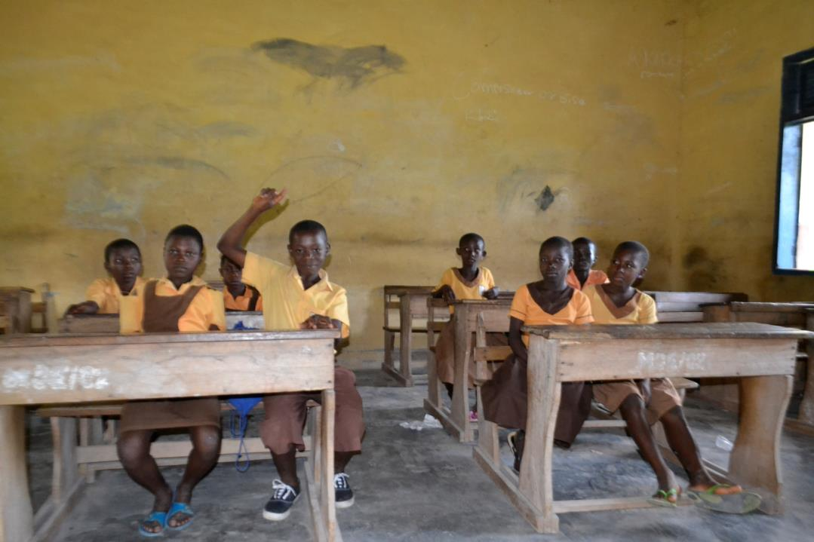
Notes:
“This is my classroom. I was raising my hands to answer a question.”
Though Samuel’s school is a good quality brick building and they have sturdy desks to sit at, the school has no exercise books or text books. The only teaching resources are blackboards and chalk. In Ghana, the government only funds teachers’ salaries. There is no additional money for school resources, which have to be provided by the local community.

Slide 14
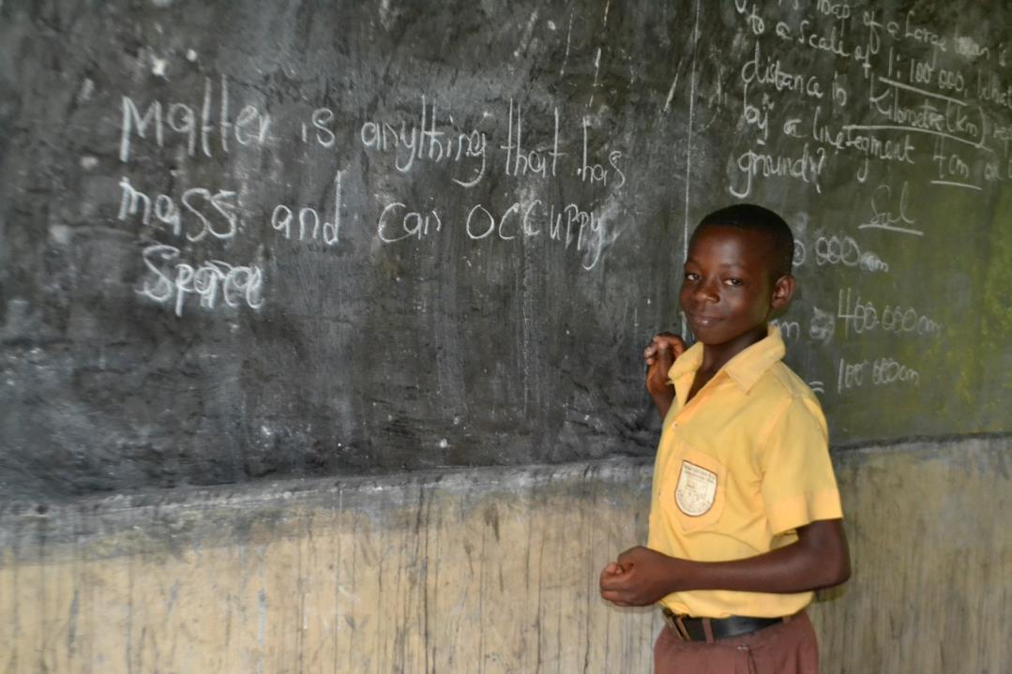
Notes:
“My teacher asked me to define ‘matter’ and write it on the board.”

Slide 15
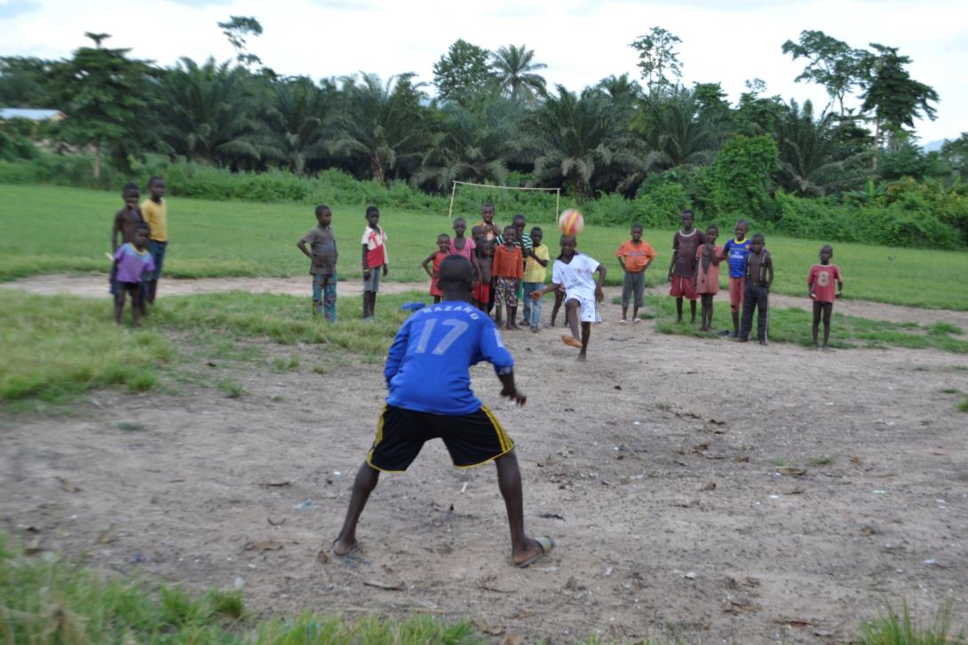
Notes:
“Here I was playing football with my friends. I always play football with my friends after close of school. I am the one wearing a white shirt in the middle of the pitch.”

Slide 16
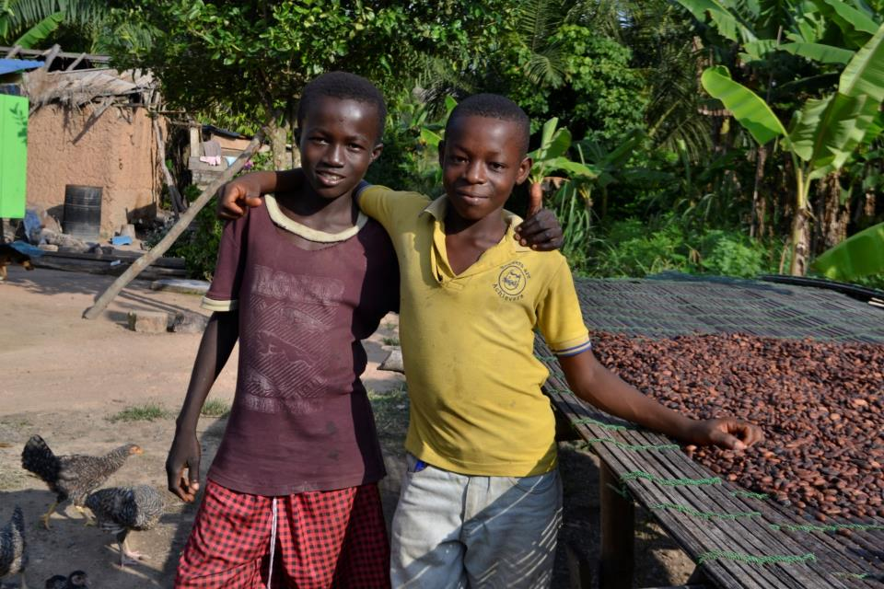
Notes:
“This is my best friend. The name of my best friend is Amos Mbawuli. He is in the same class as me.”

Slide 17
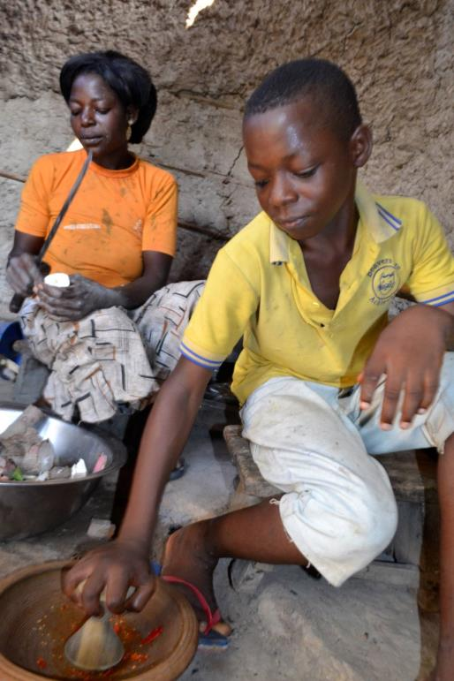
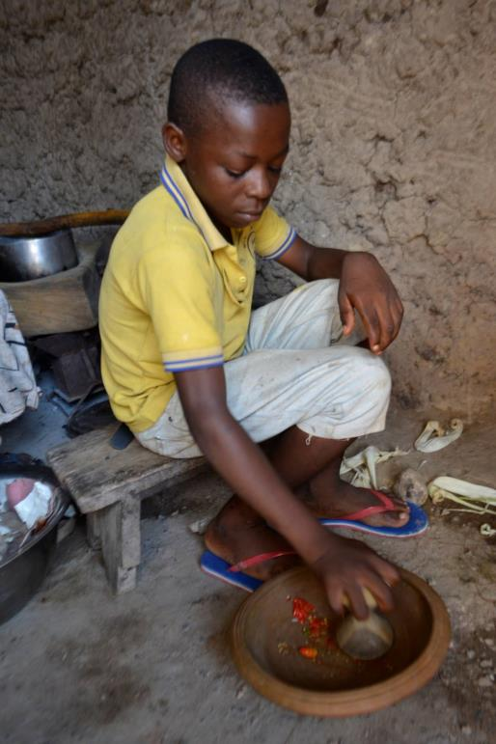
Notes:
“On Sundays, I always help my mother in the kitchen to prepare fufu. Here I was grinding pepper for my mother to prepare fufu.”
Fufu is a popular staple in Ghana. It is a thick savoury porridge made of cassava flour and plantain flour, usually served at the bottom of a hot bowl of soup. Here Samuel is grinding chilli peppers for the soup.
Check out this video on Pa Pa Paa LIVE for some footage showing how to pound fufu paste in a massive pestle and mortar: www.papapaalive.org/videos/food-day

Slide 18
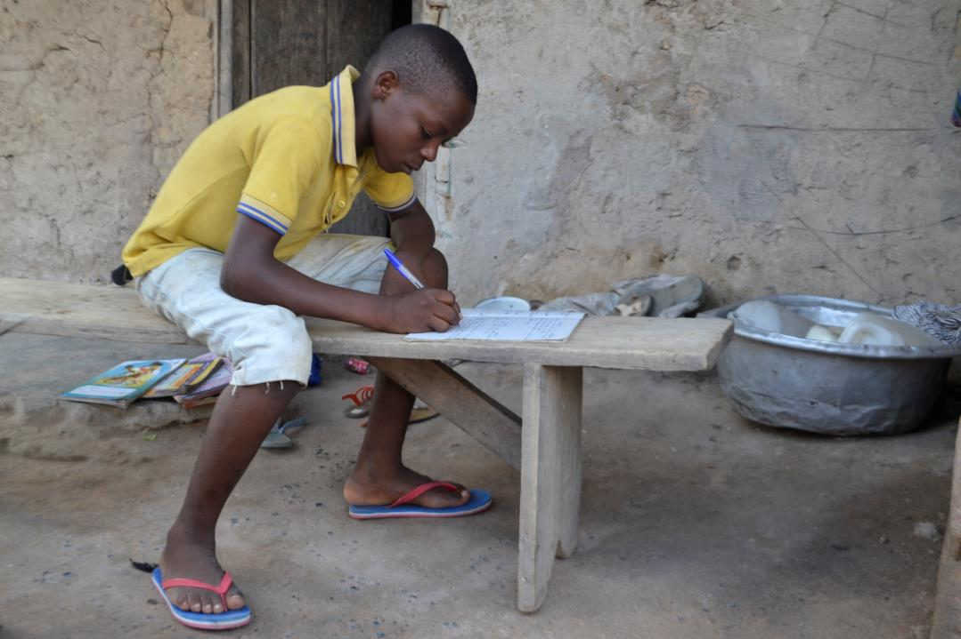
Notes:
“After I help my mother in the kitchen and I have homework, I always go and sit down beside our house and do it. So in this picture I was doing my homework.”

Slide 19
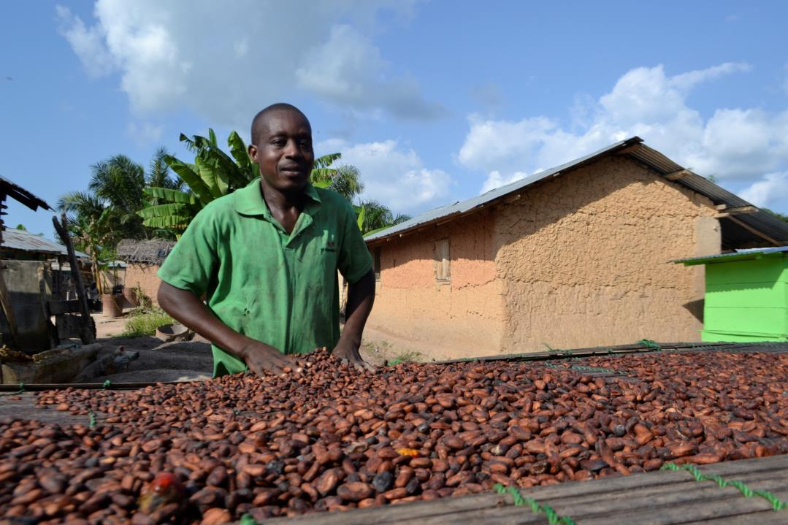
Notes:
“Here my father was drying cocoa on a raised raffia mat under the sun.”

Slide 20
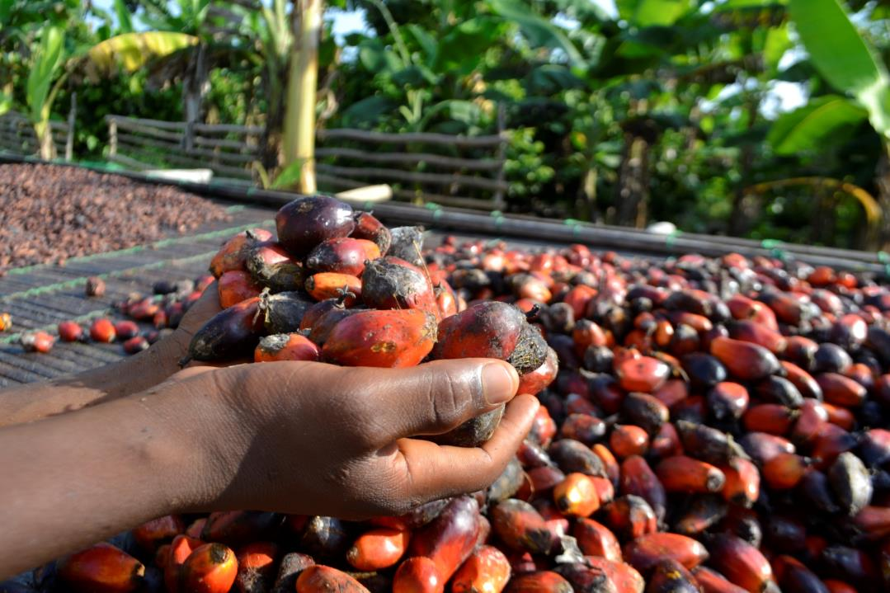
Notes:
“Here my mother was holding palm nuts. She always uses palm nuts to produce palm oil to sell so that when there is no cocoa, she can get money to take care of me and my brothers.”
Samuel’s family grow oil palms as well as cocoa trees. They turn the nuts from the oil palm into palm oil which they sell locally. Most cooking traditionally uses palm oil, a thick red oil that gives a particular flavour to Ghanaian cuisine.

Slide 21
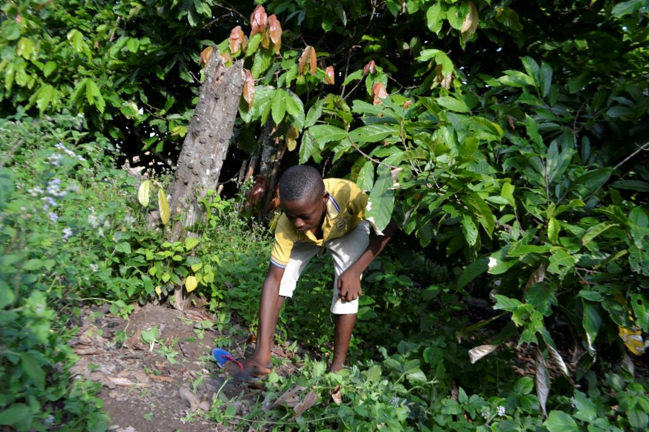
Notes:
On Saturdays when I do not go to school, I help my parents on the cocoa farm. So here I was weeding.”

Slide 22
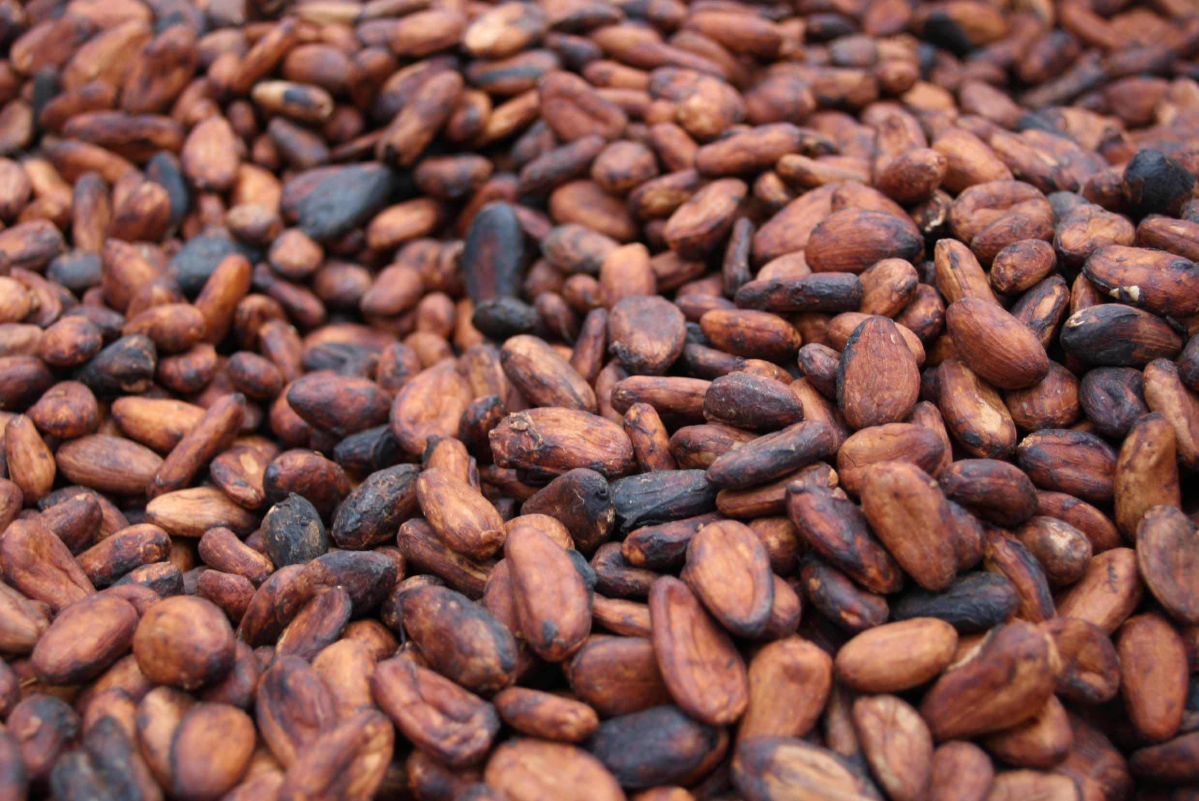
Growing Cocoa
Notes:
“That was about myself. Now we are going to cocoa growing in Ghana.”

Slide 23
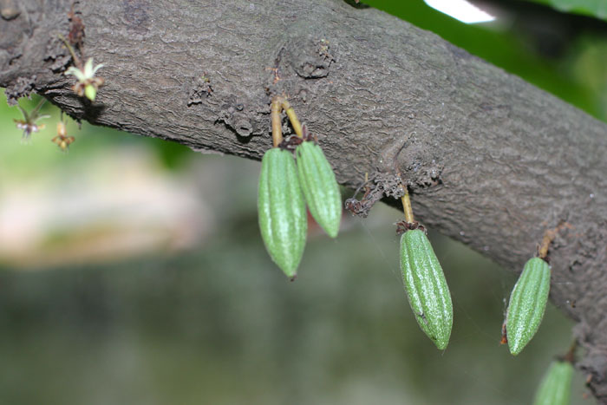
Notes:
“Cocoa is a fruit that grows on the cocoa tree. This picture shows a tiny cocoa pod on the cocoa tree.”
Cocoa trees produce little white and pink flowers, some of which turn into cocoa pods after they are pollinated by midges.

Slide 24
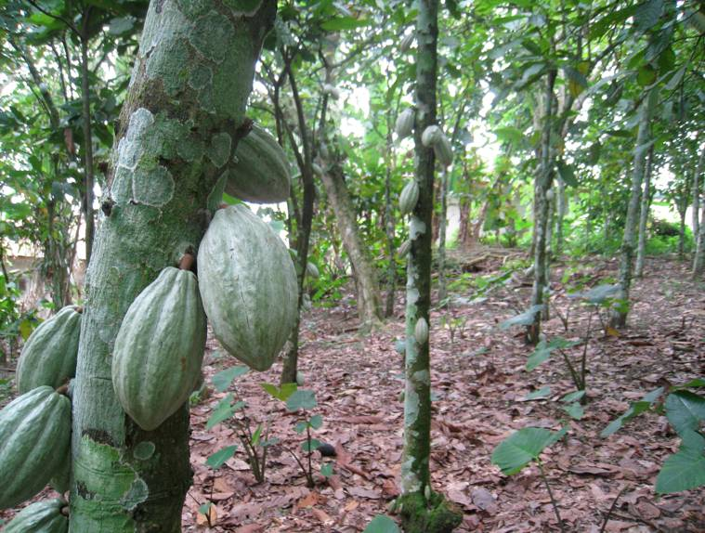
Notes:
“Now you can see that the cocoa pods are growing bigger. Each tree can produce about 50 to 80 cocoa pods in a year.”
Cocoa trees grow up to five metres tall and they need shade, so farmers plant the seedlings under the rainforest canopy. They also plant other useful tall crops in amongst the cocoa trees, like banana plants and palm nut trees. When the cocoa trees are young, the ground around them needs to be well weeded, as weeds can smother the trees. Three to five years after planting, cocoa trees will begin to fruit, just 10 to 20 pods a year at first but increasing in subsequent years if the tree is well looked after. Notice how the pods grow directly out of the trunk or branches of the tree.

Slide 25
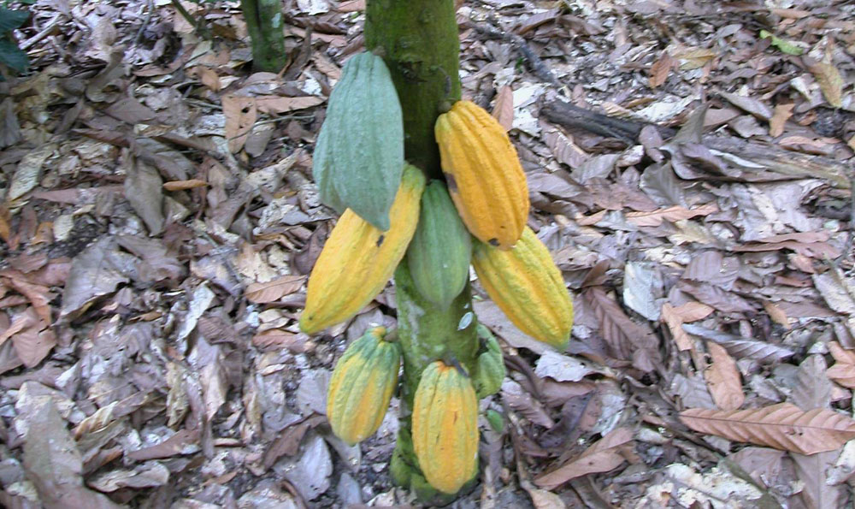
Notes:
“This is cocoa that is ripe. When the cocoa is ripe it turns yellowish like this one.”
The cocoa pods grow up to 20cm-30cm in length, and turn yellow when they are ripe. Cocoa beans, the seeds, grow inside the cocoa pods. There are generally about 40 beans in a pod.

Slide 26
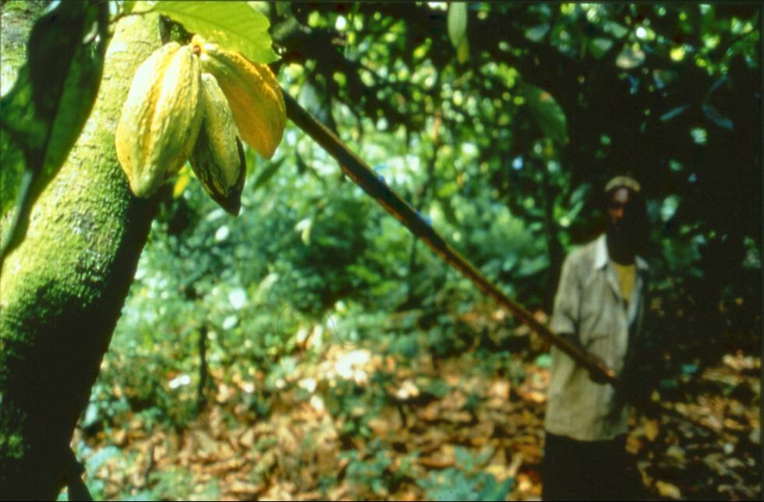
Notes:
“Once the cocoa is ripe you need to harvest the pods. In this picture, the farmer is using a tool with a sharp blade on the top to cut down the pods. This tool is called ‘go-to-hell’.”
The cocoa pods are harvested twice a year using a machete or a ‘go-to-hell’, a long stick with a sharp blade on the end. The main harvest is October to February, and there is a smaller one in June/July.

Slide 27
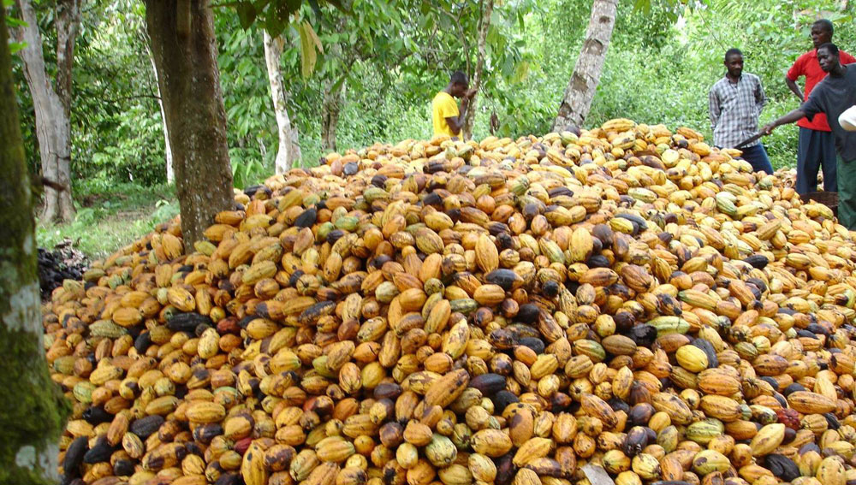
Notes:
“When you harvest all the cocoa, you need to gather the pods at one place and use a cutlass to break the cocoa pods and remove the beans from the pod.”
Farmers travel to each other’s farms to share the work between them and support each other to get more done, faster.

Slide 28
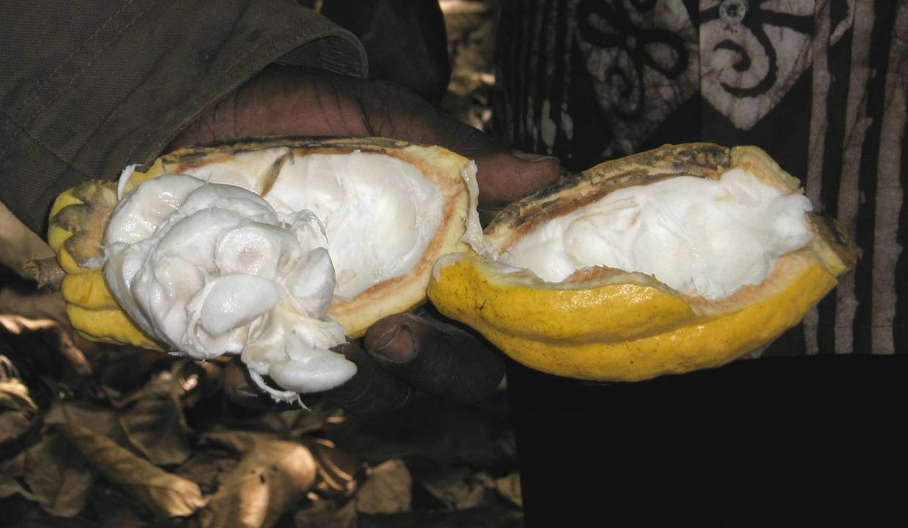
Notes:
“This is the inside of a cocoa pod. You can see the beans inside the pod.”
The cocoa beans are in a gooey white fruit pulp inside the cocoa pod.

Slide 29
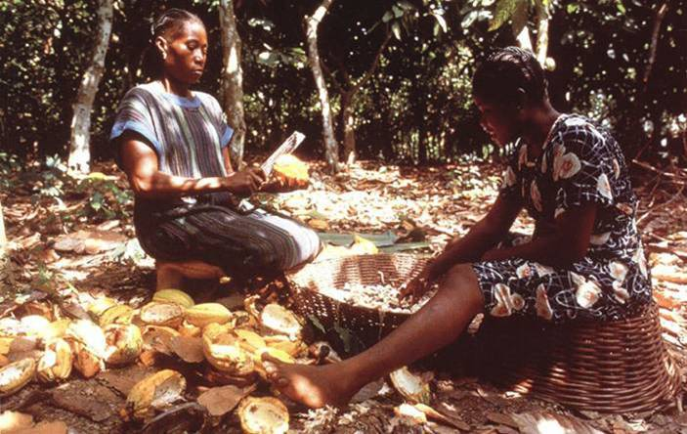
Notes:
“Here, two farmers are breaking the pods and removing the beans to put it in the basket.”
This is a farmer and her daughter sitting in a clearing on their cocoa farm. They have cut down the pods from the tree with the machete; now they are splitting the pods and scraping out the sticky white beans. The women have brought a spare basket with them so that they have something to sit on.

Slide 30
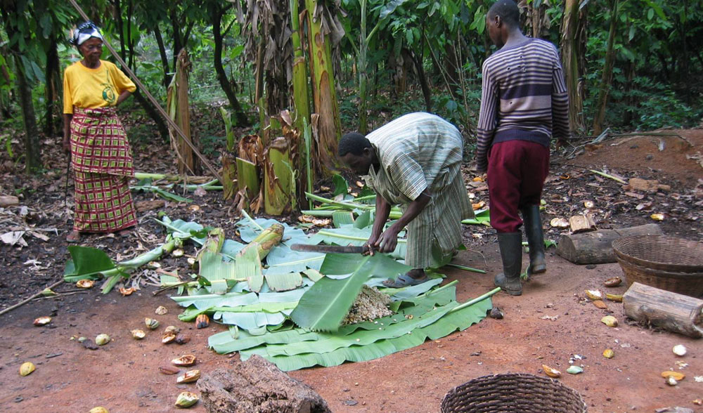
Notes:
“The long leaves are plantain leaves. The farmers put the cocoa beans on the plantain leaves and wrap them up and leave them for 7 to 10 days to ferment.”
Having collected the cocoa beans, the farmers tip the beans on to banana leaves, and then wrap the beans up in the leaves. They leave the cocoa beans in a warm, shady place in the rainforest to ferment for about 7 days.

Slide 31
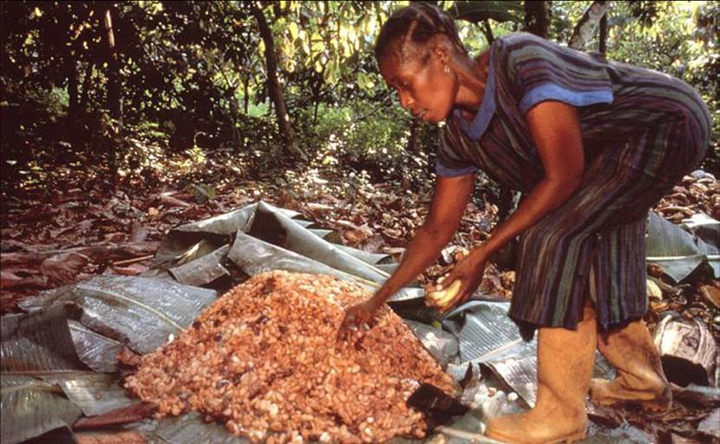
Notes:
“This is well fermented cocoa. They ferment cocoa to get that chocolatey flavour.”
They check the beans from time to time. You can see in this picture how the beans are starting to ferment – the sticky goo on the leaves shows the process has begun. Fermentation makes the pile of beans quite hot, and it has a strong yeasty chocolatey smell. Fermentation is what gives chocolate its distinctive chocolatey taste and colour.

Slide 32
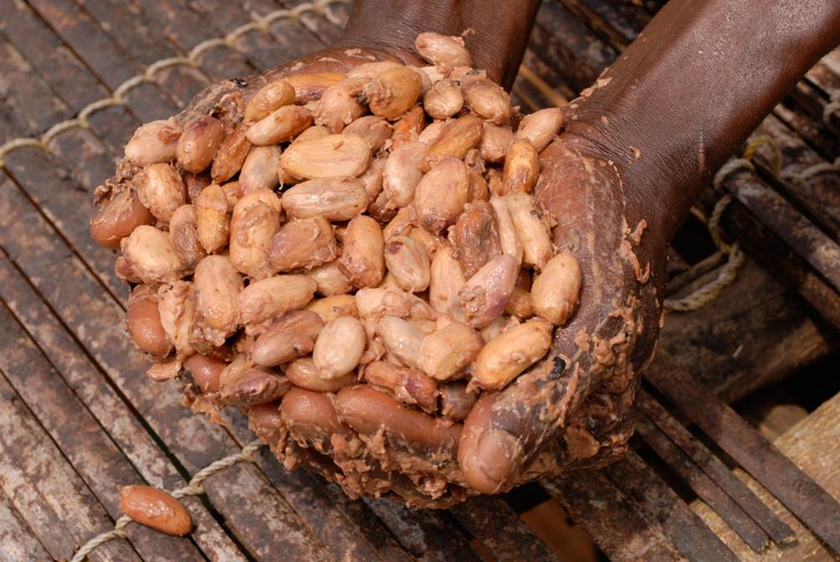
Notes:
“You can see that the fermented cocoa beans are sticky.”
After about 7 days of fermentation, the sticky beans are taken back to the village.

Slide 33
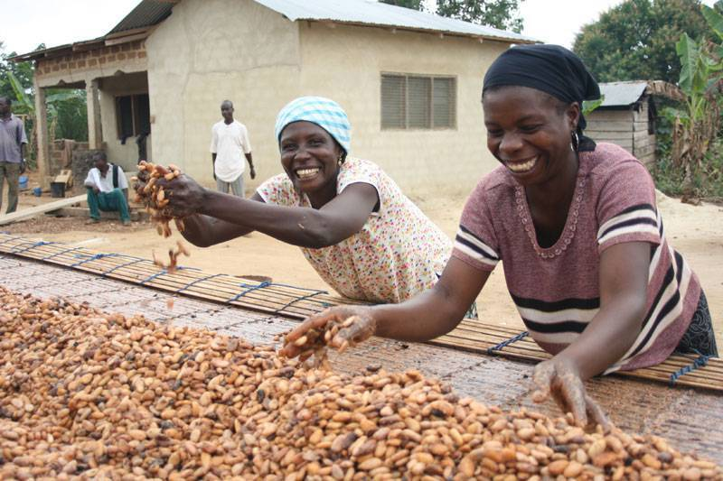
Notes:
“Here the farmers are drying the cocoa on a raised raffia matt under the sun.”
In the village, the beans are laid out in the direct sunlight to dry on special long drying tables made of locally grown bamboo. It takes about 7 days in the hot sun for the cocoa beans to dry completely. Farmers need to turn the beans every few hours to stop them sticking together in clumps, picking out poor quality beans as they go along.

Slide 34
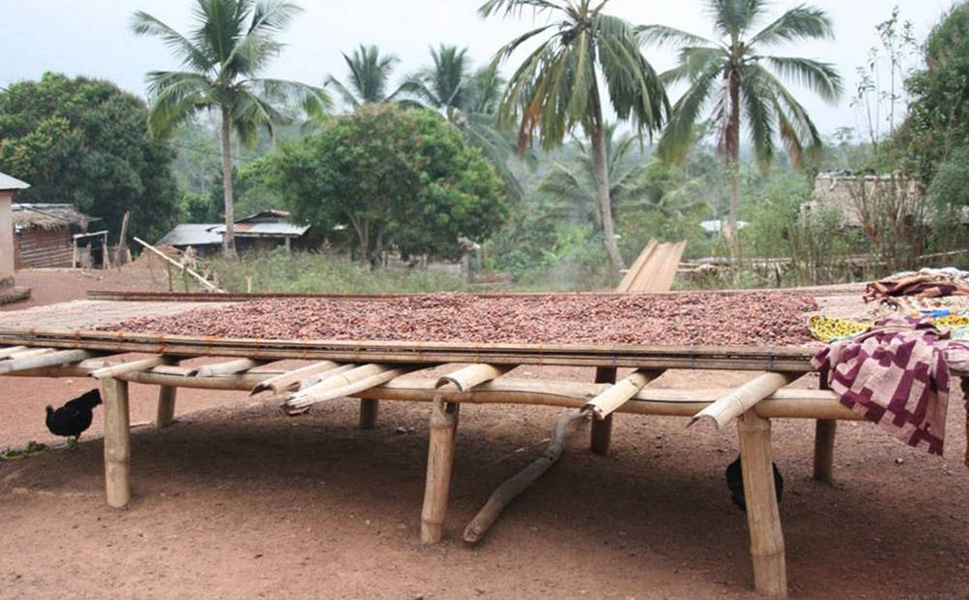
Notes:
“The cocoa beans are dried under the sun for 7 to 10 days. Once they are dry, they are ready to sell.”
After a week, these sun dried cocoa beans are a lovely dark brown colour.

Slide 35
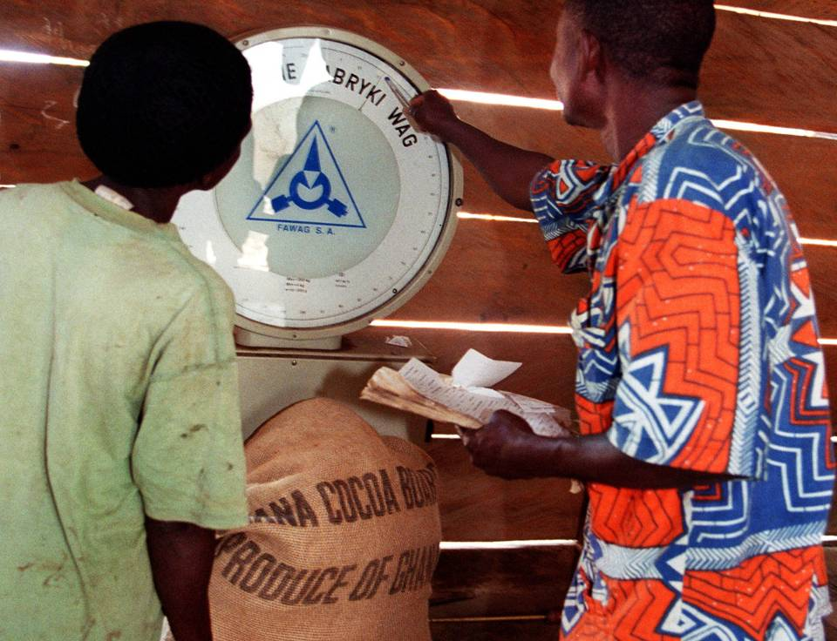
Notes:
“Here the farmer is selling a sack of cocoa to the Kuapa Kokoo recorder. The recorder is elected by the farmers to record how much cocoa is sold and to pay farmers a fair price. My family sold 13 sacks of cocoa last year.”
Once the beans are dry, farmers pack them into jute sacks and take them to the Kuapa Kokoo recorder. The recorder is elected every four years by the other farmers in the village and is responsible for weighing and paying for the cocoa that local Kuapa Kokoo farmers bring to them. The recorder uses the scales to check that each sack weighs exactly 62.4kg, and pays the farmer half of what they will earn. The other half is paid when the cocoa is accepted by COCOBOD, the government cocoa board. The farmers can inspect the scales at any time to give them confidence that they are not being cheated. Each sack is printed with ‘Ghana Cocoa Board, Produce of Ghana’ and with a unique number that shows the cocoa comes from a specific village.

Slide 36
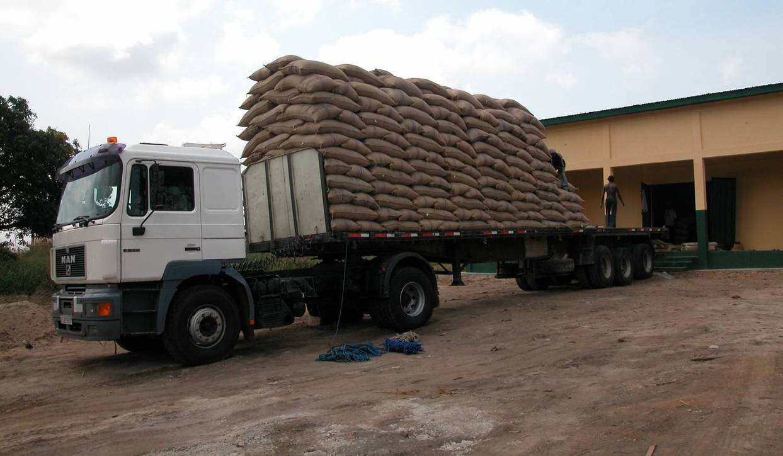
Notes:
“Next the cocoa sacks are transported to the port on a lorry.”
The sacks are loaded on to a big truck; each truck can carry 180 sacks. The sacks have to be stacked like this to ensure that the weight is evenly balanced, otherwise the truck would tip over on the pot-holed roads. They are taken to the Kuapa Kokoo warehouse, and then to Tema, the port close to Accra, Ghana’s capital city, for export by ship.

Slide 37
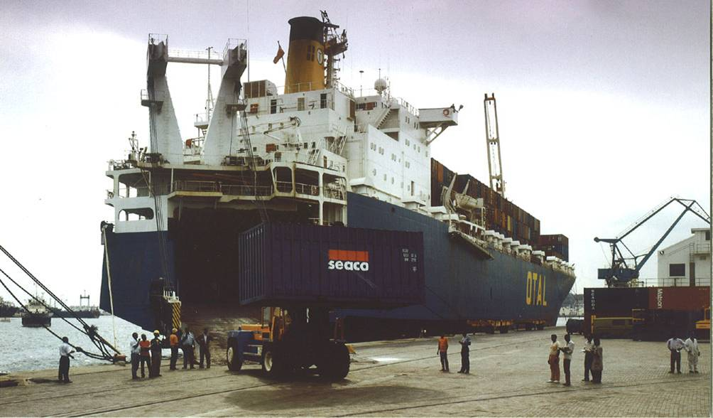
Notes:
“This is the boat carrying the cocoa from Ghana to Europe.”
Tema is the biggest port in the country, and it’s from here that most of Ghana’s cocoa is exported. Containers are loaded on to ships, which carry cocoa to Europe, where it will be used to make chocolate.

Slide 38
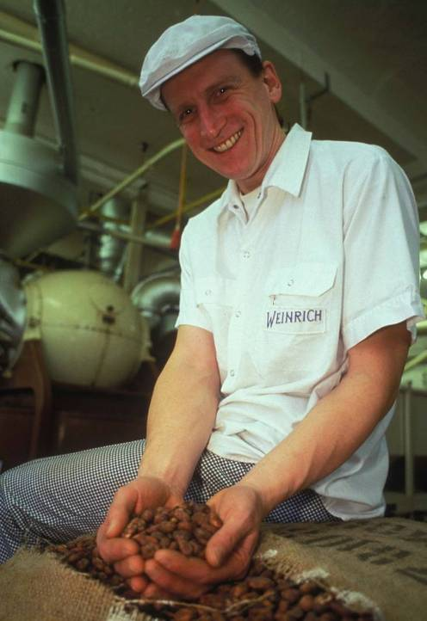
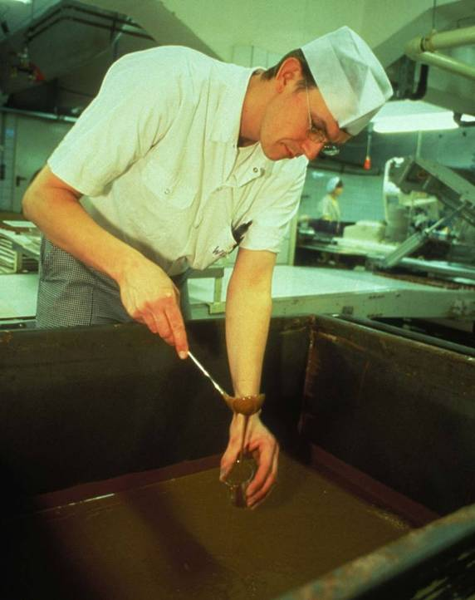
Notes:
“This is the factory where our beans are made into chocolate. The man on the right is a chocolate taster.”
After the cocoa beans arrive at the European port, they are taken by lorry to the chocolate factory. This is Weinrich factory in Germany, which makes Divine chocolate. Here the cocoa beans are roasted and winnowed (to get rid of their shells), and turned into cocoa butter and cocoa liquor. These are then mixed together in a process called conching. Milk, sugar and flavourings are mixed in at this stage to a specific and secret recipe. The liquid chocolate is then tested to make sure the consistency and flavour are right.

Slide 39
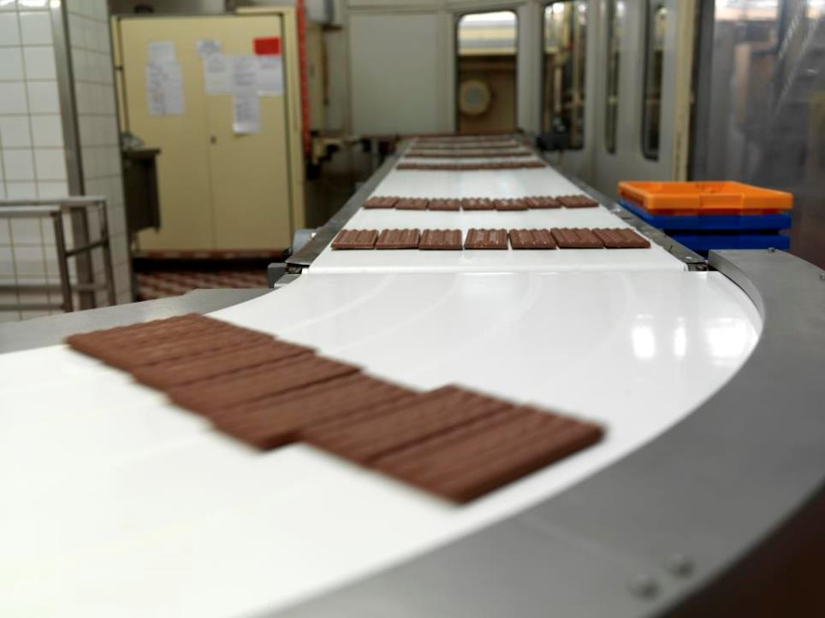
Notes:
“The chocolate is poured into moulds to form bars.”
The bars are then formed by pouring liquid chocolate into moulds, and sent down the production line to be wrapped in Divine wrappers. They will then be transported by ship to the UK.

Slide 40
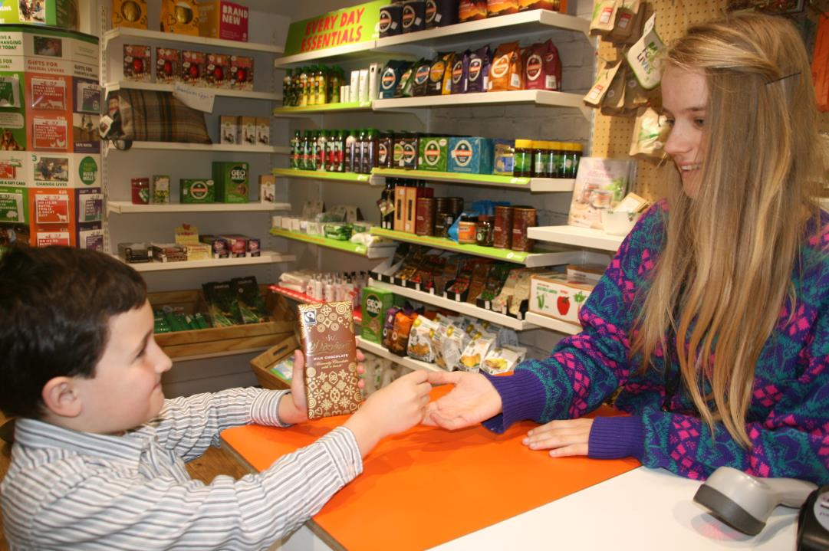
Notes:
“The chocolate is then wrapped up and transported to the shop to be sold.”
This is the very final stage of the chocolate chain. The final link in the bean to bar story is you, the buyer. The choices you make have an influence all the way back through the chain to its very beginning, the cocoa farmer. Lots of hard work has gone into your chocolate bar. It takes around 30 beans, or one whole cocoa pod, to make a bar of Divine milk chocolate like the one in this picture!

Slide 41
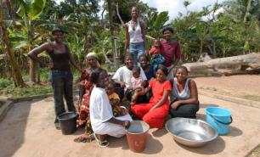
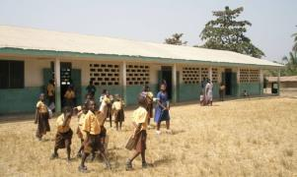
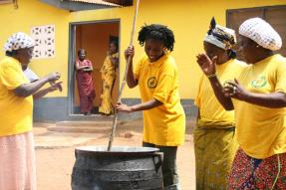
Benefits of Fairtrade
Fairtrade water pumps for clean water in the village
New Schools – This school block was built with Fairtrade premiums.
Alternative income generation projects like soap-making for women’s groups.
Notes:
“For every tonne of cocoa beans that are sold, Kuapa Kokoo receives $200 of Fairtrade Premium. The farmers decide together how to spend this Fairtrade Premium.”
When you buy Fairtrade products, the farmer at the other end is helped because he or she earns a fair amount for their crop. Their community also earns a ‘Fairtrade Premium’, an extra amount that they can use to spend on projects which help everyone.
You could spend some time thinking through things that cocoa farming communities might need. What would they spend their Fairtrade premiums on?
Here are some examples of what Kuapa Kokoo have spent Fairtrade premiums on:
Direct payments to farmers in the form of an end-of-year bonus;
Wells and bore holes for drinking water;
Construction of public toilets;
Mobile health clinics to visit villages;
Construction of two day-care centres;
Construction of a block of six classrooms;
Purchase of two mobile cinema vans for a farmers' education programme;
Construction of warehousing to store cocoa at Tema port;
Initiation of alternative income generating activities for the lean seasons in between the cocoa harvests, such as soap making, and snail farming;
A new machete for every farmer in Kuapa Kokoo.

Slide 42

Notes:
“This is a water pump that was built by Kuapa Kokoo.”
Notice that nearly all the people in the picture are women. Women and girls tend to do the work of fetching water. A water pump in the community means that instead of having to walk into the forest to a stream or pond to fetch water every day they have more time and energy for other things. Girls can get to school on time.
Kuapa Kokoo has built hundreds of water pumps in cocoa growing villages. Water from a pump is much cleaner than water from streams and ponds. There is a video on our Pa Pa Paa LIVE website which shows what water from the forest looks like: http://www.papapaalive.org/videos/water

Slide 43

Notes:
“This is good quality school that was built with FairTrade premium.”
This is a school block built with Fairtade Premium money. Traditionally school buildings are made of mud. This building of concrete blocks and with a corrugated iron roof is much more robust.

Slide 44

Notes:
“Some of the Fairtrade Premiums are used to train women on income generating activities, like how to make soap, tie-and-dye and how to make palm oil.”
Fairtrade funds alternative income generation projects for women’s groups: like soap-making, setting up food selling stalls, clothes selling, palm oil making, and tie-dye batik.

Slide 45
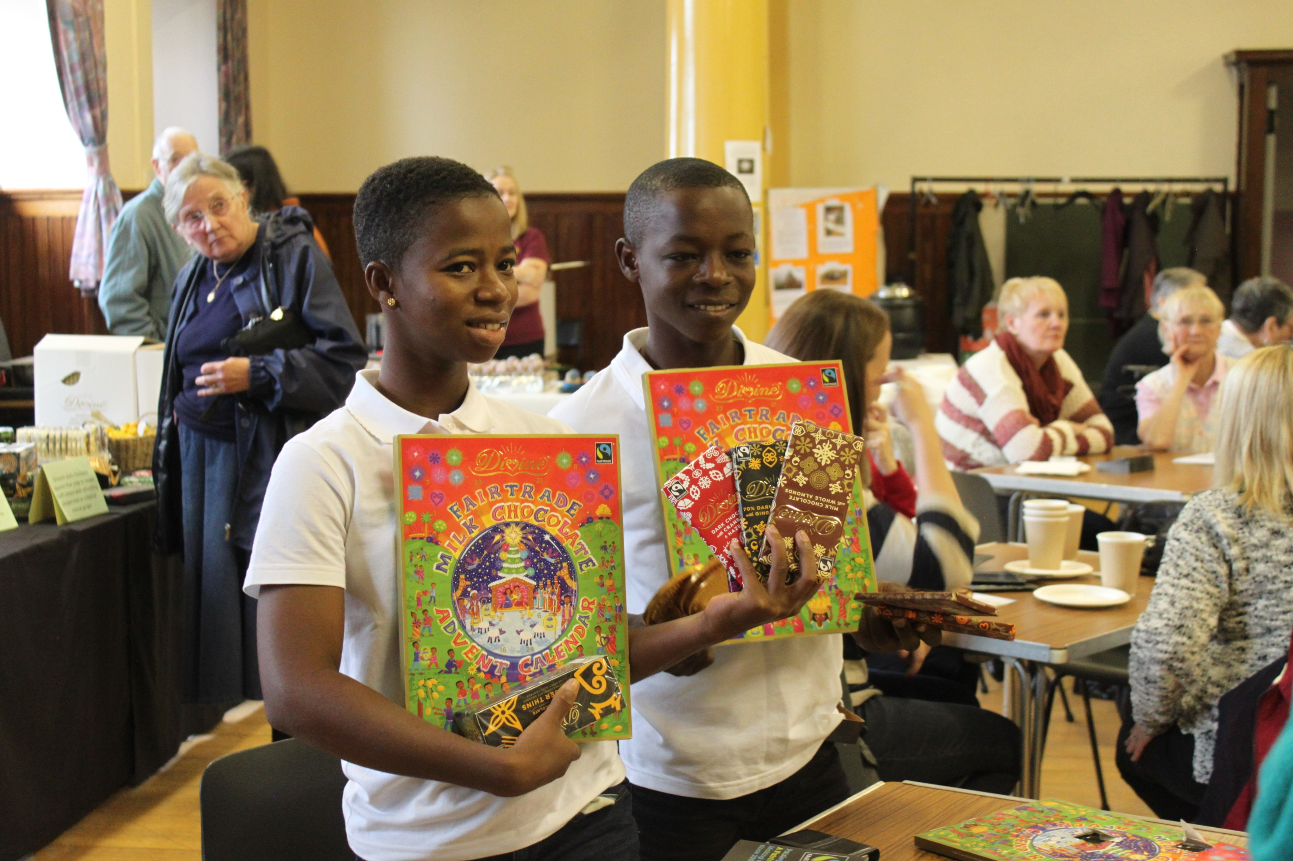

Notes:
“Because of this, we want you to buy more Divine chocolate so that our parents will get more Premium. We thank you for your cooperation.”
Divine Chocolate is an extra special company. Not only is it 100% Fairtrade, but the cocoa farmers in Ghana actually co-own the company. The farmers own 45% of the shares, and share in the profits.
This is a picture of Esther and Samuel when they visited the UK in 2016. They are at an event organised by Fairtrade campaigners in Paisley.

