Slide 1
What’s in the bar?

Slide 2
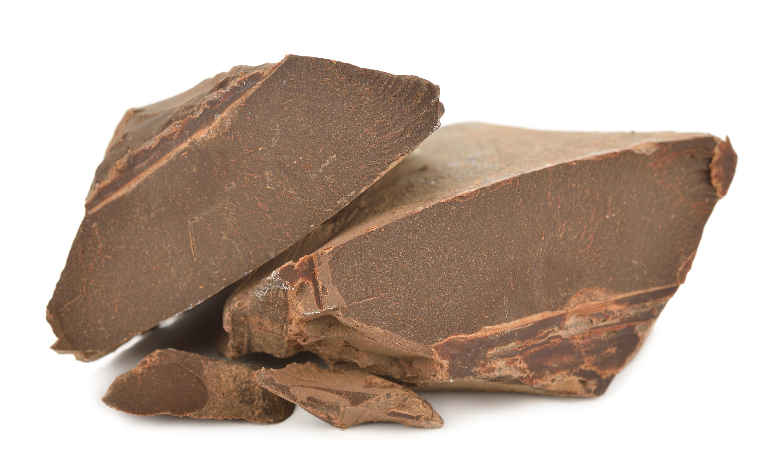
Cocoa mass
Notes:
Half of the cocoa bean is cocoa mass. Cocoa mass is the brown stuff that gives chocolate its distinctive flavour.

Slide 3
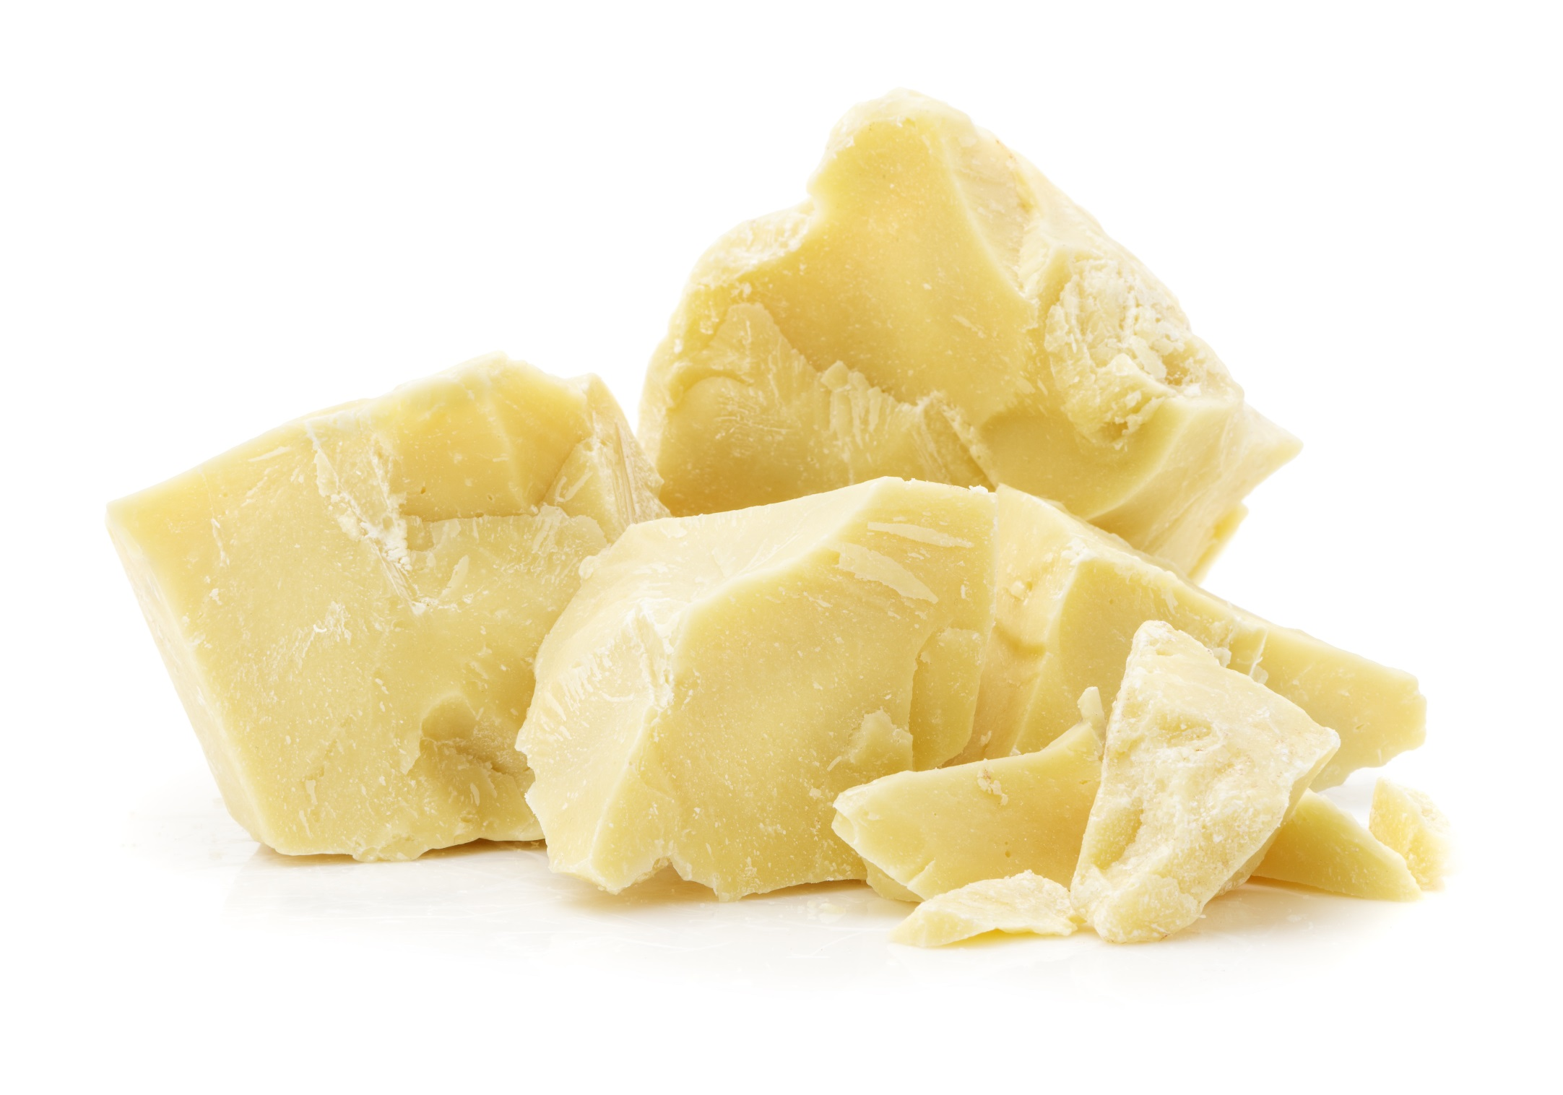
Cocoa butter
Notes:
Half of the cocoa bean is cocoa butter. Cocoa butter is the fat from the cocoa bean. It has the special property of melting at just below body temperature, so it melts in the mouth.

Slide 4
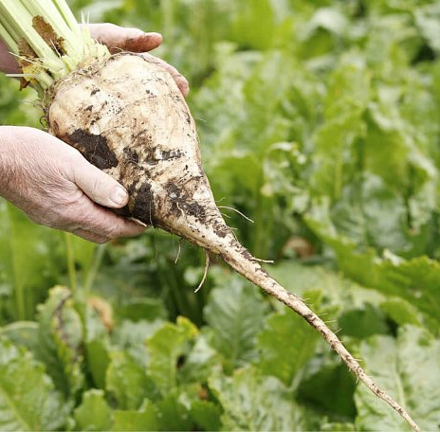

Sugar
Sugar beet
Sugar cane
Notes:
Sugar in chocolate comes from either sugar beet grown in Europe or from cane sugar grown in tropical countries. The Fairtrade rules stipulate that where an ingredient in chocolate can be Fairtrade, it must be Fairtrade. Therefore, producers of Fairtrade chocolate usually use cane sugar, which can be Fairtrade, rather than beet sugar. Divine Chocolate uses Fairtrade cane sugar from Malawi.

Slide 5
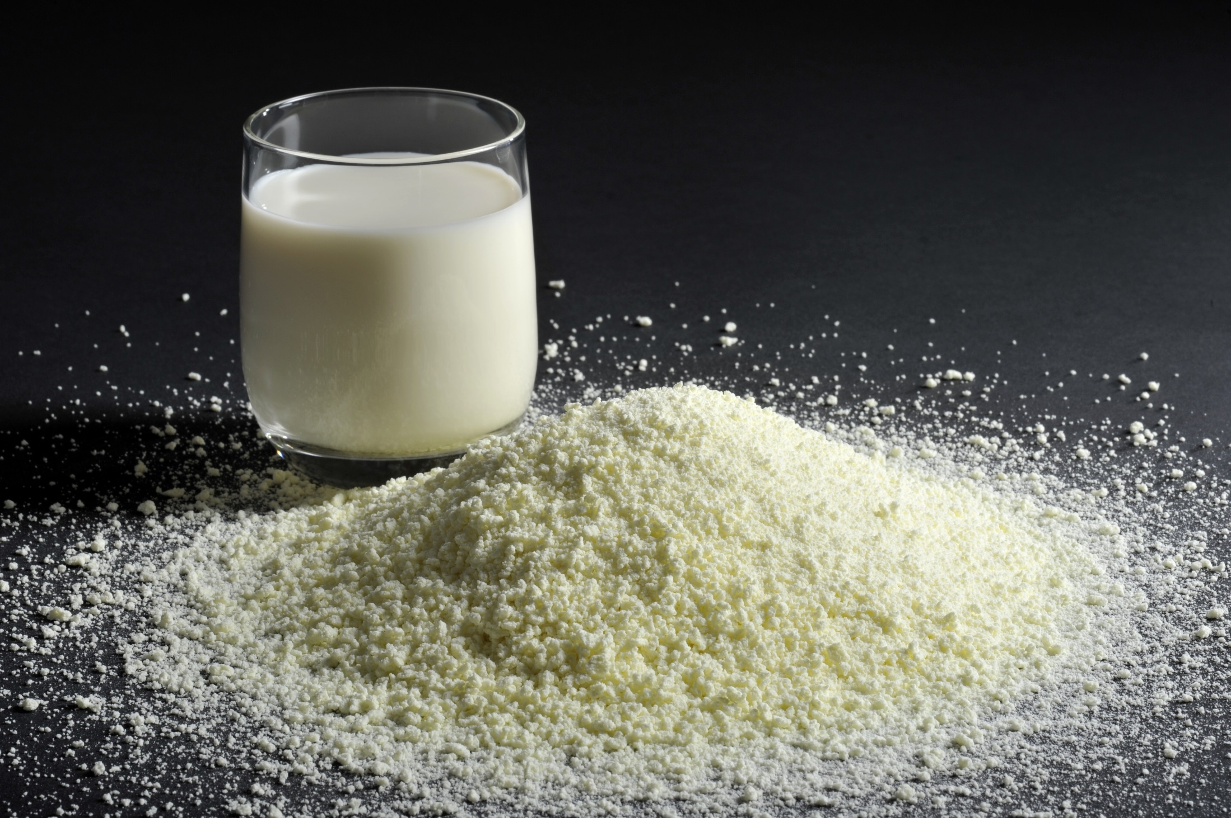
Milk
Notes:
Milk is added to chocolate in the form of milk powder.
Dark chocolate is made by combining cocoa mass, cocoa butter and sugar.
Milk chocolate is cocoa mass, cocoa butter, sugar and milk.
White chocolate contains no cocoa mass. It is just cocoa butter, sugar, milk and vanilla.

Slide 6
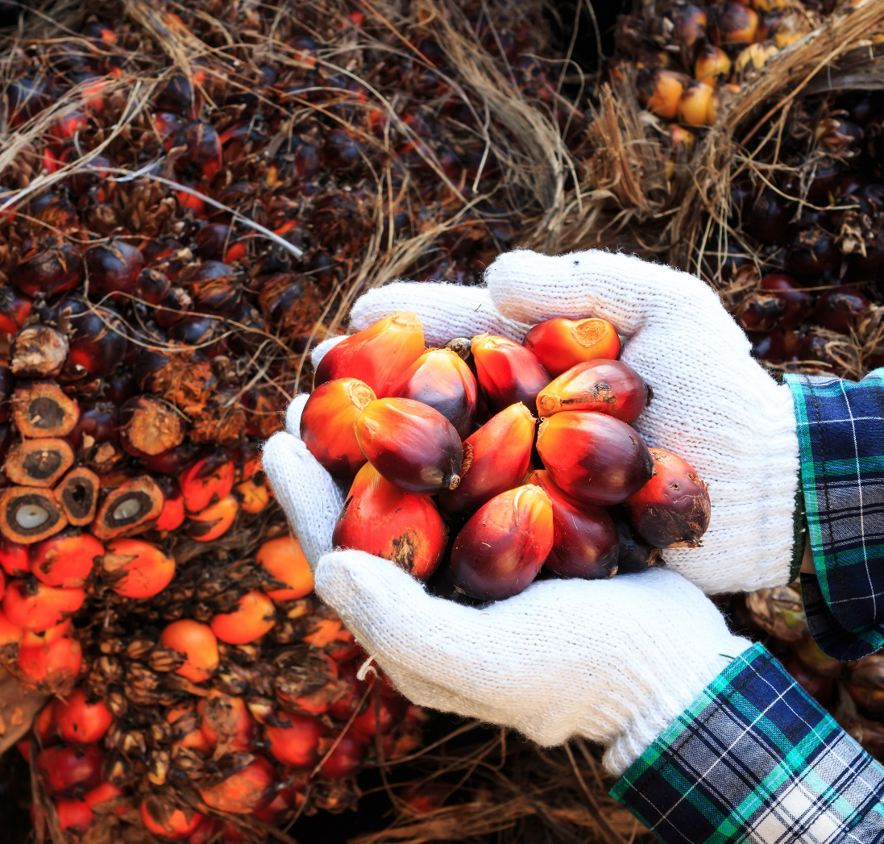
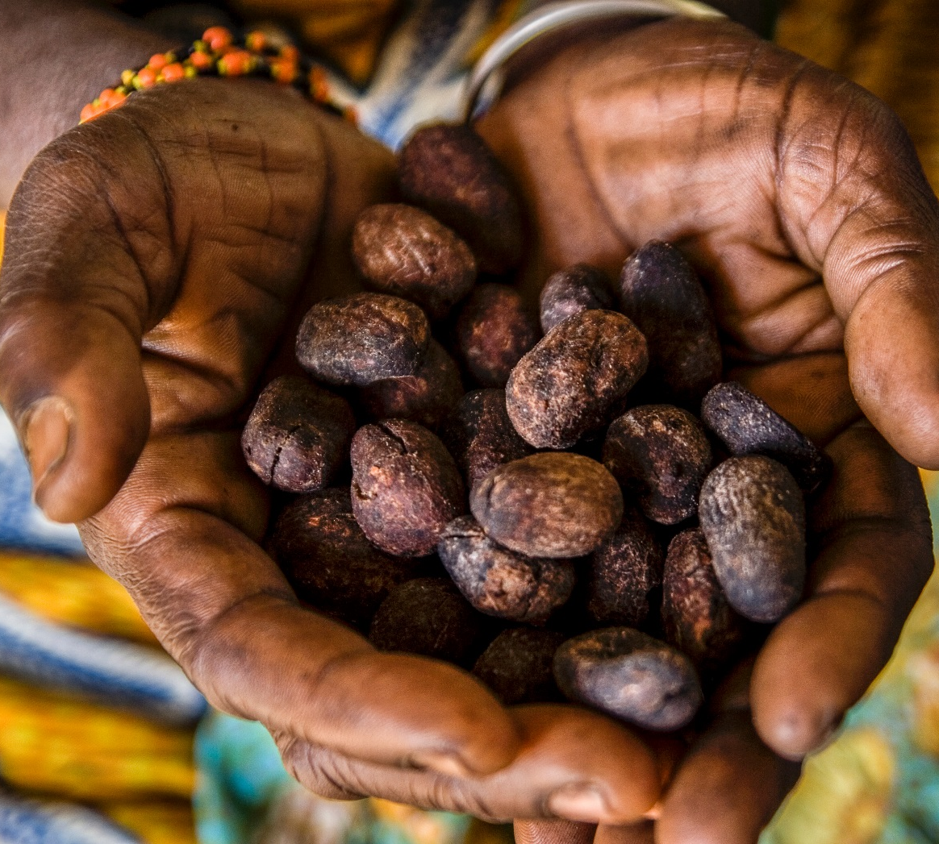
Vegetable fat
Palm oil
Shea butter
Notes:
Chocolate companies often substitute vegetable fats such as palm oil and shea butter for some of the cocoa butter in the bar to reduce costs, as cocoa butter is the most expensive ingredient in the bar. Regulations mean that these vegetable fats can make up no more than 5% of the bar.

Slide 7

A typical milk chocolate bar
Cocoa solids
20%
Milk
23%
Sugar
52%
Veg fats
5%
Notes:
These are the main ingredients, by percentage, of Cadbury Dairy Milk, the UK’s favourite milk chocolate bar.

